Slide 1
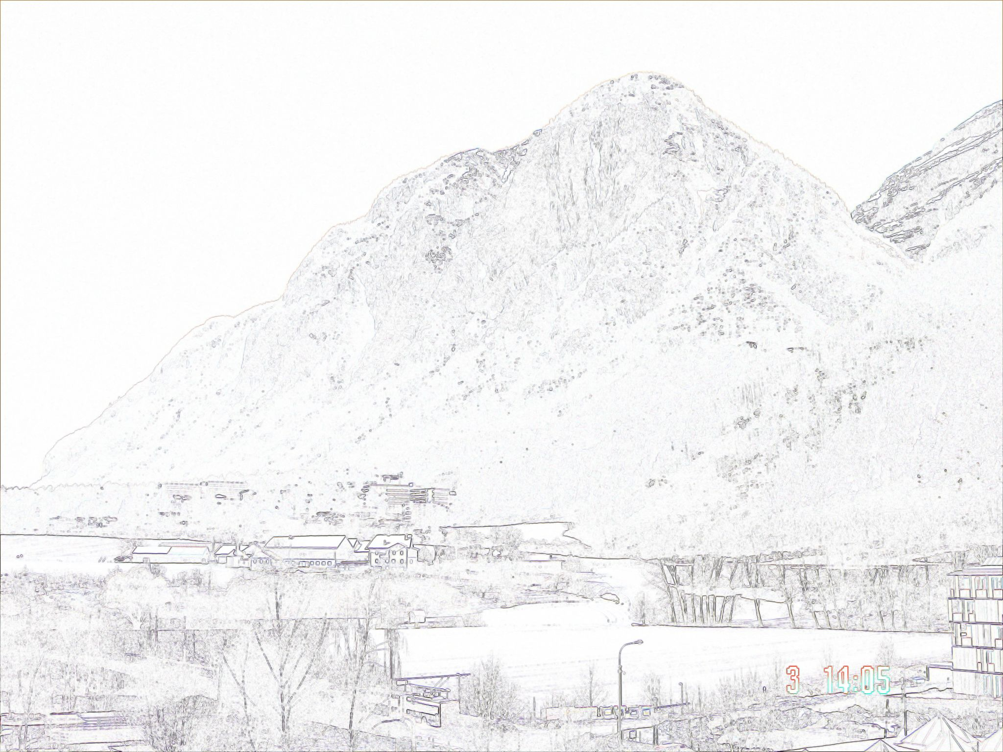
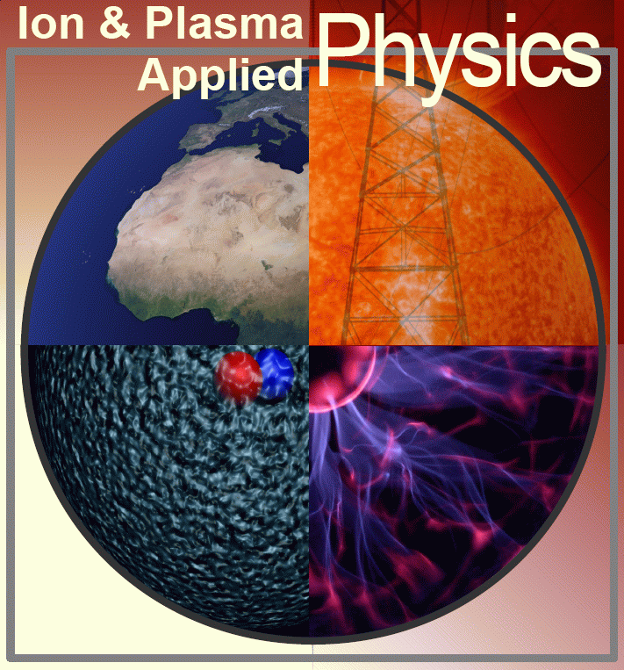
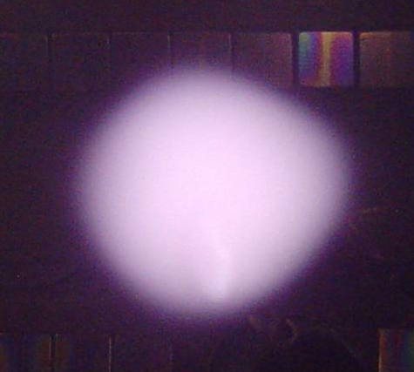

Introduction to
Fusion Plasma Physics
IEPPG
Roman Schrittwieser
with the collaboration of:
Codrina Ioniţă
Innsbruck Experimental Plasma Physics Group (IEPPG)
Institute for Ion Physics and Applied Physics
University of Innsbruck, Austria

Slide 2
Outline
Binding energy per nucleon and fusion reactions.
Lawson criterion, break even and ignition.
Fusion plasma confinement.
Magnetohydrostatics and magnetic pressure
Linear confinement schemes
Tokamaks
Stellarators and Torsatrons.
Nonmagnetic fusion

Slide 3
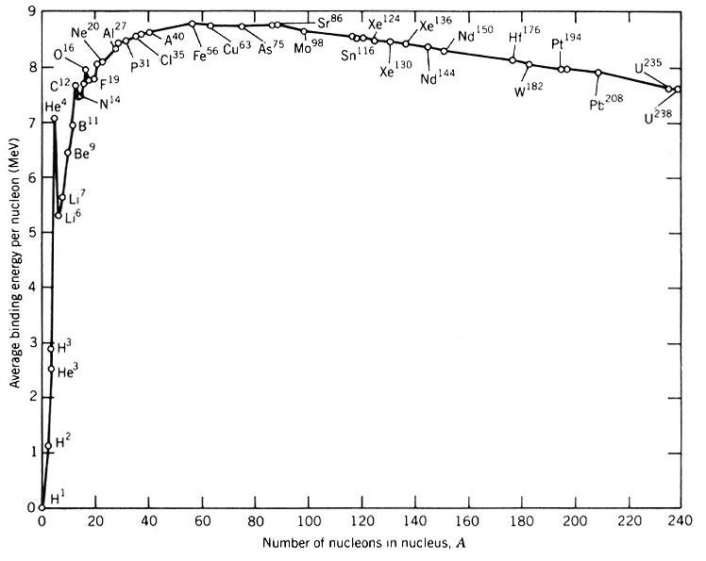
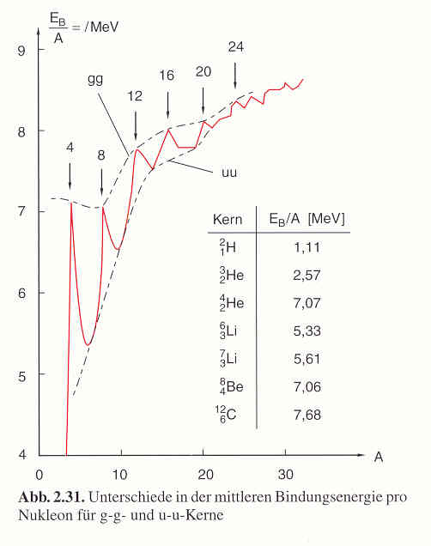
Part 1/1
Nuclear binding energy per nucleon:
The energy of nuclear processes comes from the mass defect:
A nucleus has less mass than the sum of the nucleons (neutrons and protons) of which it is compound.
And the mass defect corres-ponds to the binding energy according to the well-known formula:
E = mc²
Splitting heavy nuclei or fusing light nuclei we can gain the corresponding difference of binding energy usually as kinetic energy of the products of the nuclear transformation

Slide 4
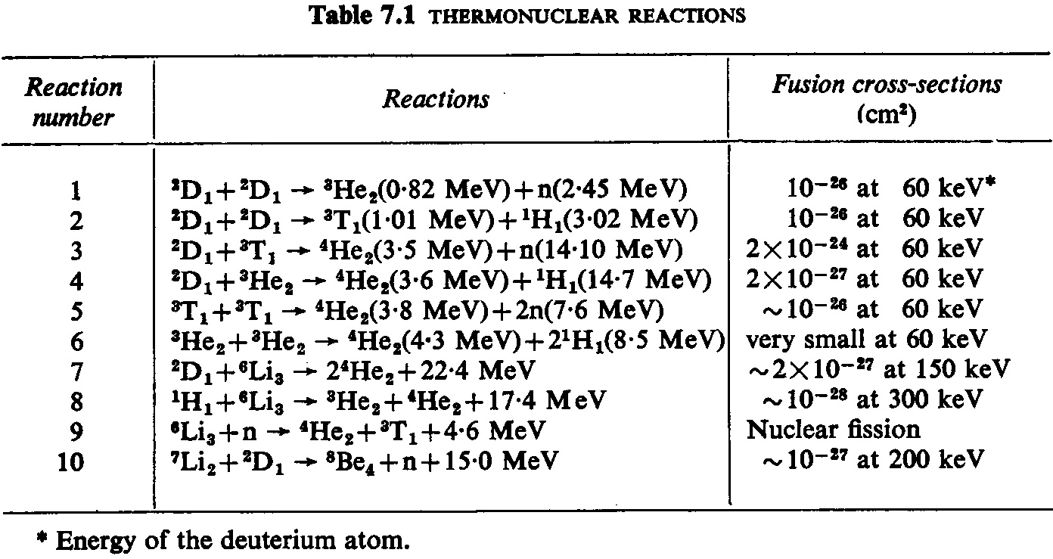
Part 1/2
The most important fusion reactions:
Concerning the D-He³ fusion the following book by Frank Schätzing (Original in German, but here in English translation) is interesting and thrilling to read:
https://www.amazon.de/Limit-Frank-Sch%C3%A4tzing/dp/1849165165

Slide 5
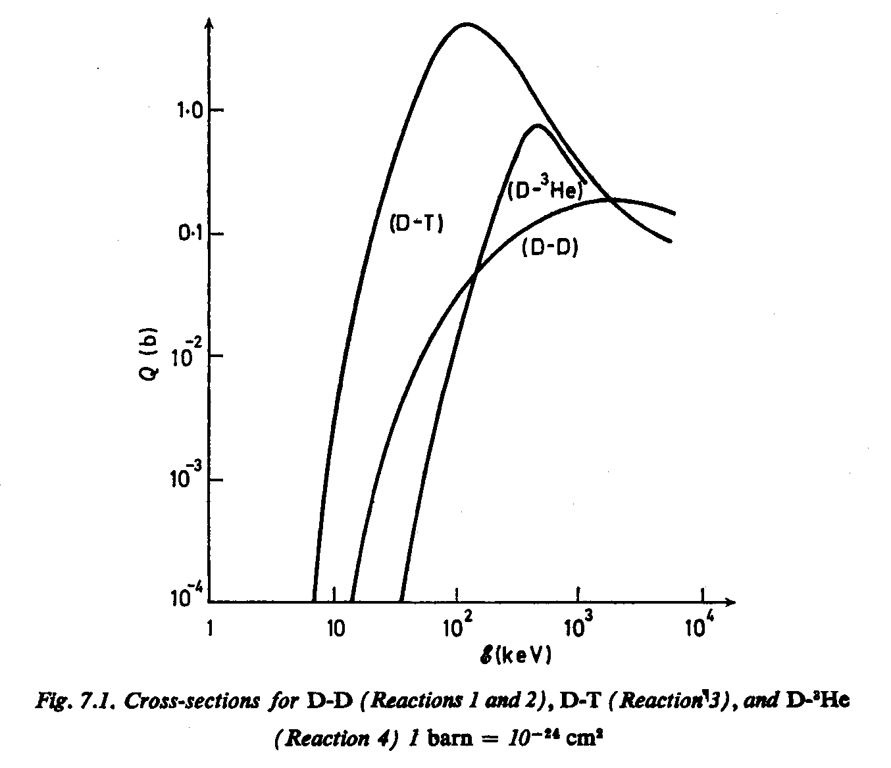
Part 1/3
Some nuclear fusion cross sections:
The D-T reaction has by far the largest cross section and the lowest threshold energy.

Slide 6
Part 1/4
The fusion reaction of the future fusion reactor:
²D₁ + ³T₁ → ⁴He₂ (3,5 MeV) + ¹n₀ (14,1 MeV)
Disadvantages and advantages:
We need the radioactive, and therefore dangerous tritium.
Tritium is (fortunately) extremely rare in nature and has therefore to be produced in situ.
During the fusion reactions a neutron is produced which cannot be confined in the magnetic field and therefore hits the wall of the fusion vacuum chamber with its high kinetic energy, there sputtering and activating the material.
On the other hand, this neutron is able to breed tritium by the fission process:
⁶Li₃ + ¹n₀ → ⁴He₂ + ³T₁ + 4,78 MeV.

Slide 7
Part 1/5
Therefore we also need Li in our reactor:
If it is liquid it serves as coolant for the first wall.
Thereby it is also the material which absorbs the kinetic energy of the neutron, transporting away the fusion energy to the first heat exchanger.
It will breed the necessary tritium for the further operation of the reactor.
However, there are other concepts in which the Li will be inserted into the first wall in form of a solid compound, whereas He will be the coolant.
He has a very high heat conductivity.

Slide 8
Part 2/1
Lawson criterion (simplest case):
n_{1,2} densities of the two species (D,T)
σ cross section of the fusion reaction
c particle velocity
ε energy per nuclear fusion reaction
The fusion energy density:
With n = n₁ + n₂ = n_{e}, per unit volume we have to invest the thermal energy:
During the time τ the energy density wτ is produced.

Slide 9
Part 2/2
Lawson criterion (simplest case):
For a plasma with equal parts of D and T (n₁ = n₂ = n/2), the condition that more fusion energy is produced than is needed for the heating, is:
This is the simplest form of the Lawson criterion. For the case of a D-T plasma this means:
nτ > 10²⁰ s/m³

Slide 10
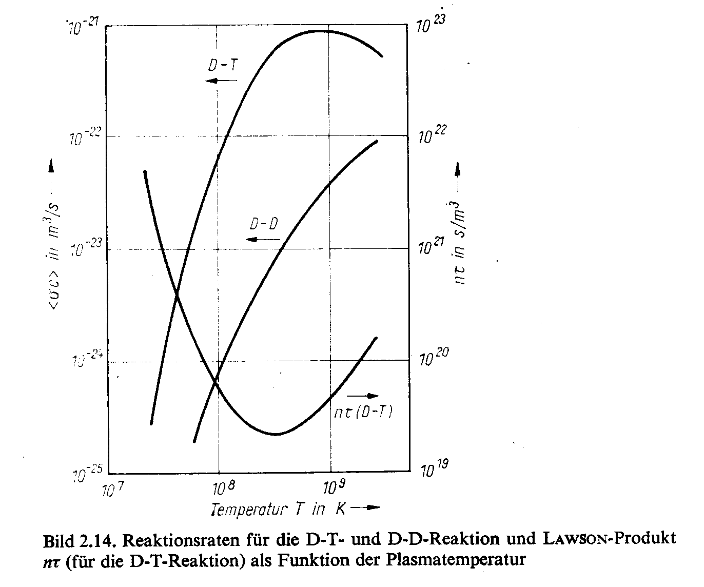
Part 2/3
Lawson criterion (simplest case):
Comparison of the reaction rates ⟨σc⟩ of the D-T and the D-D reac-tion with the Lawson product nτ.

Slide 11
Part 2/4
Breakeven and ignition:
When the Lawson criterion is reached, we call this breakeven since then the fusion reactions produce the same energy as the thermal energy of the plasma, which we first have to feed externally into the plasma .
For ignition the fusion plasma must preserve itself in a condition where the fusion reactions will continue without additional external heating. Thus the fusion products must heat the D-T plasma not yet burned. For the D-T reaction only the α-particles can do this since the neutrons escape, carrying away also their energy share.
Thus for ignition, the fusion energy must exceed the energy losses due to various mechanisms, among which the bremsstrahlung is the most important (P_{br} is its power density):
C₀ constant
c light speed
m_{e} electron mass
is the effective charge

Slide 12
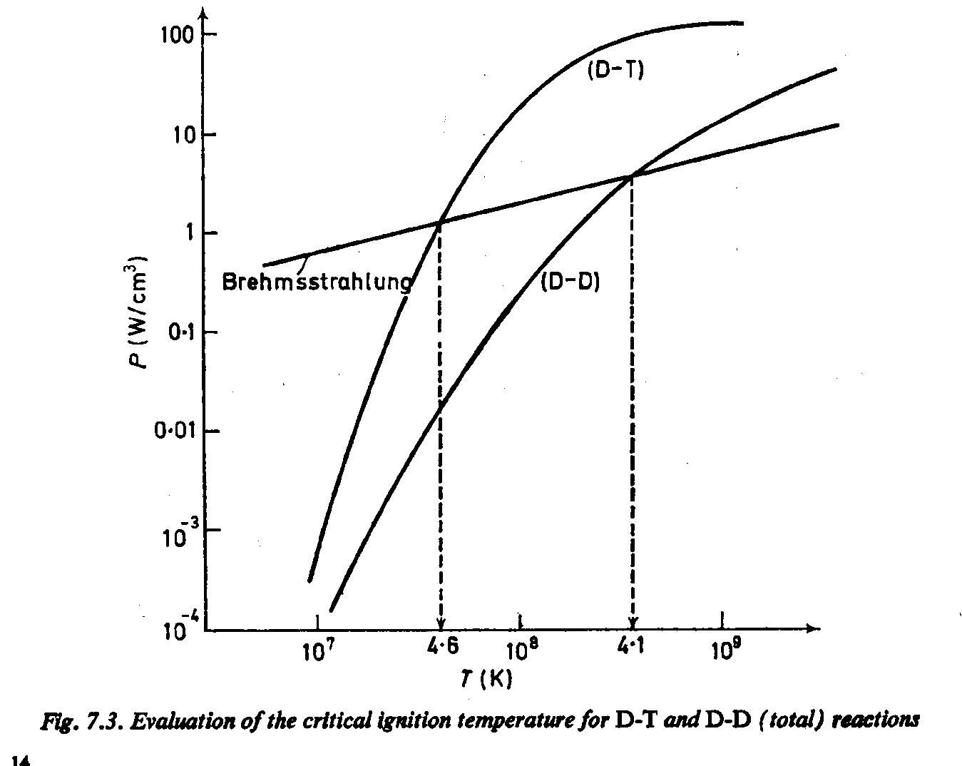
Part 2/5
Breakeven and ignition:
Comparison of the fusion ener-gy gain and the loss by brems-strahlung:
For the D-T fusion the critical ignition temperature is around 4,6⋅10⁷ K, and for the D-D reaction around 4,1⋅10⁸ K
But there are also other energy losses which have to be taken into account, in particular the electron cyclotron radiation in magnetic confinement schemes.
Not to mention the energy needed for the operation of the fusion reactor.

Slide 13
Part 3/1
Fusion confinement schemes:
Gravity: Best and simplest principle, but unfortunately only works for masses above 10²⁹ kg, i.e., above about 1/10 of the mass of the sun. The example of our sun shows that this already works for about 5⋅10⁹ years and will still work probably for some 5 billion years in the future.
Inertia: Plasma is heated up so fast and so far and compressed so strongly that a sufficient number of fusion processes can take place before the thermal pressure leads to an explosion of the plasma. This is also the principle of a thermonuclear bomb and that one of laser or particle beam fusion.
Electrostatic fields: Does not work very well since a plasma screens off external electric fields by the formation of space charge layers. Moreover the theorem of Earnshaw says that there is no E-field configuration in which a charge carrier can find a stable position of equilibrium.
High frequency fields: Works not so bad, but very high energies are needed since HF-field excite additional cyclotron radiation and bremsstrahlung in the plasma.
Magnetic fields: This principle has become most widely accepted.
Magneto-electric confinement: Relatively new idea where a magnetically confined plasma is additionally stabilised by external electric fields at the edge.

Slide 14
Part 3/2
Magnetic confinement schemes:
Open and close magnetic field configurations: An open system is for instance a solenoid, which has a good confinement perpendicular to the field lines, but on both ends plasma can stream out unhampered. Closed systems are the various toroidal configurations such as tokamaks and stellarators. In these cases, the magnetic field lines are closed in themselves (sometimes after an infinite number of orbits).
Pinches and magnetic traps or bottles: Depends on whether there are considerable electric currents inside the plasma or not. The latter is the case for instance in pinch systems or tokamaks. An example for the contrary is the stellarator, which belongs to the group of magnetic traps since there the confinement is brought about solely by externals magnetic fields.
High-β and low-β plasmas: The former have a β > 0,1. Modern tokamaks aspire for this limit. β is the ration between thermal pressure and magnetic pressure (see below).

Slide 15
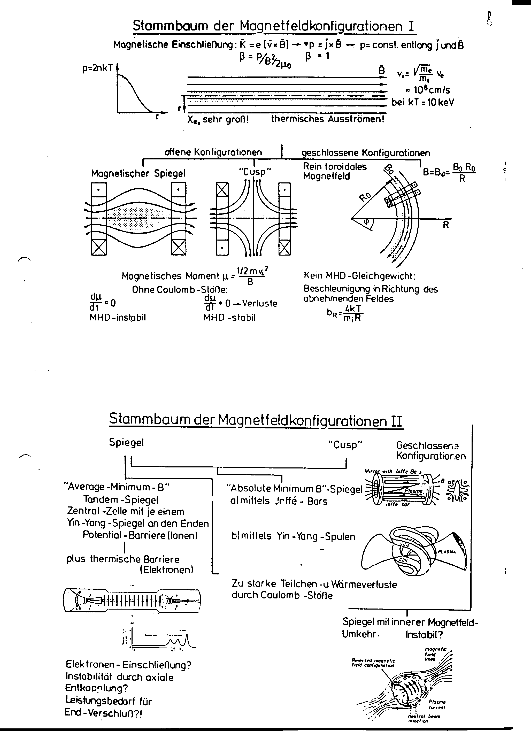
Part 3/3
Pedigree of magnetic confinements I:

Slide 16
Part 3/4
Pedigree of magnetic confinements II:

Slide 17
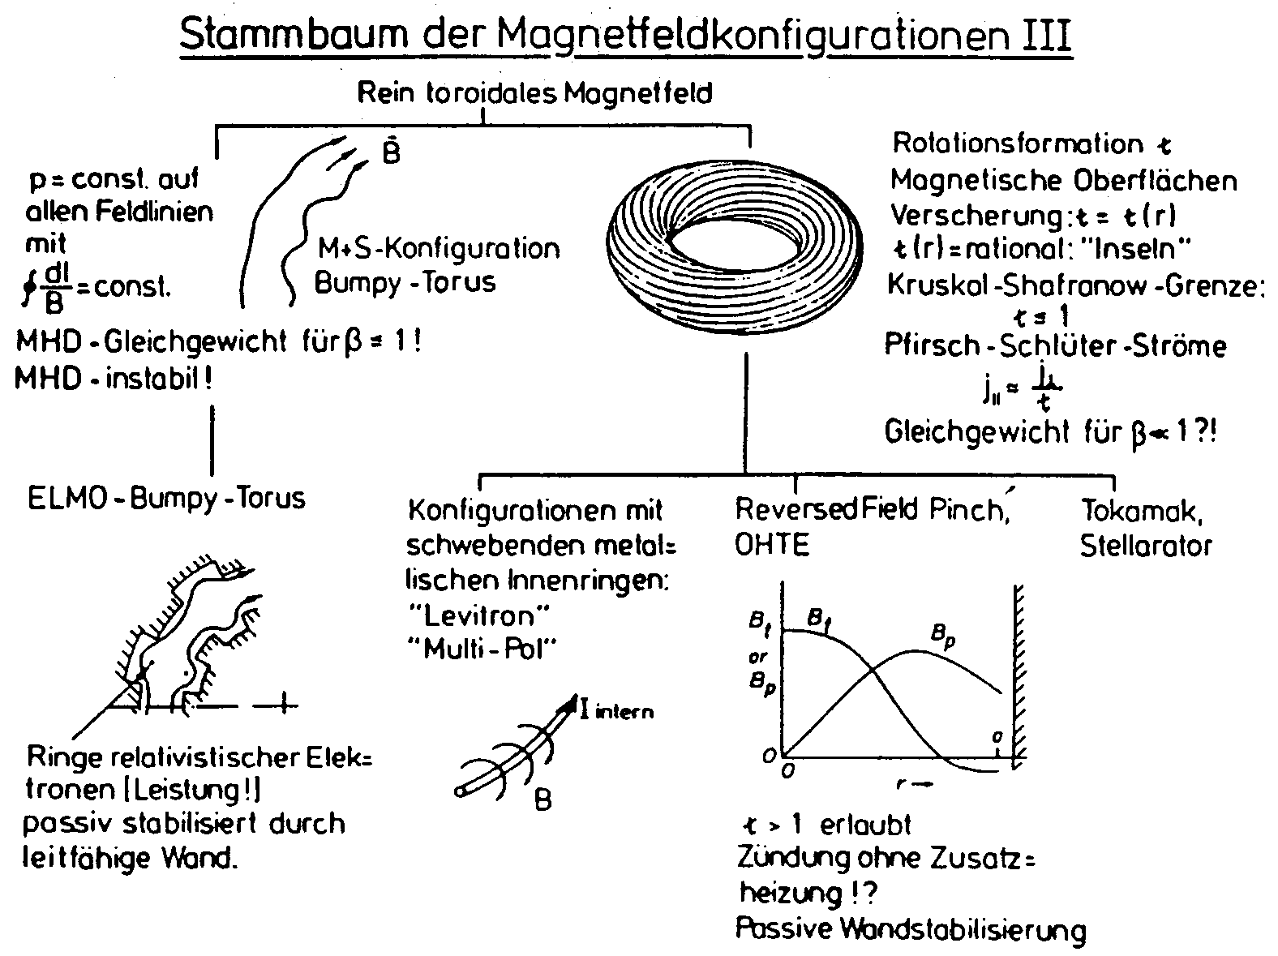
Part 3/5
Pedigree of magnetic confinements III:

Slide 18

Part 3/6
Pedigree of magnetic confinements IV:

Slide 19
Part 4/1
Magnetohydrodynamics (1):
By considering a hot plasma as a conductive fluid, we can derive a simple equation. We define:
A common mass density:
ρ ≡ n_{i}m_{i} + n_{e}m_{e} ≅ n(m_{i} + m_{e})
A common flow velocity :
A common current density:
j ≡ e(n_{i}v_{i} − n_{e}v_{e}) ≅ n_{e}(v_{i} − v_{e}).
The fundamental MHD equation then reads:

Slide 20
Part 4/2
Magnetohydrodynamics (2):
By restricting ourselves to stationary cases and neglecting gravity we obtain:
grad p = j×B
Together with Maxwell's equation rot B = μ₀ j, where we have also dropped the time-dependent term ε₀(∂E/∂t) we finally can derive:

Slide 21
Part 4/3
Magnetic pressure (1):
In straight cylinders, where B is constant, the right-hand side becomes zero. In other cases, such as a slightly toroidal geometry, the right-hand side is small:
We see that the term B²/2μ₀ has the dimension of a pressure. Therefore it is called the magnetic pressure:

Slide 22
Part 4/4
Magnetic pressure (2):
What is for instance the pressure of a magnetic field such as that of our Q-machine with B = 0,2 T?
≅ 1,6⋅10⁴ Pa = 160 hPa = 160 mbar.
This is about 10⁹ times higher than the thermal pressure in a so called Q-machine plasma.
And what is the magnetic field which corresponds to the normal pressure of air of about 1 bar = 10⁵ Pa?
≅ 0,5 T

Slide 23
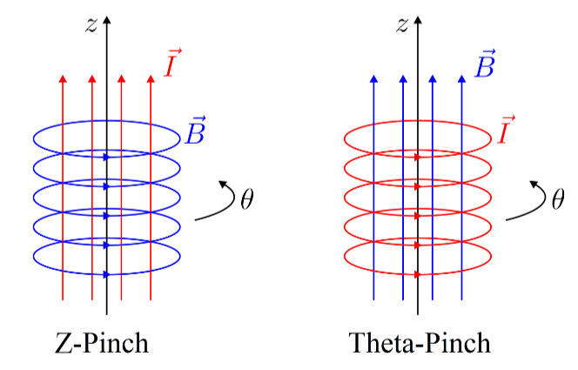
Part 5/1
Linear confinement schemes (1): Pinch machines
If a current through a plasma is so strong that its magnetic field is not negligible, the pinch effect leads to a compression of the plasma:
The two possible forms of cylindrical pinches:
the z-pinch,
(b) the ϑ-pinch
From M. Reinhart, Master Thesis [in German], Faculty for Physics and Astronomy, Ruhr-University Bochum, Germany, 2011;
http://www.ep5.ruhr-uni-bochum.de/ag/publikationen/master_pdf/dipl_reinhart.pdf).
(a) (b)

Slide 24
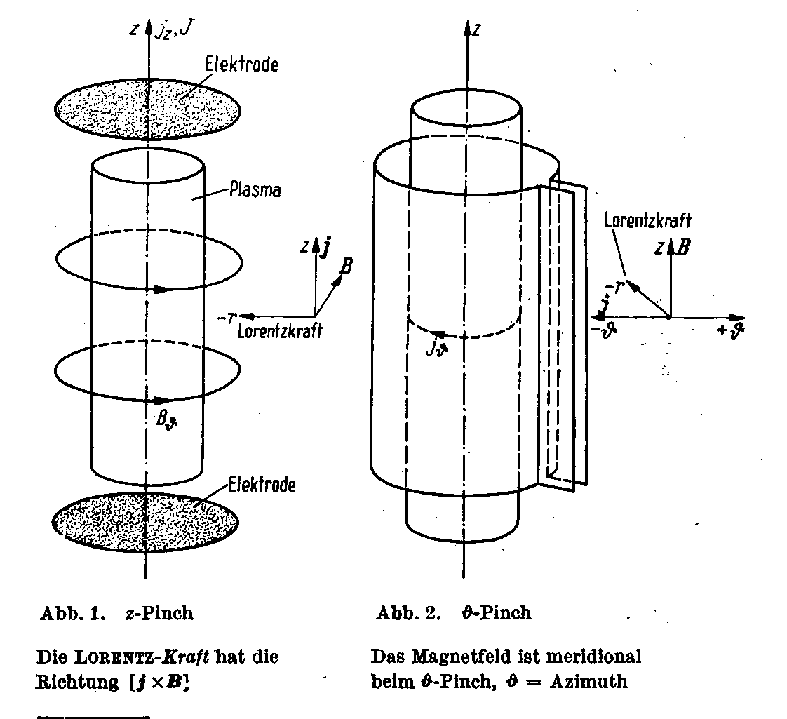
Part 5/2
Linear confinement schemes (2): Pinch machines
How to produce such a strong current in a plasma?
While a z-pinch can in principle run stationary, the azimuthal current a ϑ-pinch can only be produced by induction.

Slide 25
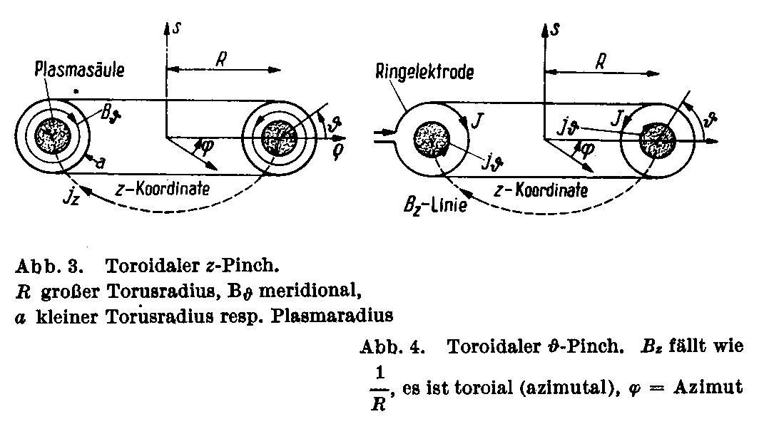
Part 5/3
Torodial pinch machines:
The same principle of plasma pinches can also be designed for toroidal devices
A tokamak is in principle a toroi-dal z-pinch

Slide 26
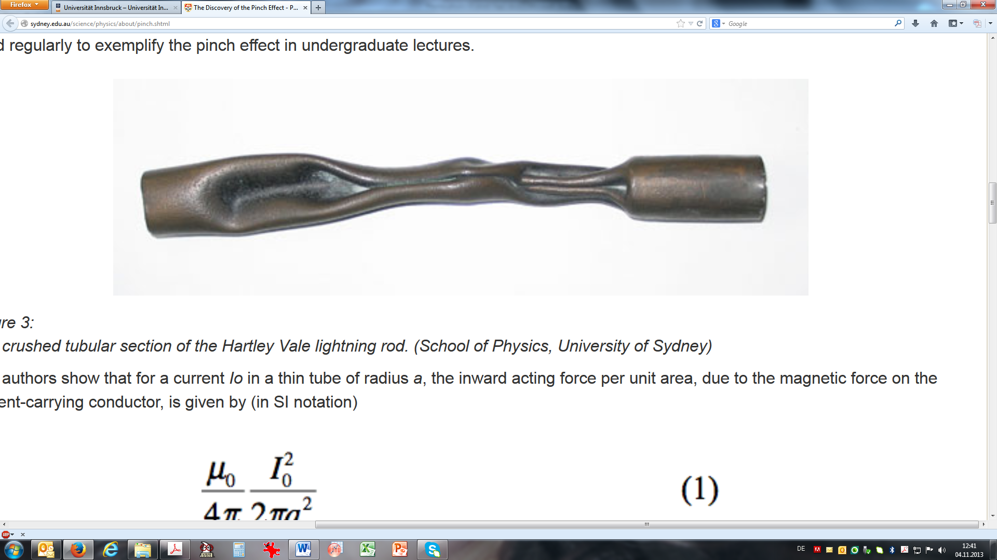
Part 5/4
Linear confinement schemes (3): Pinch effect
First observation of the pinch effect in 1905:
A lightning conductor on the chimney stack of the Hartley Vale Kerosene Refinery (near Lithgow, NSW, Australia) after struck by a lightning. Later it was calculated that a current of about 200 kA was necessary to cause this deformation.
From: http://sydney.edu.au/science/physics/about/pinch.shtml
See also: https://www.youtube.com/watch?v=ubOTTPD1GL0 and
https://www.youtube.com/watch?v=YFTH8ywXaZs

Slide 27
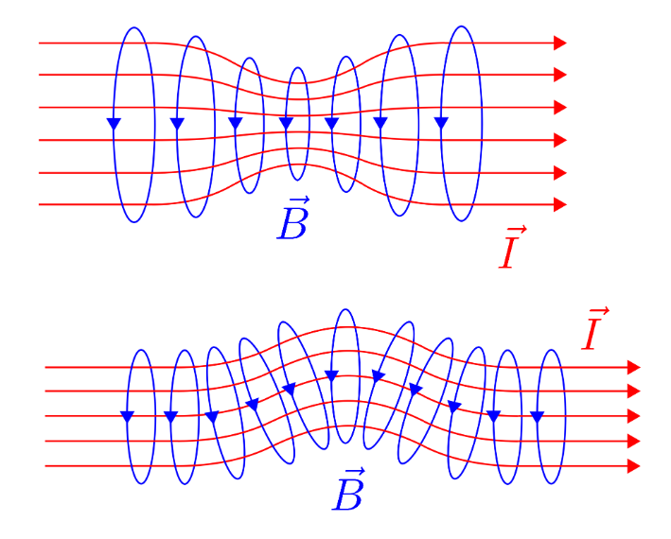
Part 5/5
Linear confinement schemes (4): Interchange instability
But the slightest inhomogeneity of the current carrying plasma column will lead to an interchange instability
Sausage instability (upper panel) and kink instability (lower panel) in a z-pinch shown by the constriction respectively twisting of the current tube (shown by the red flux lines) by the magnetic field (shown by the blue field lines) (from M. Reinhart, Master Thesis [in German], Faculty for Physics and Astronomy, Ruhr-University Bochum, Germany, 2011;
http://www.ep5.ruhr-uni-bochum.de/ag/publikationen/master_pdf/dipl_reinhart.pdf).

Slide 28
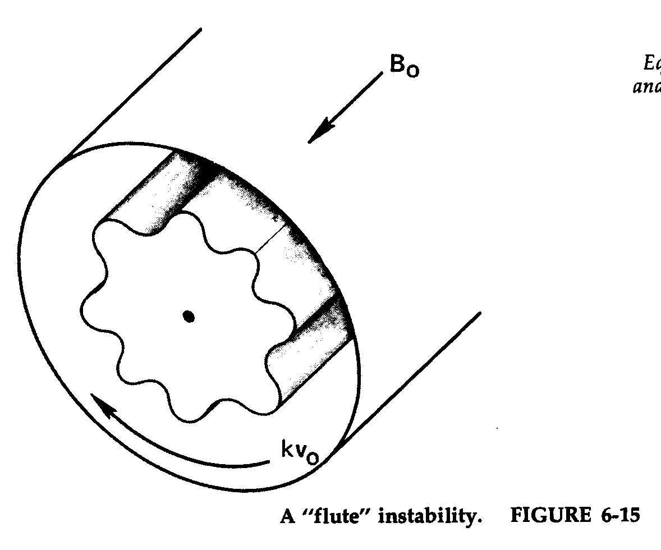
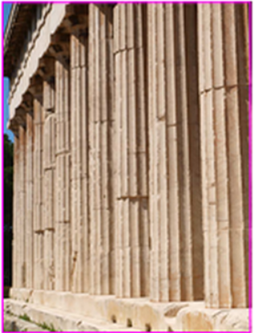
Part 5/6
Linear confinement schemes (4): Interchange instability
Very common is also the flute instability:
Schematic of a flute instability of a cylindrical plasma column
From F.F. Chen Introduction to Plasma Physics (first edition),
p. 193, Fig. 6-9
Doric columns with flutes

Slide 29
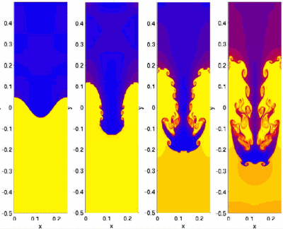
Part 5/7
Linear confinement schemes (5): Interchange instability
Also in between two immiscible fluids of different densities, an interchance instability can occur. This instability is also called Rayleigh-Taylor instability
Heavier fluid
Lighter fluid
Computer simulation of a Rayleigh-Taylor instability (from Shengtai Li, Hui Li "Parallel AMR Code for Compressible MHD or HD Equations" (Los Alamos National Laboratory),
http://en.wikipedia.org/wiki/Rayleigh-Taylor_instability
Note that we see here also signs of the Kelvin-Helmholtz instability which occurs when two layers of fluid or gas pass by each other with different speeds.
Interchange or Rayleigh-Taylor insta-bility between two fluids of different densities.

Slide 30
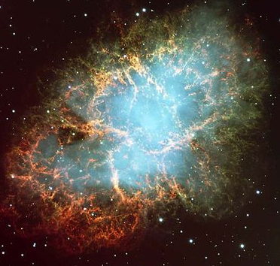
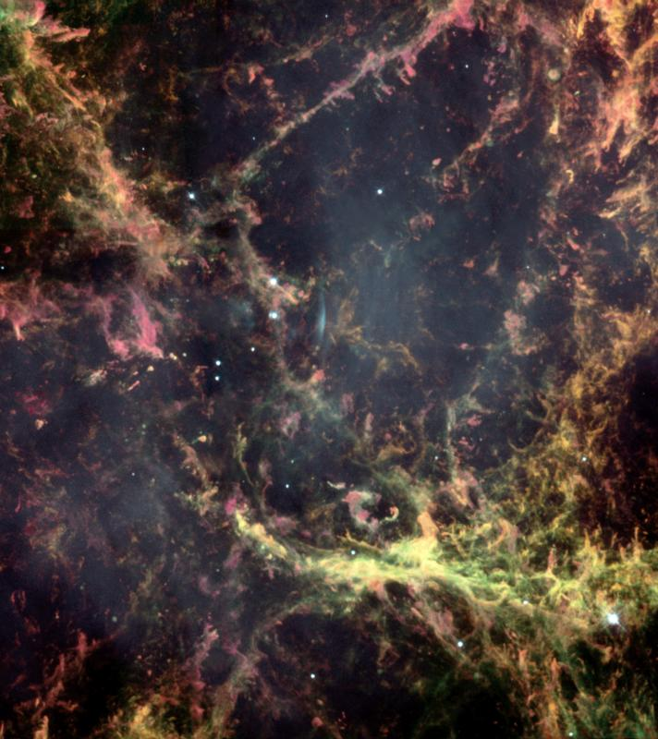
Part 5/8
Linear confinement schemes (6): Interchange instability
In space the Rayleigh-Taylor insta-bility can occur between two gases of different temperatures and densities.
Rayleigh-Taylor fingers evident in the Crab Nebula, remnant of a supernova, observed by Chinese astro-nomers in 1054 C.E.
http://en.wikipedia.org/wiki/Rayleigh-Taylor_instability

Slide 31
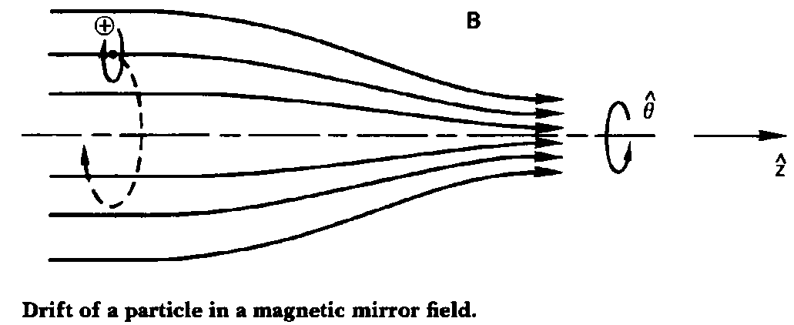
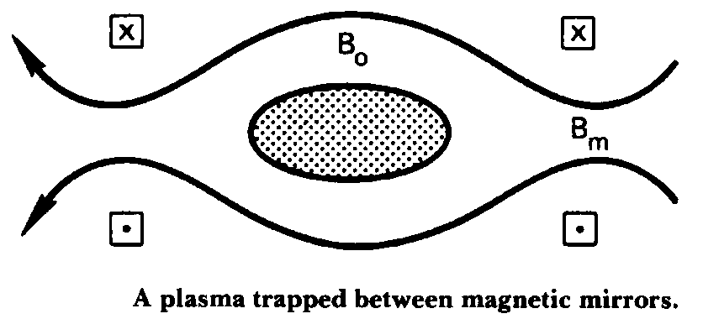

Part 5/9
Mirror machines (1): the mirror effect
The Mirror effect can confine a plasma at least partly:
The total kinetic energy of an ion or electron is invariant:
From F.F. Chen Introduction to Plasma Physics, Vol. I, p.30, Fig. 2-7)
And the magnetic moment is invariant:
Electrons in a mirror field (by Prof. Reiner Stenzel
http://www.physics.ucla.edu/plasma-exp/beam/).
From F.F. Chen Introduction to Plasma Physics,
Vol. I, p.33, Fig. 2-8)

Slide 32
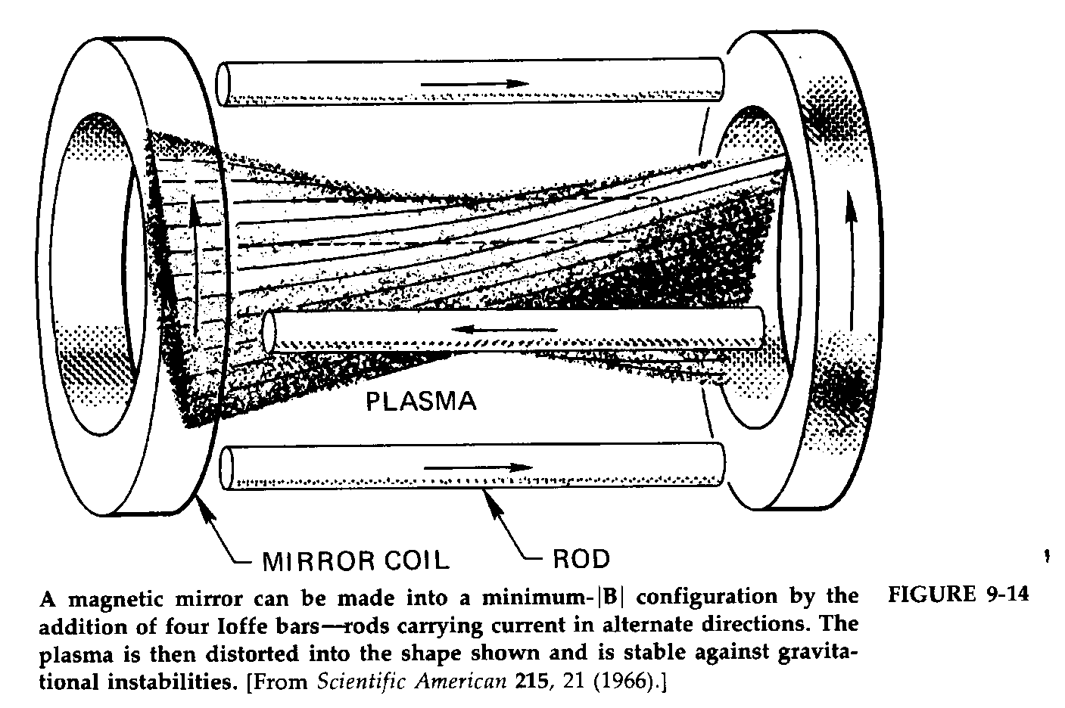
Part 5/10
Mirror machines (2): minimum B-field
A magnetic field (B-field) with a local minimum of the field strength is relatively stable against interchange instabilities:
The so-called Ioffe bars
From F.F. Chen Introduction to Plasma Physics (first edition),
p. 299, Fig. 9-14.

Slide 33
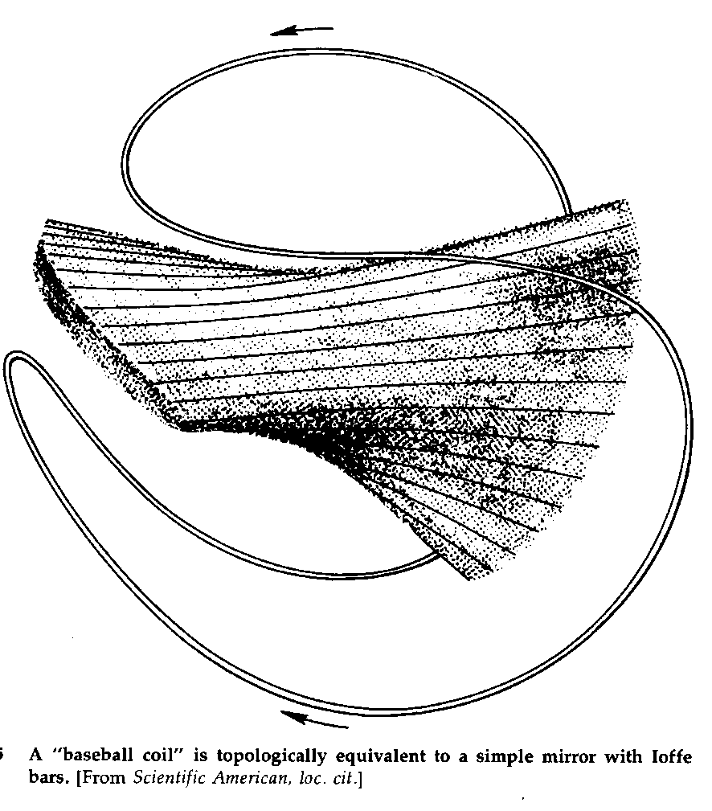
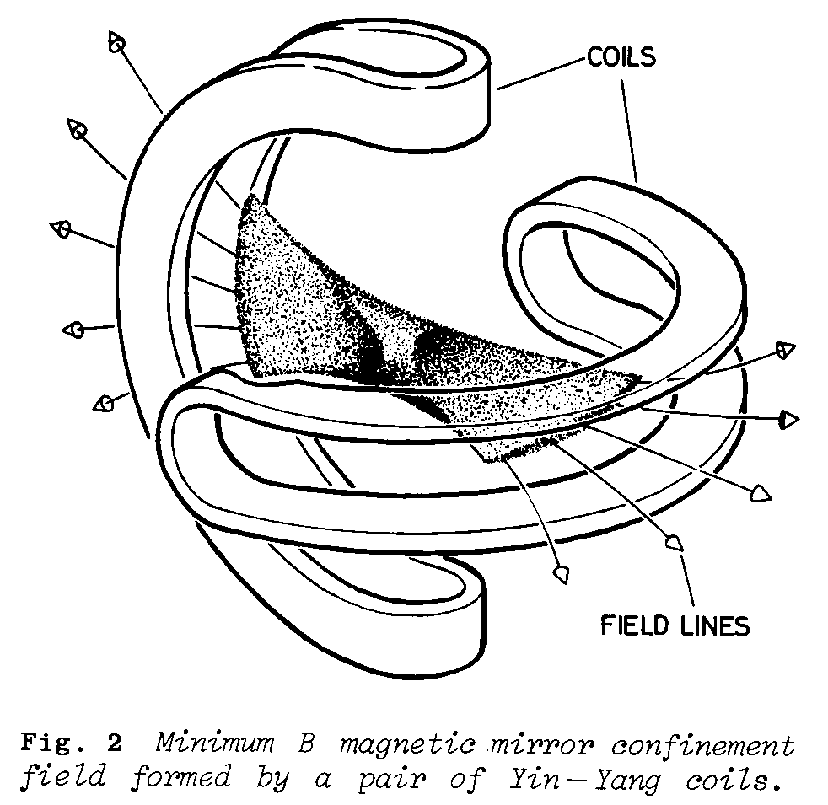
Part 5/11
Mirror machines (3): minimum B-field
Other confinement schemes with minimum B-field
From F.F. Chen Introduction to Plasma Physics (first edition), p. 300, Fig. 9-15.
From Culham Plasma Physics Summer School, Gill, 1981, p. 405, Fig. 2.

Slide 34
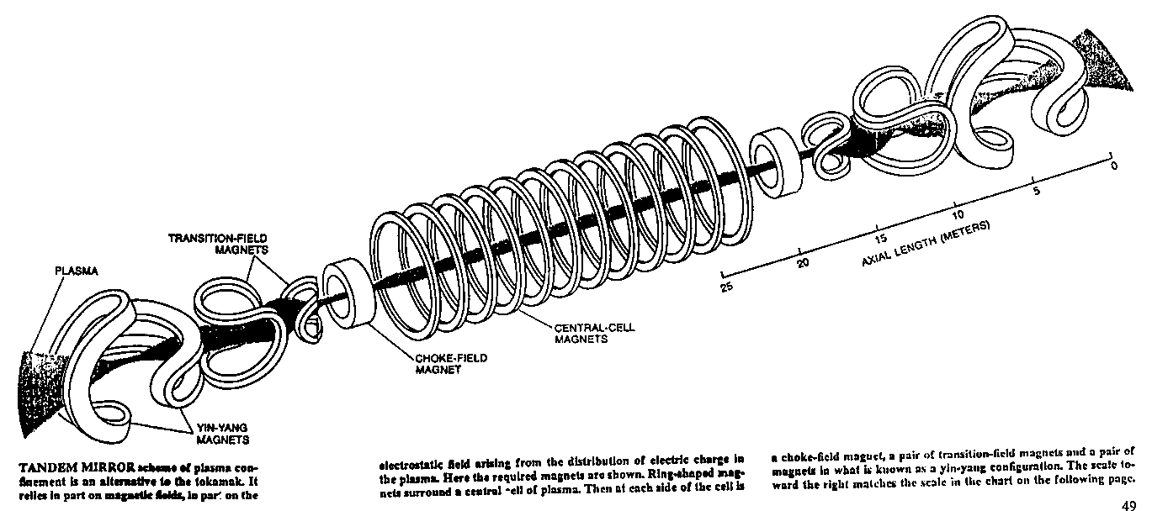
Part 5/12
Mirror machines (4): the tandem mirror
An attempt to approach fusion in a linear machine
The Mirror Fusion Test Facility 2X II at the Lawrence Livermore National Laboratory from the 1980-ies (from Scientific American).

Slide 35
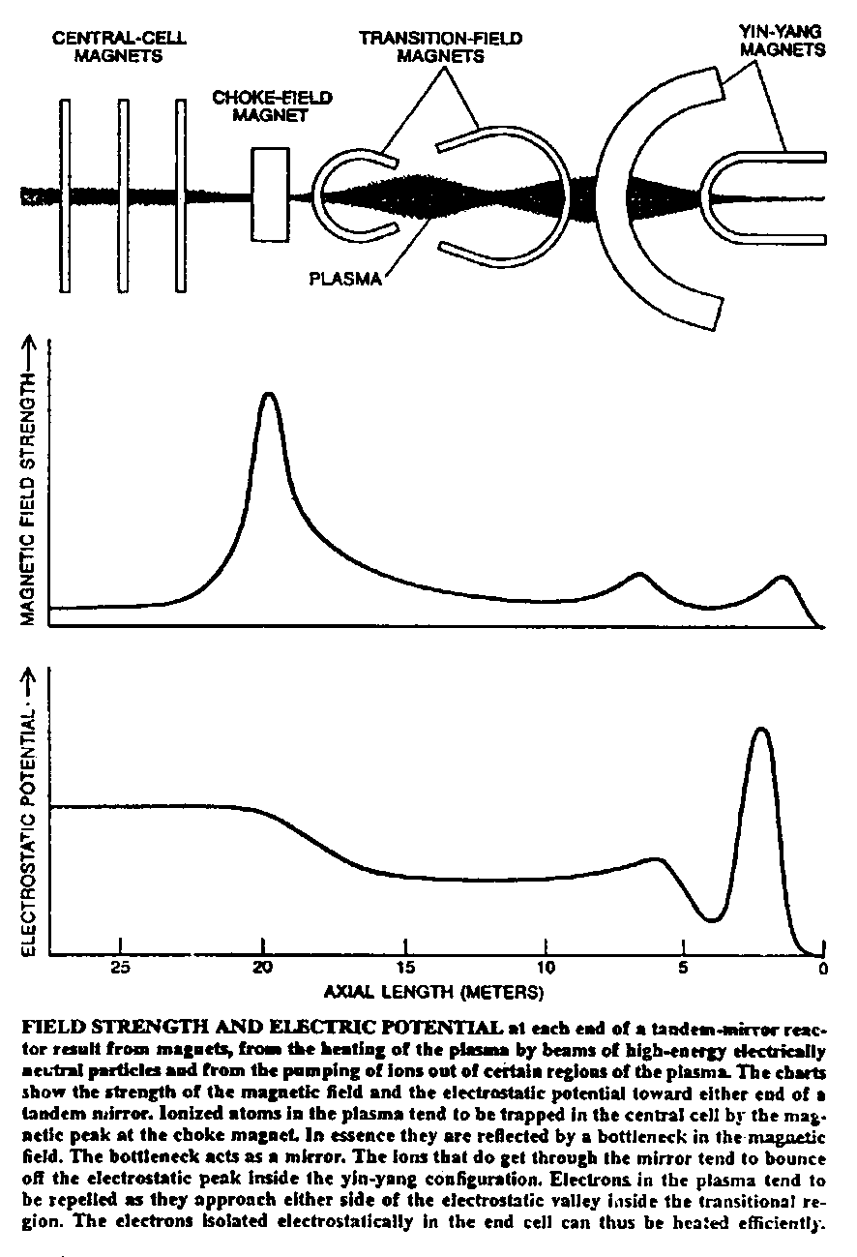
Part 5/13
Mirror machines (5): the tandem mirror
Magnetic and electric confine-ment in the tandem mirror
(from Scientific American)

Slide 36
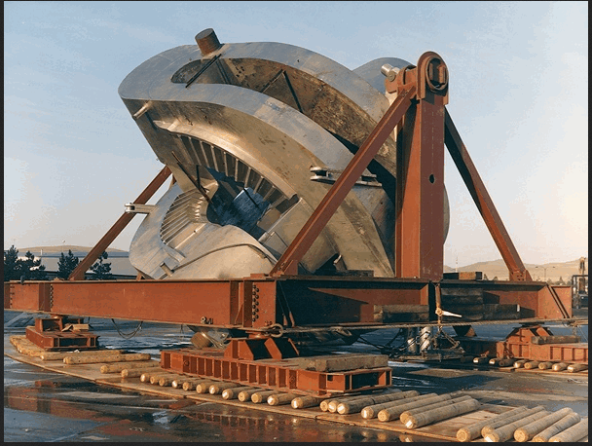
Part 5/14
Mirror machines (6): the tandem mirror
The Ying-Yang coils:
Some people believe that this is an alien artefact.
Look up
http://www.abovetopsecret.com/forum/thread314432/pg1
for the "The Rainbow Conspiracy" ☺
http://lasttechage.files.wordpress.com/2013/03/mftf-b-yingyang-moving-into-machine-hall-600x453.png

Slide 37
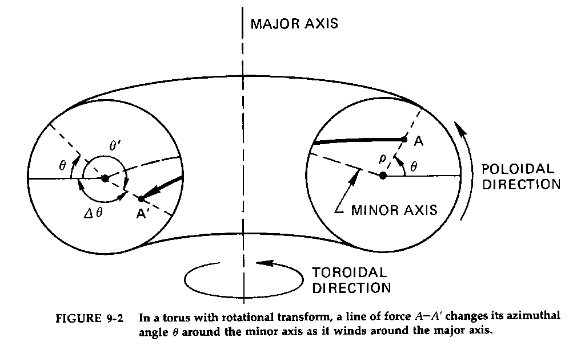
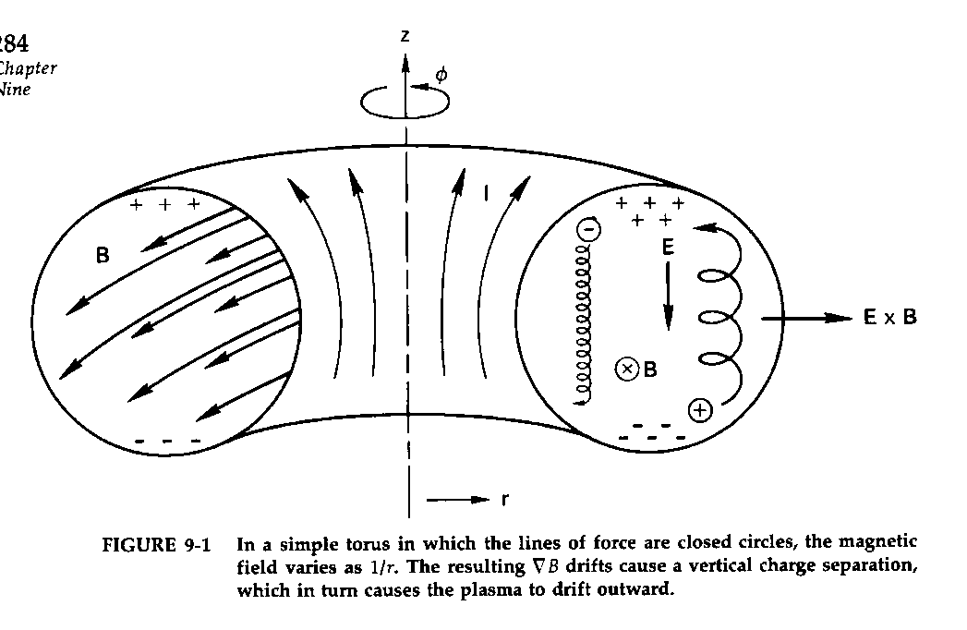
Part 6/1
Toroidal coordinate system and rotational transform:
The toroidal coordinate system: consisting of the straight major axis and the circular minor axis; the coordinates are the major radius R, the minor radius r, the toroidal angle ϕ and the poloidal angle ϑ. Also shown is the rotational transform of a mag-netic field line.
The three particle drifts which prevent a stable particle confinement in a purely toroidal coordinate system: curvature drift and gradient-B drift lead to a charge separation in vertical direction, which creates a vertical electric field which gives rise to an outward E×B drift.

Slide 38
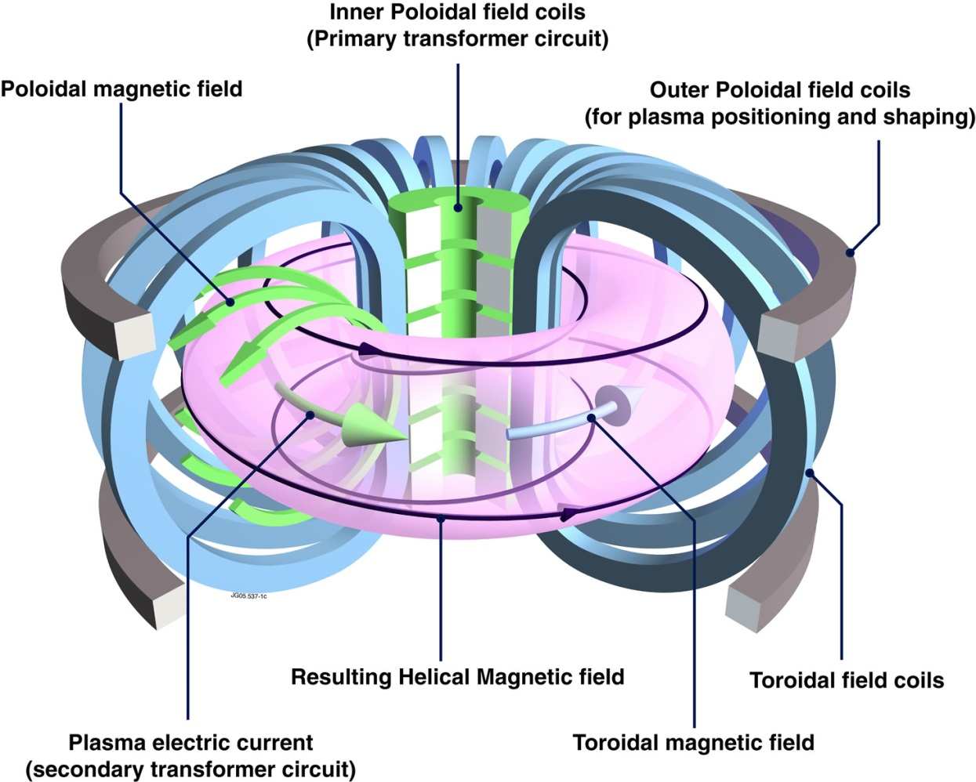
Part 6/2
Schematic of a tokamak:
In a tokamak the plasma is confined by a combination of a toroidal and a poloidal mag-netic field. The former is produced by external field coils, the latter by a toroidal plasma current. This, in turn is created like in a trans-former via induction by a slowly increasing current in the primary coil. Therefore the field lines show rotational transform, i.e. a particle following a field line rotates around the "major axis" while also rotating around the "minor axis", which is a circle around the centre of the torus with the radius R.
Toroidal coordinate system:
This system has two axes: the major axis and the minor axis which is a circle!
To describe any arbitrary point A within this system, we need even four coordinates:
The major radius R, which is, however a fixed number,
The minor radius r, i.e. the shortest distance of A from the minor axis,
The angle φ in toroidal direction and the angle θ in poloidal direction.

Slide 39
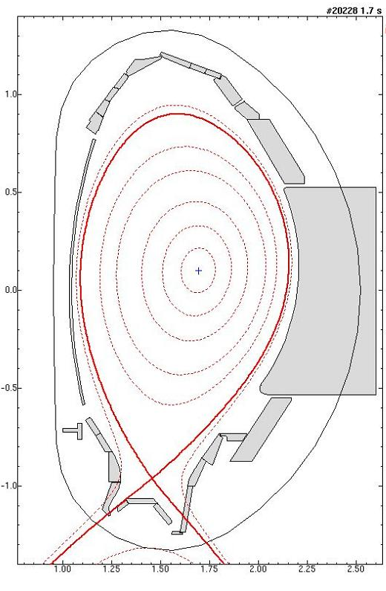
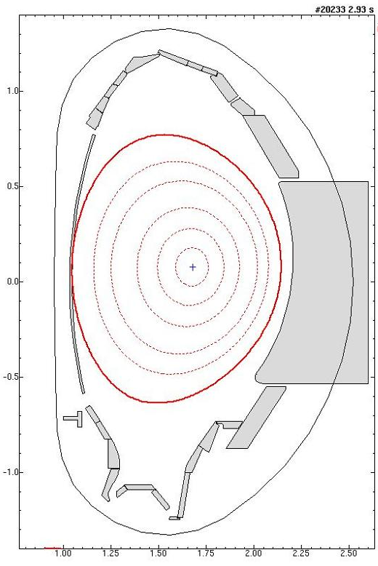
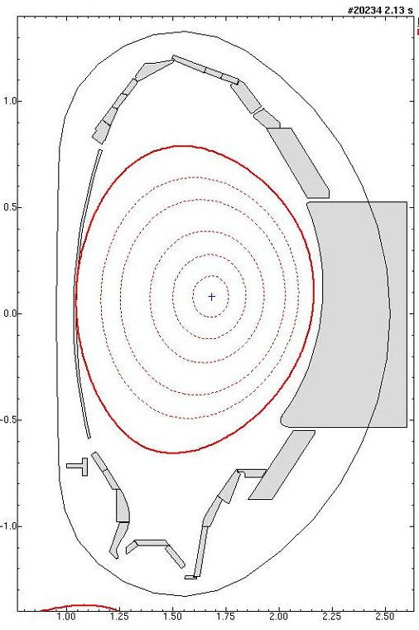
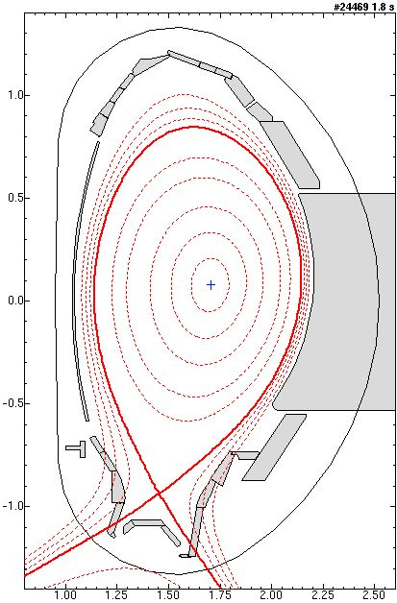
Part 6/3
Cross section through a tokamak:
H-mode #20228 L-mode #20233 L-mode #20234 L-mode #24469
(a) (b) (c) (d)
Poloidal cross sections of the AUG plasma during some of the discharges treated here; the red lines shows the LCFS. (a) diverted H-mode #20228, limiter L-mode #20233, limiter L-mode #20234, diverted L-mode #24469.

Slide 40
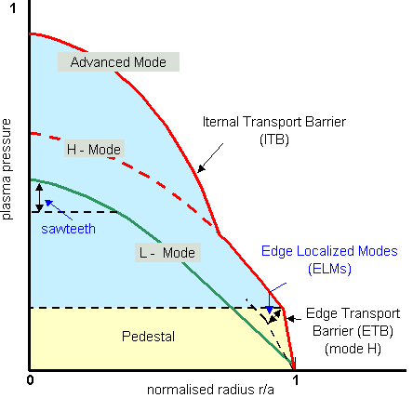
Part 6/4
Typical radial plasma pressure in a tokamak at H-mode and
L-mode:
Typical for H-mode are the steep density gradient at the edge – the so-called pedestal
The edge transport barrier
The edge localized modes (ELMs) leading to strong periodical variations of the edge steepness and strong losses of particles, energy and momentum.

Slide 41
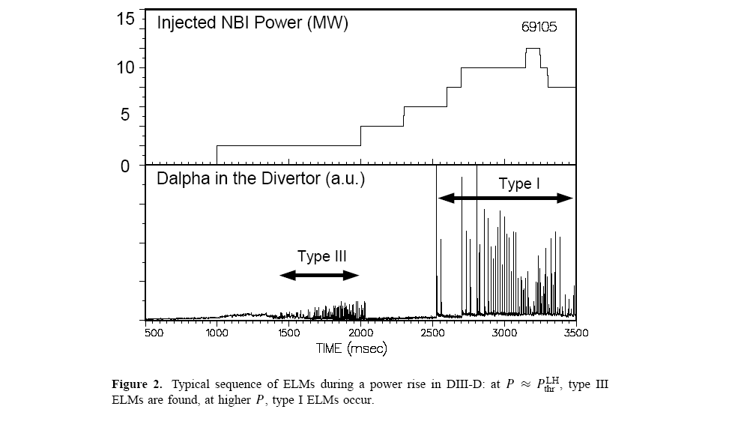
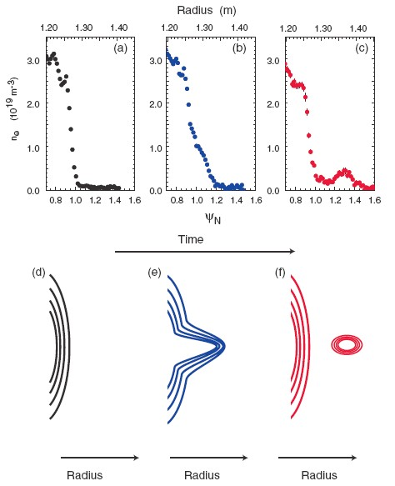
Part 6/5
Typical radial plasma pressure in a tokamak at H-mode and L-mode:
In spite of a relatively stable magnetic confinement in the toroidal/poloidal field of a tokamak, radial plasma losses are inevitable.
And here it is especially ELMs which still are not completely understood and still present the greatest problems.
Phenomenological model of ELMs (A. Kirk et al., Plasma Phys. Control. Fusion 47 (2005) 315):
Type III and I ELMs with increasing input power
(H. Zohm, Plasma Phys. Control. Fusion 38 (1996) 105).
Radial density profiles in H-mode during type I ELMs.
Schematic plasma density contours.

Slide 42
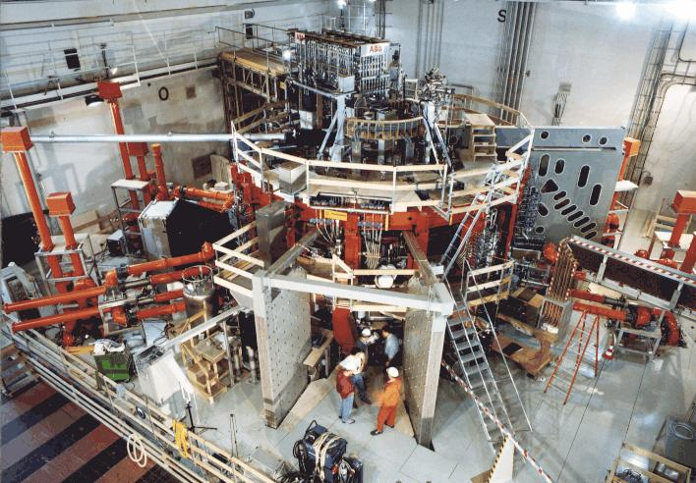
Part 6/6
Example of a tokamak:
ASDEX Upgrade = AxiSymmetric Divertor Experiment Upgrade (AUG)
at the Max-Planck Institute for Plasma Physics (IPP) in Garching near Munich

Slide 43
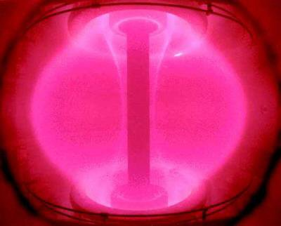
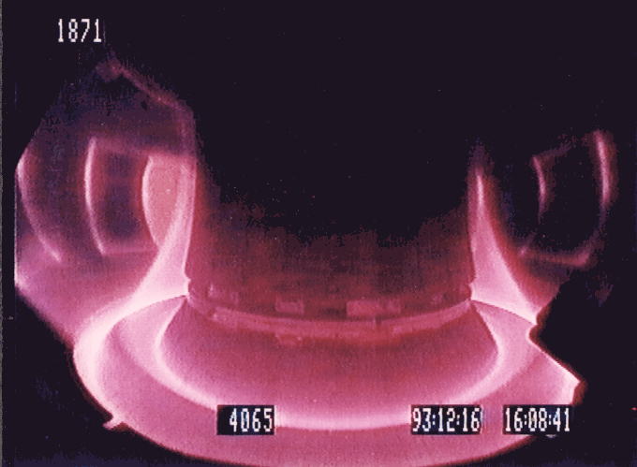
Part 6/7
Inside a tokamak:
ASDEX Upgrade and START
A typical discharge in ASDEX Upgrade
A discharge in the START in Culham, England

Slide 44
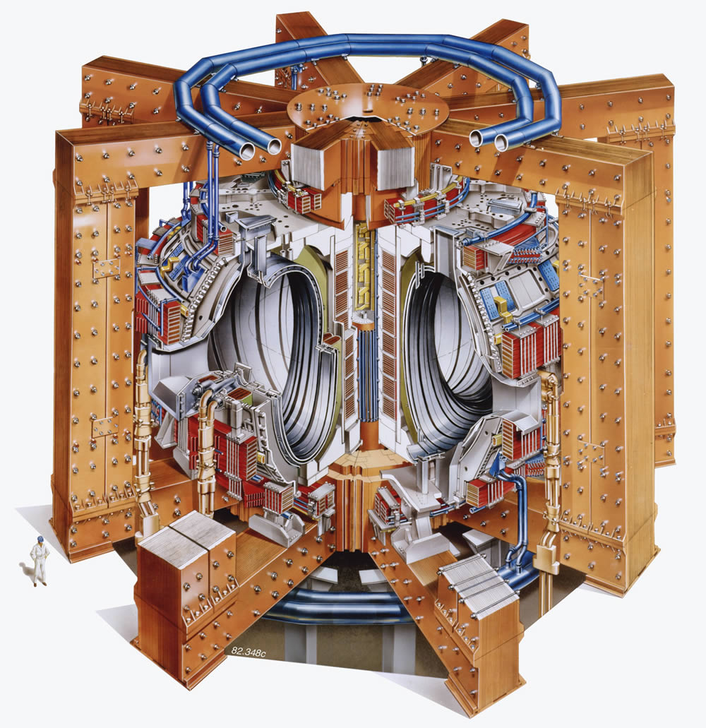
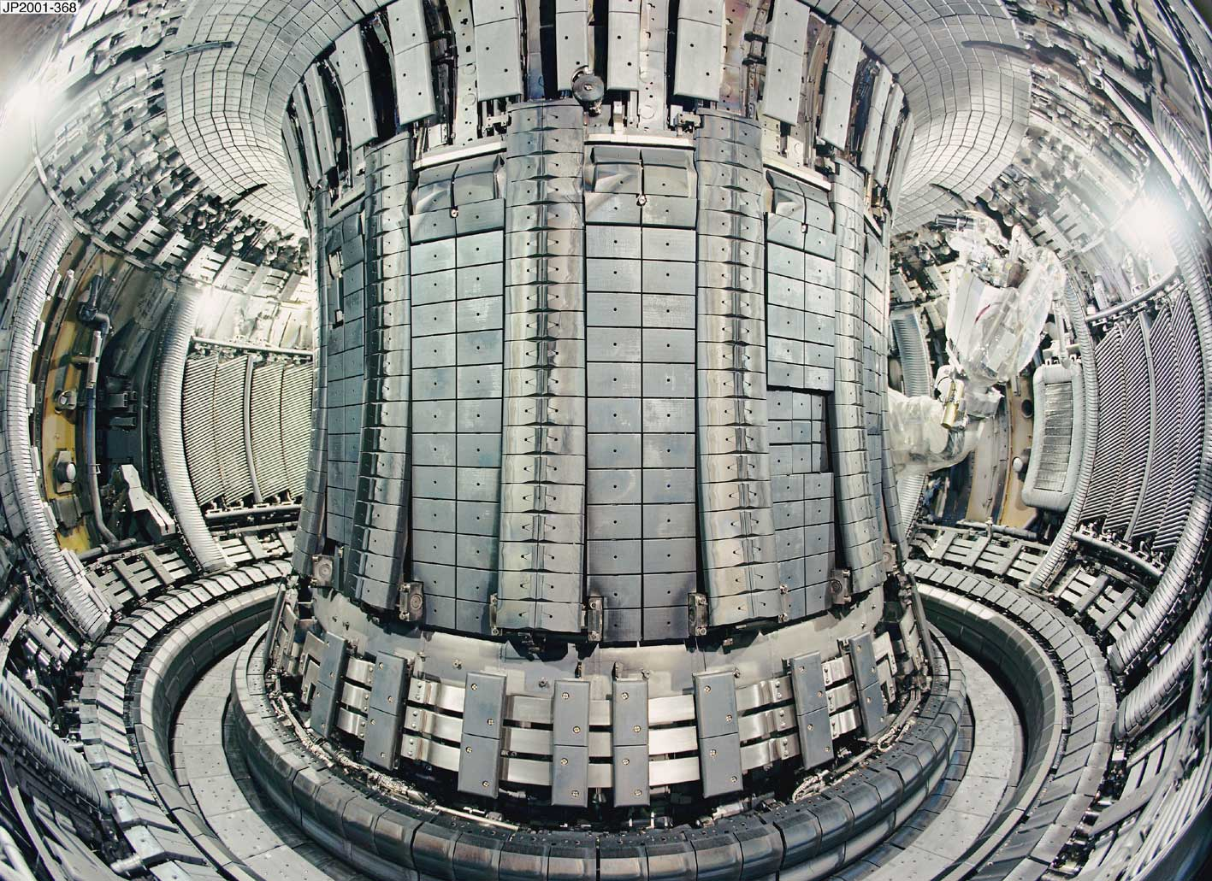
Part 6/8
The still largest tokamak at present:
Joint European Torus - JET
Inside JET, on the right side the robot arm to exchange wall tiles.
Schematic of JET

Slide 45
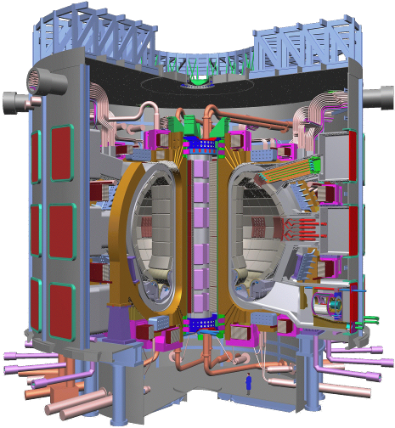
Part 6/9
ITER – the way (Latin):
International Thermonuclear Experimental Reactor
Central Solenoid
Blanket Module
Outer Intercoil Structure
Vacuum Vessel
Cryostat
Toroidal Field Coil
Port Plug (IC Heating)
Poloidal Field Coil
Divertor
Machine Gravity Supports
Torus Cryopump

Slide 46
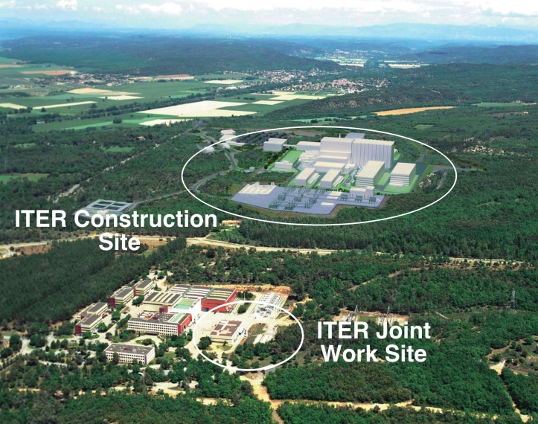
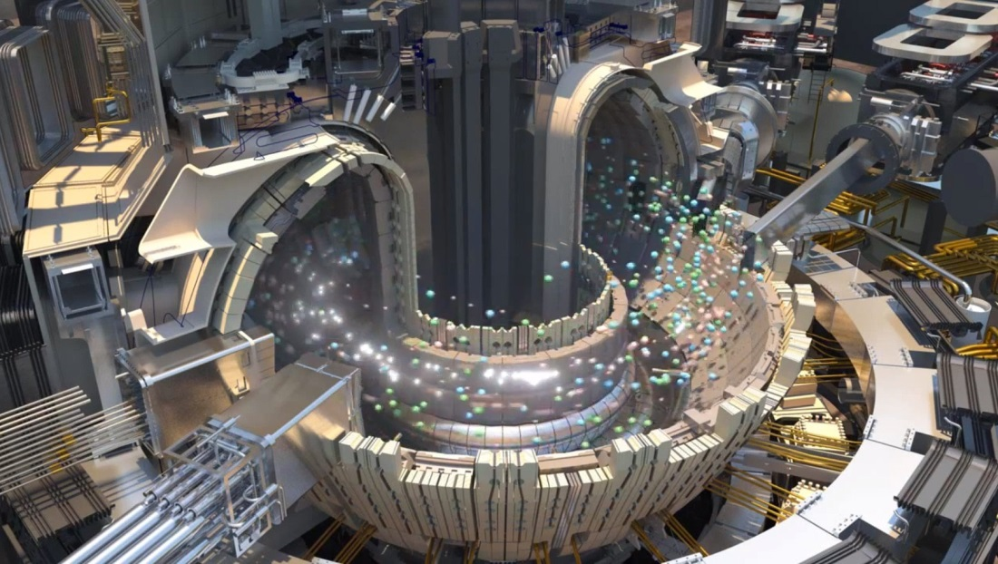
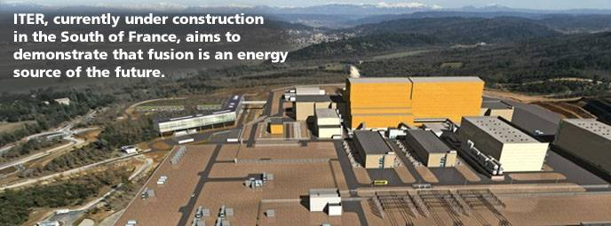
Part 6/10
The ITER site

Slide 47
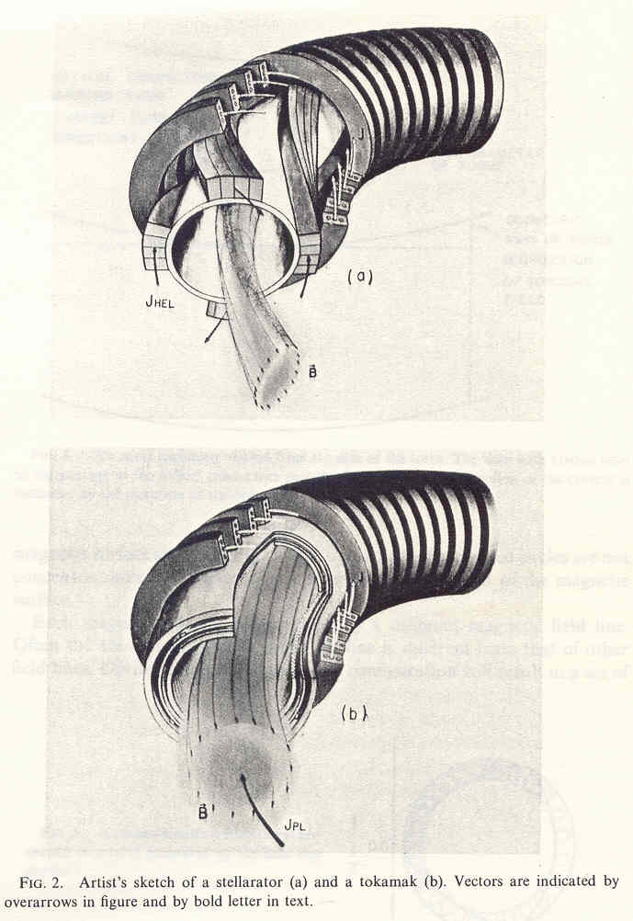
Part 7/1
Tokamaks and stellarators:
Schematic view of a tokamak where the rotational transform is created by a current in the plasma in toroidal direction, which gives rise to an additional magnetic field in poloidal direction. Advantages: simple geometry and ohmic heating possible.
Schematic of a stellarator where the rotational transform is created by additional helical coils (magnetic bottle). Advantages: no plasma current necessary.

Slide 48
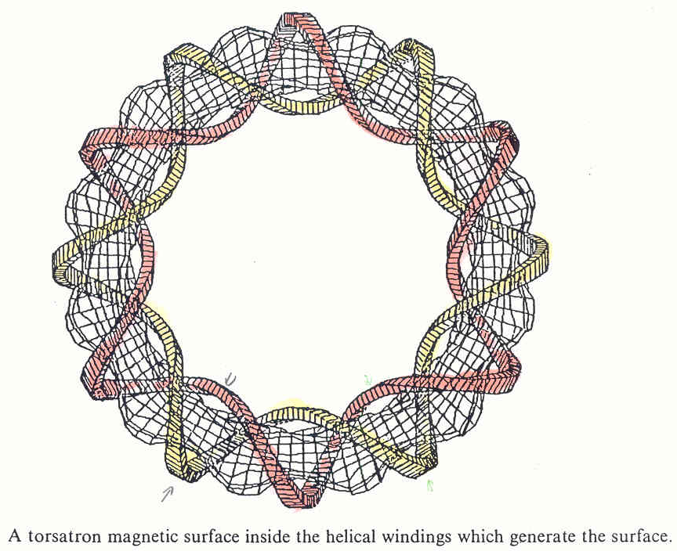
Part 7/2
Stellarators and torsatrons:
From Shohet, p. 255, Fig. 12

Slide 49

Part 7/3
Torsatron and ultimate torsatron:
From Shohet, p. 256, Fig. 13

Slide 50

Part 7/4
Early experiments:
From Shohet, p. 279, Fig. 29

Slide 51

Part 7/5
The largest stellarator of the world, Wendelstein 7-X, recently went into operation
Max-Planck-Institute for Plasma Physics, Greifswald, Mecklenburg-
Vorpommern, Germany
From
http://www.bigel-labs.de/8.Jufo2008/2.Theorie.htm

Slide 52


Part 7/6
Wendelstein 7-X recently went into operation
From
https://upload.wikimedia.org/wikipedia/commons/8/8f/Wendelstein7-X_Torushall-2011.jpg
Die deutsche Bundeskanzlerin Angelika Merkel bei der Zündung des ersten D-Plasmas im Wendel-stein 7-X am 03.02.2016

Slide 53
Part 8/1
Nonmagnetic fusion
1) Laser fusion or inertial confinement fusion
A tiny sphere of frozen deuterium and tritium, a so-called pellet, is shot into the evacuated reaction chamber. In the centre of the chamber, the pellet is irradiated from as many as possible sides by extremely strong focused laser beams.
What then happens comes close to a miniaturized thermonucl-ear bomb so that many laser fusion experiments have a military background or goal.
In the USA lots of money for these experiments comes from the army or the department of defence, and only a small part of the scientific results may be published. The rest is classified.

Slide 54
Part 8/2
Nonmagnetic fusion
1) Laser fusion or inertial confinement fusion
Under laser irradiation the pellet is adiabatically compressed to much more than the solid state density and extremely heated, becoming a plasma and reaching fusion conditions.
Then the plasma starts expanding rapidly, because of thermal expansion and the nuclear fusion reactions.
Because of its inertia the expansion still occurs in a finite time τ, whilst the density of the plasma decreases rapidly.
Thus plasma remains "confined" in an extremely small volume during the confinement time τ.
During τ so many fusion reactions should take place that the gained fusion energy exceeds the heating energy, i.e. mainly the energy needed for the lasers.

Slide 55

Part 8/3
Nonmagnetic fusion
1) Laser fusion or inertial confinement fusion
Irradiation of pellet by extremely strong, focused laser beams as spherically homo-geneously as possible from all sides.
From Christoph Leubner “Feasibility study on laser fusion" (in German, Univ. of Innsbruck, Sept. 1981) p. 2-17,Abb. 2.4a)

Slide 56

Part 8/4
Nonmagnetic fusion
1) Laser fusion or inertial confinement fusion
Spherical abla-tion of hot “co-rona” plasma.
By repulsion a spherical shock-wave propagates inward.
Thereby further compression occurs to much more than solid state density.
From Christoph Leubner “Feasibility study on laser fusion" (in German, Univ. of Innsbruck, Sept. 1981) p. 2-17,Abb. 2.4b)

Slide 57

Part 8/5
Nonmagnetic fusion
1) Laser fusion or inertial confinement fusion
About 80% of pellet is ablated. The rest is strong-ly compressed.
Only in a very small centre zone fusion conditions are reached.
k
e
z
From Christoph Leubner “Feasibility study on laser fusion" (in German, Univ. of Innsbruck, Sept. 1981) p. 2-18,Abb. 2.4c)

Slide 58

Part 8/6
Nonmagnetic fusion
1) Laser fusion or inertial confinement fusion
Then the process reverses and the re-maining pellet expands in a thermo-nuclear explosion.
If one laser pulse is not enough for sufficient compres-sion, it might be necessary to use several laser pulses after each other.
Sequence of laser pulses to reach a compression of 10000. Each subsequent laser pulse has higher energy and is shorter.
By ablation each pulse produ-ces a compressional spherical shockwave propagating in-ward, thereby further com-pressing the pellet centre.
Each subsequent shockwave propagates in a denser medium
and therefore faster than the previous one so that all shockwaves will arrive at the same time in the centre.

Slide 59

Part 8/7
Nonmagnetic fusion
1) Laser fusion or inertial confinement fusion
Here once again the sequence of events in inertial fusion:
Laser beams or laser-produced X-rays rapidly heat the surface of the fusion target, forming a surrounding plasma envelope (the corona plasma).
Fuel is compressed by the rocket-like blow-off of the hot surface material (ablation of the corona plasma).
During the final part of the capsule implosion, the fuel core reaches 20 times the density of lead and ignites at about 10⁸ K ≅ 10⁴ eV.
Thermonuclear burn spreads rapidly through the compressed fuel, yielding many times the input energy.
From: https://en.wikipedia.org/wiki/Inertial_confinement_fusion

Slide 60


Part 8/8
Nonmagnetic fusion
1) Laser fusion or inertial confinement fusion
Modern experiments work with metallic capsules filled with D+T:
Indirect drive laser ICF uses a hohlraum which is irradiated with laser beam cones from either side on its inner surface to bathe a fusion microcapsule inside with smooth high intensity X-rays. The highest energy X-rays can be seen leaking through the hohlraum, represented here in orange/red.
From: https://en.wikipedia.org/wiki/Inertial_confinement_fusion

Slide 61
Part 8/9
Nonmagnetic fusion
2) Muon-catalysed fusion
A muon is an elementary particle with negative charge and a spin of ¹⁄₂. Together with the electron, the tauon, and the three neutrinos, it is now classified as a lepton (http://en.wikipedia.org/wiki/Muon).
It is a subatomic particle with the second longest mean lifetime (2,2 µs), behind the free neutron (14,7 min).
Like all elementary particles, the muon has a corresponding anti-particle of opposite charge but equal mass and spin: the antimuon (also called a positive muon).
Muons are denoted by μ⁻ and antimuons by μ⁺. Muons were some-times referred to as mu-mesons or μ-mesons in the past, even though they are not classified anymore as mesons by modern particle physicists.

Slide 62
Part 8/10
Nonmagnetic fusion
2) Muon-catalysed fusion
Muons make unusually strong bonds between hydrogen atoms. The nuclei of deuterium and tritium can approach each other up to sever-al fm and fuse. Then the muon is released and can catalyse further fusion processes. This leads to a heating of the chamber, and this heat could be utilized as usual.
Muon catalysed fusion is temperature-dependent:
It works especially well at low temperatures of 13 K, i.e. in a mixture of liquid deuterium and tritium since there the density is much larger than in a gaseous mixture of D and T.
It also works well at higher temperatures, but still far below the tem-peratures of normal fusion. Best efficiency is reached at 900°C. This temperature would be favourable for the production of high pressure water vapour for the operation of steam turbines.

Slide 63
Part 8/11
Nonmagnetic fusion
2) Muon-catalysed fusion
Muons have a mass about 207 times larger than that of electrons, and this is the main advantage of muons compared to electrons, since the radius of an atom is inversely proportional to the mass of the negative particle in the orbital :
The Bohr radius is the radius of the hydrogen atom in its ground state; with an electron it is:
But if we insert into this formula the mass of a muon, m_{μ} = 207m_{e}, we obtain:
So a muonized hydrogen atom is much smaller than a normal electron hydro-gen atom. Nevertheless comparing this to the approximate diameter of a proton of 1,7 fm, we see that such an atom is still much larger than the bare proton.

Slide 64
Part 8/12
Nonmagnetic fusion
2) Muon-catalysed fusion
The process to create a muon with the sign μ is the following:
Here A can be any nucleus, p is a proton, and π is the sign for a pion, which has a mean lifetime of about 10^{–8} s. Now just considering the negative pion, after 10^{–8} s it will decay as follows:
with being a muonic antineutrino. After 2,2 μs the muon decays as follows:
is an electronic antineutrino.

Slide 65


Part 8/13
Nonmagnetic fusion
2) Muon-catalysed fusion
From: J. Rafelski and S.E. Jones, Scientific American 257, July 1987, p. 67)
The worst problem is the short lifetime of the muon. To produce a positive ener-gy balance one single muon has to catalyse as many fusion reactions that at least the accelerator to produce fast protons can be supplied with energy.

Slide 66

Part 8/14
Nonmagnetic fusion
2) Muon-catalysed fusion
From: J. Rafelski and S.E. Jones in Scientific American 257, July 1987, p. 68)

Slide 67

Part 8/15
Nonmagnetic fusion
2) Muon-catalysed fusion
From: J. Rafelski and S.E. Jones in Scientific American 257, July 1987, p. 69)

Slide 68

Part 8/16
Nonmagnetic fusion
2) Muon-catalysed fusion
REACTION CYCLE of a cold-fusion reaction starts and ends with a free muon (1). A tritiuim muoatom forms (2), sometimes by way of a deuterium muo-atom (1a). The muoatom combines with a deuterium nucleus to form a muomolecular ion (3), which fuses to make a He⁵ nucleus (4). The He⁵ splits into an α-particle and a neutron, releasing energy (5). If the muon sticks to the α-particle (5a), the cycle is interrupted because the catalyst has been removed: sticking is a primary obstacle to the development of muon-catalysed fusion. If the muon does not stick, it is free to begin another cycle (1).
From: J. Rafelski and S.E. Jones in Scien-tific American 257, July 1987, p. 70)

Slide 69

Part 8/16
Nonmagnetic fusion
2) Muon-catalysed fusion
COMMERCIAL COLD-FUSION REACTOR could be built with existing technology. To create the re-quired muons, a particle accelerator directs a beam of protons on a target made of a substance such a deuterium or lithium. The resulting muon beam is guided by a magnetic field into the reaction vessel supplied with deuterium (which can be collected from seawater) and tritium. There the muons cata-lyse fusion reactions. A purifier removes the helium “ash” produced by the reactions. Neutrons from the fusion reactions collide with a blanket of lithium, producing tritium and helium. The tritium is channelled into the fusion vessel and the helium is removed. Heat from the fusion reactions vaporises a working fluid that is piped through the lithium blanket. The vapour spins a set of high-pressure turbines that run electric-poser generators. Some of the electricity powers the particle accelerator, pumps and other components of the reactor.
From: J. Rafelski and S.E. Jones in Scien-tific American 257, July 1987, p. 71)

Slide 70

Part 8/17
Nonmagnetic fusion
3) “Bubble fusion” or “Sonofusion” based on sonoluminescence
Another idea about „cold fusion“ which is also not feasible, but physically at least not completely impossible, but more unlikely than the muon-catalysed fusion:
https://en.wikipedia.org/wiki/Bubble_fusion
https://en.wikipedia.org/wiki/Chain_Reaction_(film)
https://en.wikipedia.org/wiki/Cold_fusion

