Slide 1
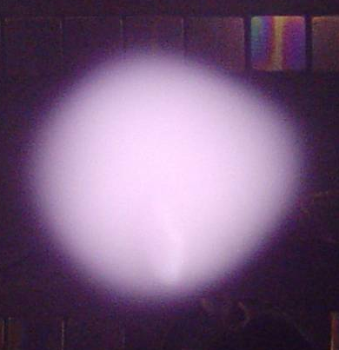


IEPPG
IEPPG
Diagnostics with Cold, Emissive and Heated Probes
Basics
Roman Schrittwieser
with contributions by
Codrina Ionita, Franz Mehlmann, Christian Maszl, Ronald Stärz
and members of the Risø Laboratory for Sustainable Energy, Denmark,
and the Max-Planck-Institute for Plasma Physics, Greifswald
Innsbruck Experimental Plasma Physics Group (IEPPG)
Institute for Ion Physics and Applied Physics
University of Innsbruck

Slide 2
Contents
Cold plane probes
  The flux of particles in gases and plasmas
  Ideal probe theory revisited
    Basic remarks
    The most important ranges and points in the characteristic
    Ion saturation current range A
    Electron retarding field region A → C, the floating potential B
    and the plasma potential C
    The plasma potential C and the electron saturation current range
Emissive probes
  Basic considerations
  The construction of an emissive probe and the heating circuit
  Measurement with emissive probes
  Laser-heated emissive probe
  A brief theory of emissive probes
Probes in reactive plasmas
  Basic considerations
  Coating effects in a potassium plasma
  Other contamination effects on probes in a potassium plasma and how to avoid them by heated probes

Slide 3
1.1. The flux of particles in gases and plasmas
ϑ
dA
r
ϕ
Unit area dA with spherical coordinate system to calculate the particle flux towards it.
(1.1)

Slide 4
Maxwellian velocity distribution function (VDF)
(1.2)
Only half the density!
(1.3)
d³v = v² dv d²Ω = v² dv sin ϑ dϑ dϕ
Volume element in velocity space
(1.4)
(1.5)
= 1
= 2π

Slide 5
(1.6)
Three-dimensional random or thermal flux of particles
(1.7)
Mean velocity of a Maxwellian VDF
(1.8)
Random or thermal current density in a plasma
(1.9)
Random or thermal current to an area A_{s} (= surface of the probe sheath)
(1.10)

Slide 6
1.2. Ideal probe theory revisited
Assumptions :
The plasma be infinite, isotropic and quasineutral.
Both charge carrier species have Maxwellian VDFs.
The size of our probe be negligible compared to the typical dimensions of the plasma and to the Debye length λ_{d}.
The thickness of the sheath be small against the size of the probe so that the geometrical size of the probe area be approximately equal to the effective collecting area of the probe, which is the sheath edge.
The space charge sheath, which forms around the probe, have a well-defined boundary, outside which the plasma is unperturbed.
The mean free paths (MFP) for electron and ion collisions (among each other and with the neutrals) be large compared to the probe size and the thickness of the sheath.
Thus inside the space charge sheath there cannot be any ionisation and recombination processes, i.e., there is neither creation nor destruction of charge carriers within the probe sheath.
Every charge carrier, which reaches the probe, deliver there only its charge, but does not react otherwise with the probe surface and, if it is an ion, remains not on the surface.

Slide 7
Ideal probe characteristic I_{p}(V_{p}) under the above assumptions in an unmagnetized plasma
Ideal probe characteristic (current density versus probe voltage) for a potassium plasma with T_{e} ≅ T_{i} ≅ 0,2 eV with a density of n_{e} ≅ n_{i} ≅ 10⁹ cm⁻³. The dashed line shows the pure electron current density towards the probe (technical current direction), the dotted line the ion current density. The magnitudes of both currents decrease exponentially below, respectively, above the plasma potential Φ_{pl} (which here is assumed to be −2V) according to their respective velocity distribution functions. The solid line shows to total characteristic, which we obtain by adding both partial currents.

Slide 8
Φ_{pl}
I_{p}
I_{p}(V_{p}) = I_{e} − I_{i}
C
D
(1.11)
Schematic probe characteristic
Total probe current
I_{es}
I_{is}
B
V_{p}
A
Φ(x)
D: V_{p} > Φ_{pl}
Above, schematic of the current-voltage characteris-tic of a single-sided plane probe; the points A to D refer to the lower part of the figure. Below, schematic of the potential profiles in front of the probe surface for four different cases as indicated.
Plasma
Probe
x
C: V_{p} = Φ_{pl}
Potential profiles in front of the probe
(schematically)
B: V_{p} = V_{fl}
A: V_{p} << Φ_{pl}

Slide 9
1.2.1. The different ranges of the probe characteristic:
For V_{p} ≤ Φ_{pl} :
I_{i} = I_{is} and
Boltzmann relation
(1.12)
Total probe current
(1.13)
A. Ion saturation current range, in which the value of the exponential function in Eq. (1.12) is close to zero: I_{p} = –I_{is}.
B. The floating potential point where V_{p} = V_{fl} and where the ion and electron currents exactly cancel each other so that I_{p} = 0. Thus from Eqs. (1.11) and (1.13) follows:
For floating probe
(1.14)
C. The plasma potential where V_{p} = Φ_{pl} and where there is no space charge sheath around the probe. There the value of the probe current is: I_{p} = I_{es} – I_{is}.
D. The electron saturation current range where no ions can reach the probe anymore and where I_{p} = I_{es}.

Slide 10
1.2.2. Ion saturation current range A:
(1.15)
Ion density at the edge of the real sheath!
Ion-acoustic velocity to satisfy the Bohm criterion
(1.16)
n_{i}
n_{i,ps}
(1.17)
x
(1.18)
Φ_{pl}
Presheath
Sheath
Plasma
Floating probe
V_{fl}

Slide 11
(1.19)
Child-Langmuir law
(1.20)
Ion density:
No real saturation in the beginning of the ion branch of the I-V characteristic!

Slide 12
Probe with geometrical surface area A_{p}, ceramic-coated on the rear side
Schematic of a sing-le-sided plane probe with sheath in front, plasma and the wall with sheath in front as reference elec-trode; not in scale. For the idealised probe theory the probe sheath is assumed to be so thin that it can be neglected so that A_{s} ≅ A_{p}.
Probe sheath with surface area A_{s}
Plasma
Electrical probe connection
Wall (= reference electrode) with sheath in front
Φ(x)
Space potential profile in front of the probe for floating or negatively biased probe (Φ_{pl} = 0)
x
Φ_{pl}
V_{p}

Slide 13
1.2.3. Electron retarding field region A → C, floating potential B and plasma potential C:
Boltzmann relation:
electron density inside
the sheath
(1.21)
For Φ_{p}(x) = V_{p}:
Electron density at the probe
(1.22)
Random electron current outside the sheath
(1.23)
on the probe
(1.24)

Slide 14
Total probe current in electron retarding field region
(1.25)
(1.26)
For V_{p} = V_{fl}:
(1.27)
Floating potential
(1.28)
T_{e} determined from the difference between Φ_{pl} and V_{fl}
(1.29)

Slide 15
Difference between plasma potential and floating potential
(1.30)
(1.31)
Element | Atomic mass μ | α = 0,5 ln(812μ)
H | 1 | 3,35
D | 2 | 3,70
He | 4 | 4,04
Ne | 20 | 4,84
Na | 23 | 4,91
K | 39 | 5,18
Ar | 40 | 5,19
Cs | 133 | 5,79
Table 1

Slide 16
Determination of T_{e} from the slope of the logarithmized electron retarding field current
(1.32)
(1.33)

Slide 17
1.2.4. Plasma potential C and electron saturation current region (still ideal probe theory!):
For V_{p} = Φ_{pl}:
(1.34)
Total probe current at plasma potential
(1.35)
In a realistic case, the effective areas of the probe for collecting ions and electrons might be strongly different
Ratio between electron current and ion current at plasma potential
for T_{e} = T_{i}:
(1.36/37)

Slide 18
Thus electron current is always at least (1836)^{1/2} ≅ 43 larger than ion current
Therefore:
Approximate probe current at plasma potential
(1.38)
Determination of the plasma density
(1.39)

Slide 19
2. Emissive probes
Schematic characteristics of a cold probe in the edge region of a typical small tokamak; the general plasma parameters are the same in both cases: Φ_{pl} = +20 V, T_{e}* = 10 eV, n_{pl} = 10¹² cm⁻³. (a) the electrons have no drift; (b) the electrons have a drift with a kinetic energy of eΦ_{b} = 40 eV.

Slide 20
CP (positively biased)
HP
Plasma
(a)
Schematic of the conditions in a Q-machine plasma with a localised complex potential structure, specifi-cally a double layer (DL) created inside. (a) schematic cross section of the Q-machine plasma column, (b) axial profile of the space potential in such a case, (c) conditions when a cold probe is inserted first in the position I and then in II with the sheath around it.
Φ_{pl}
z
(b)
Φ_{pl,0}
Φ_{pl}
(c)
e–
z
Φ_{pl,0}
I
II
Cold probe, biased at V_{p} = Φ_{pl,0}

Slide 21
Schematic characteristics of an emissive probe in the edge region of a typical small tokamak; the magnitude of the saturated electron emission current is adjusted to about twice the plasma electron saturation current; the general plasma parameters are the same in both cases: Φ_{pl} = +20 V, T_{e}* = 10 eV, n_{pl} = 10¹² cm⁻³. (a) the electrons have no drift; (b) the electrons have a drift with a kinetic energy of eΦ_{b} = 40 eV.

Slide 22
Considerations :
The ion saturation current I_{is} can usually be neglected, especially in the case of an isotropic gas discharge plasma, where T_{i} often much smaller than T_{e}.
But T_{i} can be approximately equal to T_{em}, the temperature of the emitted electrons, which have the same temperature as the heated filament from which they are emitted. The latter can hardly be higher than about 2500 K.
Seldom T_{em} and T_{e} will be similar. Especially in gas discharge plasmas T_{em} << T_{e}. Only in a Q-machine the temperatures can be almost identical namely about 2200 K. But if T_{e} >> T_{em}, then the exponential drop of the magnitude of the electron emission current I_{em} will be much narrower than that of the plasma electron current I_{e}.
One serious problem for the emissive probe method might arise exactly from this problem, namely that T_{e} >> T_{em}. Thus the mean flux of the latter is much larger than the mean flux of the former. This might lead to the formation on an electron-rich space charge around the probe collector, pulling the floating potential of the probe down. This can be under-stood by the fact that the emitted electrons have to be accelerated a bit in order to be really able to compensate the plasma electron flux. In such a case the emission current is no longer saturated and given by Richardson's law (and thus a function of the emissive probe temperature), but is determined by the potential difference between the plasma and the wire, and the Child-Langmuir law has to be taken instead for the emission current, which is then space charge limited.

Slide 23
2.1. The construction of an emissive probe and the heating circuit:
Richardson’s law for the unhindered emission of electrons from a hot me-tallic surface
(2.1)
For the most often used material for emissive probe, namely tungsten, W_{w} is 4,55 eV and the Richardson constant is A* = 6,012⋅10⁵ Am⁻²K⁻². Often also thoriated tungsten is used for emissive probe wires. This is tungsten alloyed with just about 0,2% thorium, which reduces the work function to about 2,63 eV, but also the Richardson constant drops to about 3⋅10⁴ Am⁻²K⁻².⋅Still the emission from a thoriated tungsten wire at the same temperature is stronger than from pure tungsten.

Slide 24
Currents and particle fluxes around an emissive probe and the effect of a possible space charge formed by the emitted electrons on the emissive probe
Electric currents
Particle fluxes
Plasma ions
Plasma ions
Plasma electrons
Plasma electrons
Emitted electrons
Emitted electrons
Space potential profile in front of the probe with saturated emission current
Possible space potential profile in front of the probe with space-charge-limited emission current
Space potential
Space potential
d
x
Φ_{pl}
x
Φ_{pl}
0.99T_{e}
Space charge due to emitted electrons

Slide 25
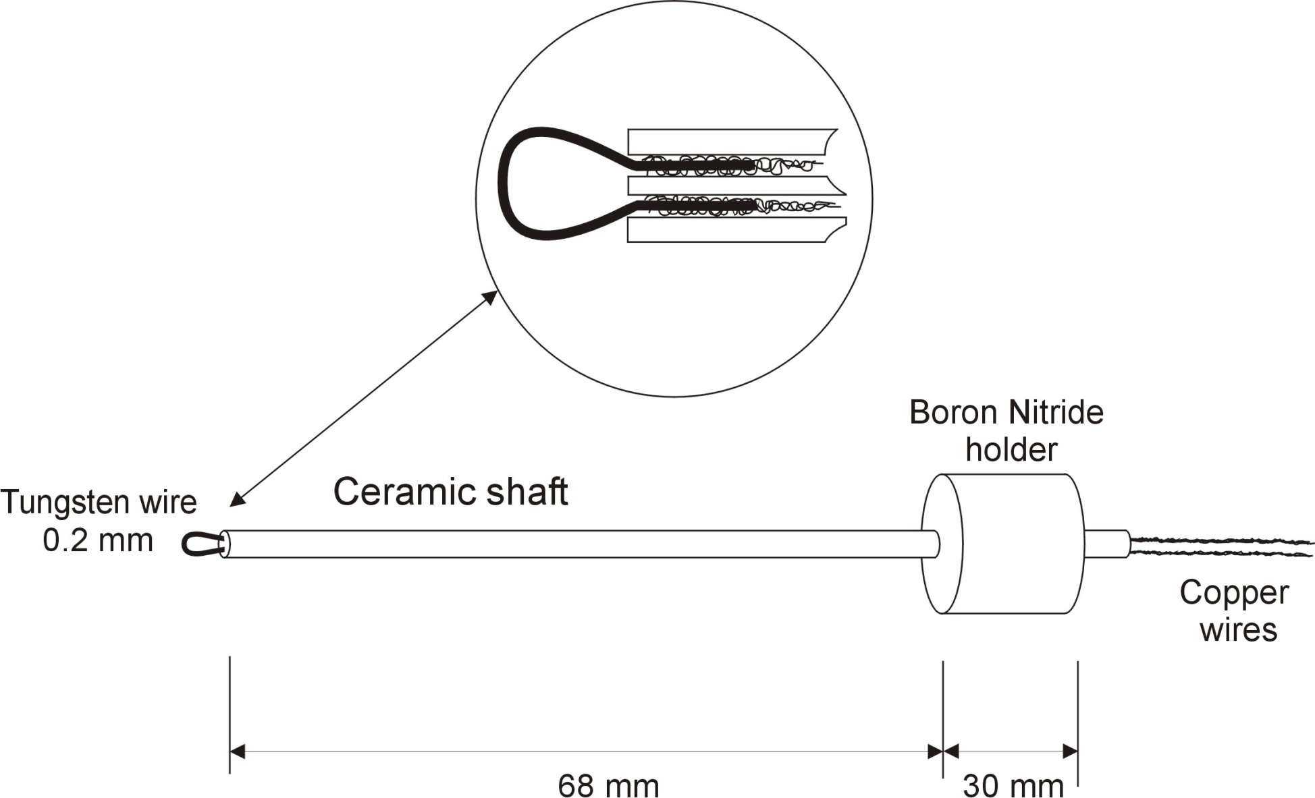
The probe holder is a ceramic tube (Al₂O₃) of oval cross section (1,4/2,3 mm outer diameters) and a length of 8 cm. The tube has two bores of 0,7 mm diameter each.
Inside the bores the tung-sten wires are spliced with thin copper threads to increase the conductivity. This guarantees that only the probe loop is glowing when a current is passed through.
Schematic of an electron emissive probe as developed by the Innsbruck Experimental Plasma Physics Group and used in the CASTOR tokamak in Prague.

Slide 26
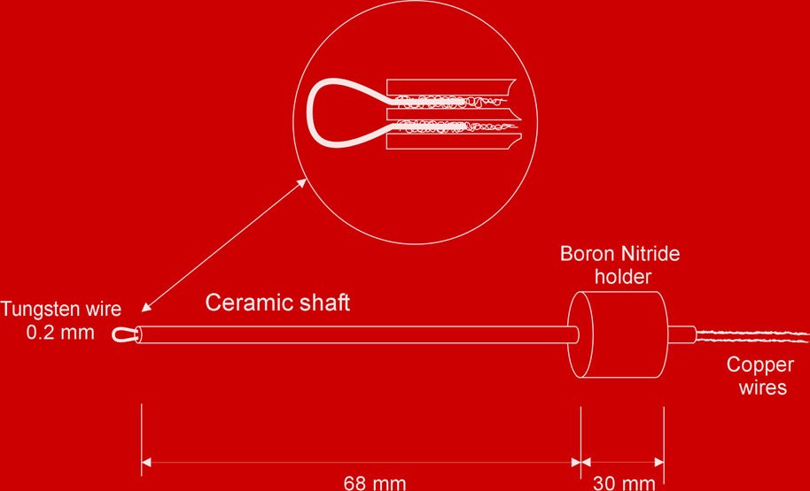
Plasma
Emissive
probe
≅ 7,5 A
Electronic regulation circuit:
0 – 10 A, 0 – 10 V
12 V Pb-battery with 50 Ah
ac amplifier to current-amplify the signal from the signal generator up to about 3 A
Switch to change between the two modes of operation
Signal generator, delivering a sawtooth frequency up to 10 kHz with about ±15 V
< 300 mA, ±150 V
R ≅ 10 Ω
Transformer, 1:10, for up to 10 kHz and 300 mA on the secondary side
Sampling device (sampling rate about 100 kHz)
Electronic circuit used for heating an emissive probe and for recording its current-voltage characteristic as used in the ISTTOK in Lisbon. The heating current is provided by a 12 V lead battery in order to avoid ground loops and other electromagnetic noises in the circuit. There are two possibilities to operate the circuit, once we can scan the current-voltage characteristic, or we can directly register the floating potential.

Slide 27
2.2. A brief theory of emissive probes:
For V_{p} ≤ Φ_{pl} :
Total probe current to (and from) and emissive probe
I_{p}(V_{p}) = I_{e} − I_{i} − I_{em}
(2.2)
Emission current
(2.3a)
(2.3b)
I_{i} = I_{is}
Ion current (= saturated)
Electron current (= retarded)
(2.3c)
(2.4)

Slide 28
For the floating case:
(2.5)
Floating potential
(2.6)
Difference between Φ_{pl} and V_{fl}
(2.7)
Floating potential
(2.8)
Difference between Φ_{pl} and V_{fl}
(2.9)

Slide 29
Theoretical dependence of the floating potential of an emissive probe for increasing heating current = emissive current according Eq. (2.9); shown is the difference Δ_{em} between the floating potential and the plasma potential, normalised to the electron temperature. (a) Δ_{em} versus the emissive current density j_{em} normalised to the electron current density j_{es}. (b) Δ_{em} versus the actual temperature of the wire T_{w}.

Slide 30
When is the floating potential of the emissive probe equal to the plasma potential, i.e., when is Δ_{em} = 0?
We remember Eq. (2.9):
(2.12)
As we have intuitively expected, this is the case when the plasma electron saturation current I_{es} is compensated by the sum of ion saturation current and electron emission current I_{em} + I_{is}.

Slide 31
2.3. Measurement with emissive probes:
Φ_{pl} ≅ 0
I_{p}
Φ_{pl} >> 0
Operating line for a sufficiently high input impedance
V_{p}
Wrong value for Φ_{pl} when input impedance is too low
Operating line for an input impedance that is too low
Schematic of two characteristics, one for Φ_{pl} ≅ 0 (solid line), one for Φ_{pl} >> 0 (dashed line). Also shown are two operating lines for two different input impedances, one sufficiently high (solid line), the other one too low (dashed line). What is actually measured is the intersection of the characteristic with the operating line.

Slide 32
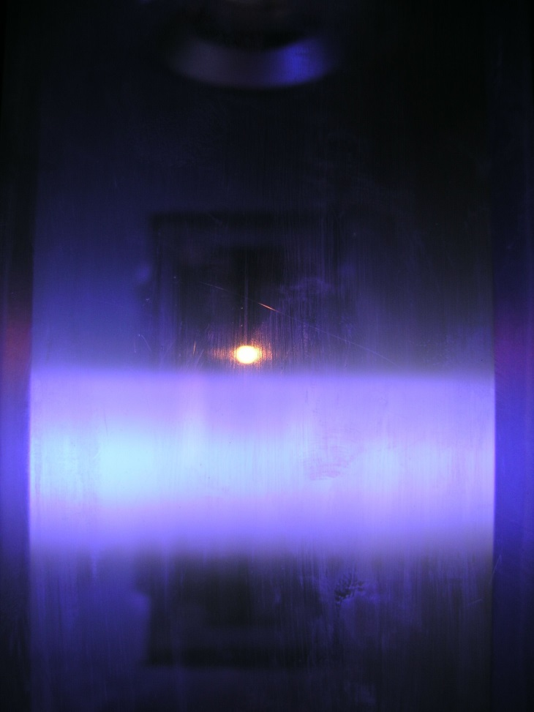
2.4. Laser-heated emissive probes:
IEPPG
Together with the IPP Greifswald :
A laser-heated probe has several advan-tages as compared to a conventional emis-sive wire probe:
Graphite or LaB₆ can be heated to much higher tempera-tures, therefore higher electron emission and longer lifetime.
No current flows through the probe, therefore no danger of deformation in a magnetic field.
Lower capacity of the probe system, therefore better time response.
Surface of the probe is an equipotential area.
A disk of LaB₆ or graphite in the VINETA experiment (Greifswald) irradiated from above by light of 808 nm from a infrared diode laser (JenLas HDL50F from JenOptik, Jena, Germany) with up 50 W.

Slide 33
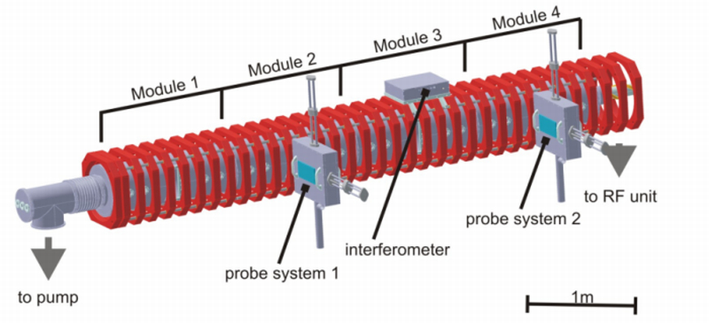
IEPPG
Prototype of a laser-heated probe for VINETA:
Glass fibre
Quartz window
Head with lens system
Vacuum cylinder
LaB₆-probe
Magnetic field B [mT] 100
Plasma density [10¹⁹ m⁻³] ≤ 2
Electron temperature T_{e} [eV] 3
Ion temperature T_{i} [eV] 0,2
VINETA Plasma
Single bore Al₂O₃ tube
Cu-wire splicing
Mo-wire

Slide 34
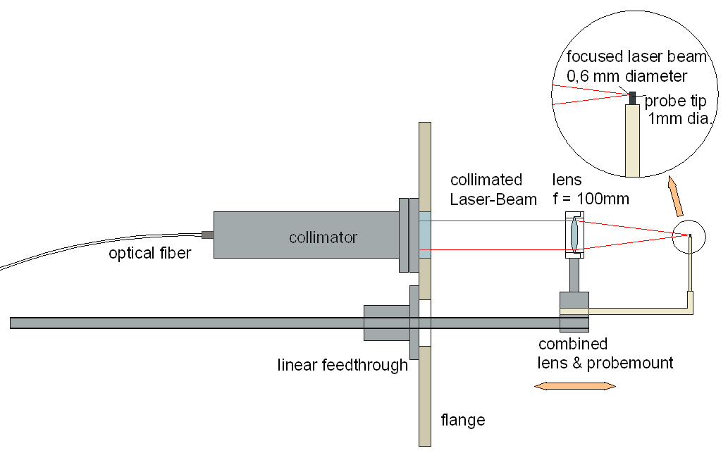
IEPPG
A radially moveable laser-heated probe :
The diverging laser beam from the optical fiber is collimated by a first lens. It penetrates a quartz window into VINETA and is focused by a second lens onto the LaB₆ or graphite pin of 1 mm diameter and 3 mm length. The second lens and the probe holder are mounted on the same radially movable shaft.

Slide 35
IEPPG
LaB₆-pin: 1,5 mm diameter, 3 mm length
I_{p}(V_{p})-characteristic of the laser-heated emissive probe with increasing laser heating power P_{L} for radial position r ≅
–15 mm. The vertical green line indicates the value of Φ_{pl,cold} derived from the first derivative. The insert shows the zero-crossing of the characteristics in close-up. However, also for this case V*_{fl,em} remains somewhat below Φ_{pl,cold}.
We can easily reach emission currents of more than 2 A.

Slide 36
IEPPG
LaB₆-pin:
1,5 mm diameter, 3 mm length
Floating potential of laser-heated probe versus laser heating power P_{L}. Horizontal blue line shows Φ_{pl,cold} as derived from the first derivative of the cold characteristic.
Also here we see that
V*_{fl,em} < Φ_{pl,cold}.
There is an ongoing discussion whether or not the floating potential of a strongly heated emissive probe reaches the plasma potential or remains below.

Slide 37
IEPPG
LaB₆-pin: 1,5 mm diameter, 3 mm length
Floating potential of the probe versus laser heating power. The blue horizontal line shows the value determined from the inflection point of the cold characteristic. 15 mm outside the centre of the plasma column
Floating potential of the probe versus laser heating power. The blue horizontal line shows the value determined from the inflection point of the cold characteristic. Centre of plasma column.
As we have found out, sometimes the emissive floating potential even be larger than the value determined from the I-V characteristic of a cold probe

Slide 38
3. Probes in reactive plasmas
3.1. Coating effects in a potassium plasma:
Schematic of a Q-machine, HP = hot plate, CP = cold plate, SG = signal generator, SA = Signal analyser. In this case, the central part of the cold plate has a diameter of 10 mm and serves as a kind of probe. It can also be heated by indirect electric heating.

Slide 39
Particle flux in a magnetized potassium plasma, as example for technical plasmas
Let us assume, we have a K-plasma with a floating cold plate, an average density of n_{i} = 10⁹ cm^{–3} and a plasma potential of Φ_{pl} = –2 V. We can easily calculate in this case that the minimum ion speed is
≅ 3130 m/s = 3,13⋅10⁵ cm/s. Thus a one-dimensional flux of ions of Γ_{i} = n_{i}v_{i} ≅ 3⋅10¹⁴ cm^{–2}s^{–1} flows along the magnetic field lines and eventually hits the cold plate. Assuming a small atomic radius of ca. 1 Å = 10^{–8} cm and therefore a cross section of about 3 Å² = 3⋅10^{–16} cm², then 3⋅10¹⁵ atoms are needed to create a monoatomic layer of potassium per cm² on the cold plate. The results is that it just takes about 10 s to transform the clean tungsten cold plate into a cold plate that is completely covered by potassium so that the work function of the cold plate is no longer given by W_{W} = 4,55 eV but by W_{K} = 2,15 eV.

Slide 40
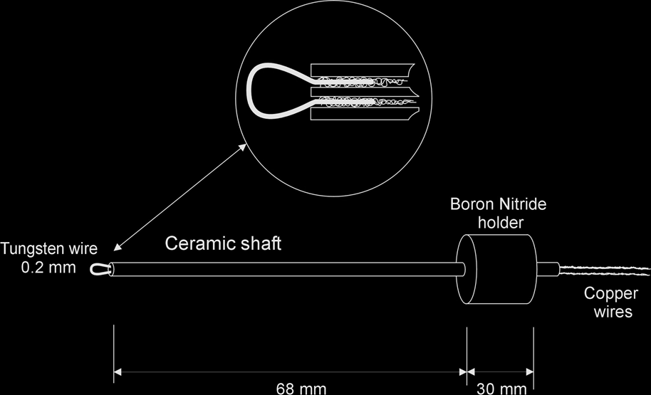
Space charge sheaths
Space charge sheaths
Plasma
Plasma
Hot plate (W)
Cold plate (W)
Hot plate (W)
Cold plate (W)
Potassium coating
Φ_{pl}
W_{W}
Φ_{pl}
W_{W}
W_{K}
z
z
Φ_{pl}
Φ_{pl}
V_{fl}
V_{fl}*
= V_{fl} + (W_{W} − W_{K}) !
Schematic axial potential profiles along a Q-machine with clean hot plate and cold plate of tungsten (left-hand side) and with a K-coating on the cold plate (right-hand side).

Slide 41
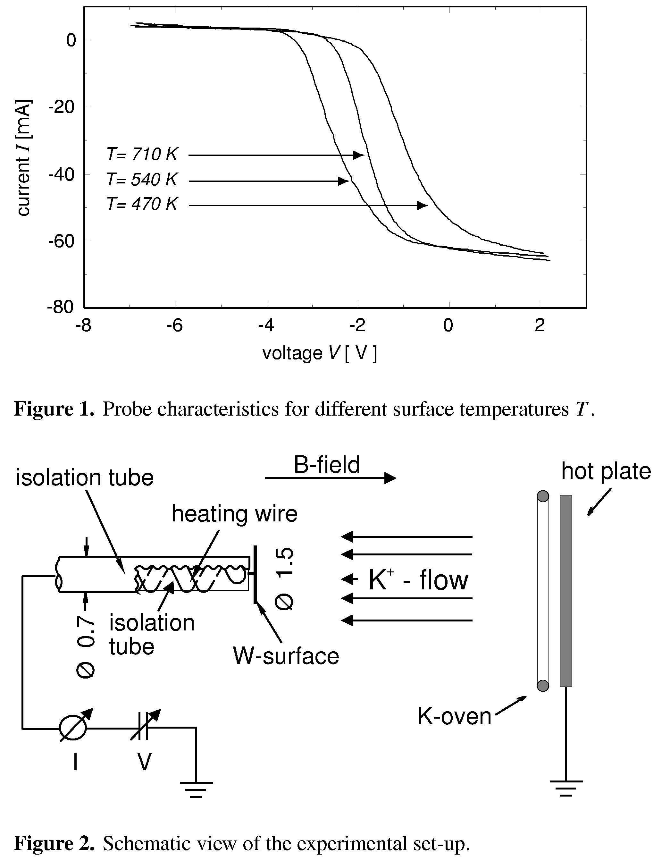
3.2 Other contamination effects on probes in a potassium plasma and how to avoid them by heated probes (C. Winkler, D. Strele, S. Tscholl, R. Schrittwieser, Plasma Phys. Contr. Fusion 42 (2000), 217.)
Schematic of an indirectly heatable tungsten cold probe, which can be heated to about 1000 K, thereby evaporating coatings by potassium and compounds so that the surface of the probe remains more or less clean. Shown are also the plasma source (hot plate) with the K-oven and the ion flow.

Slide 42
Typical current-voltage characteristics of the indirectly heatable probe for various temperatures of the collector plate. Notice that in contrast to the characteristics up to now, the probe current axis is inverted, i.e., the electron current is displayed as a negative current.

Slide 43
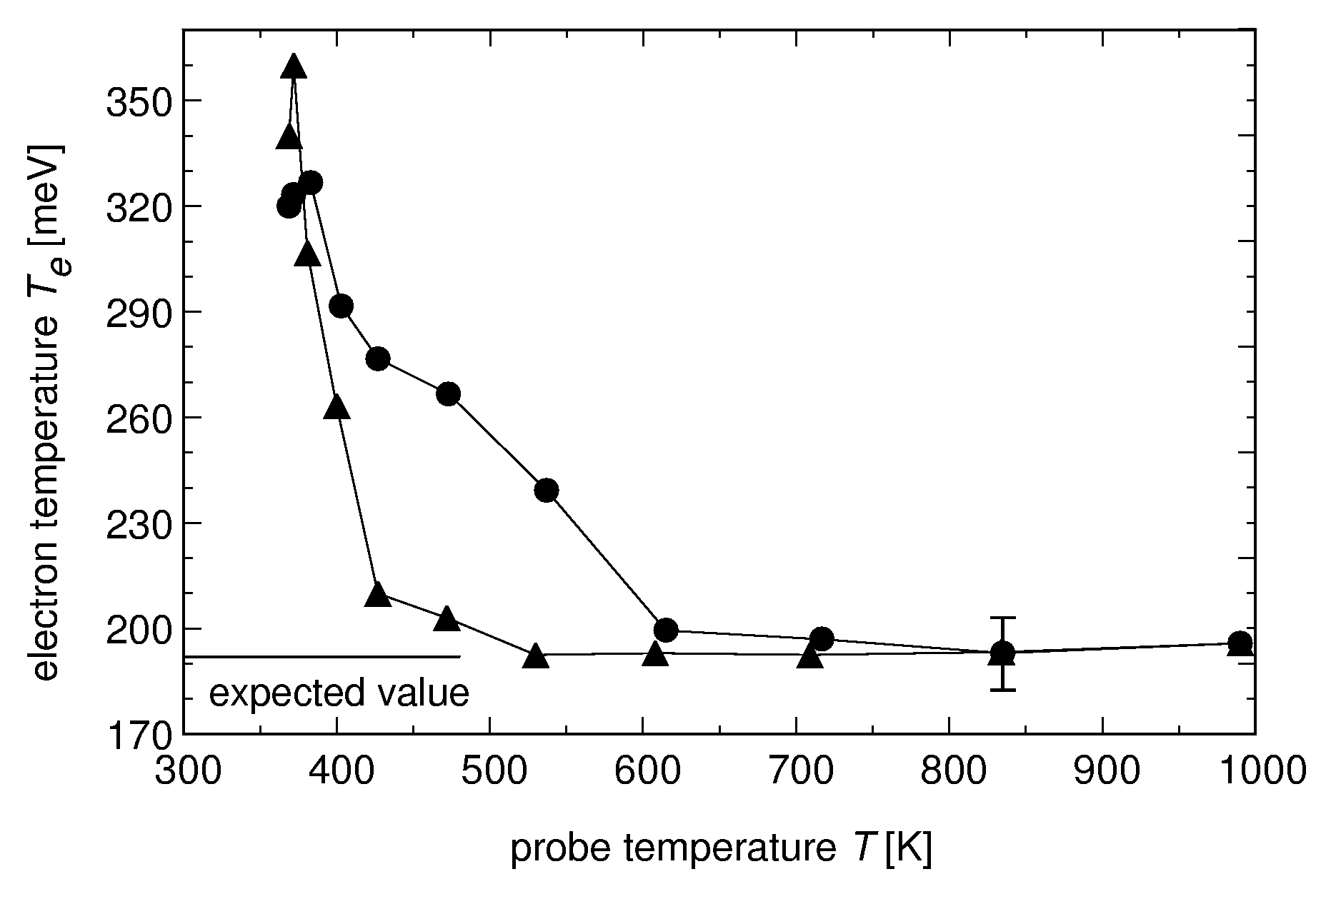
Calculated electron temperature T_{e} as a function of the surface temperature T of the probe for increasing () and decreasing () heating power. The expected value for a hot plate temperature of T_{HP} ≅ 2220 K is T_{e} ≅ 191 meV.

Slide 44
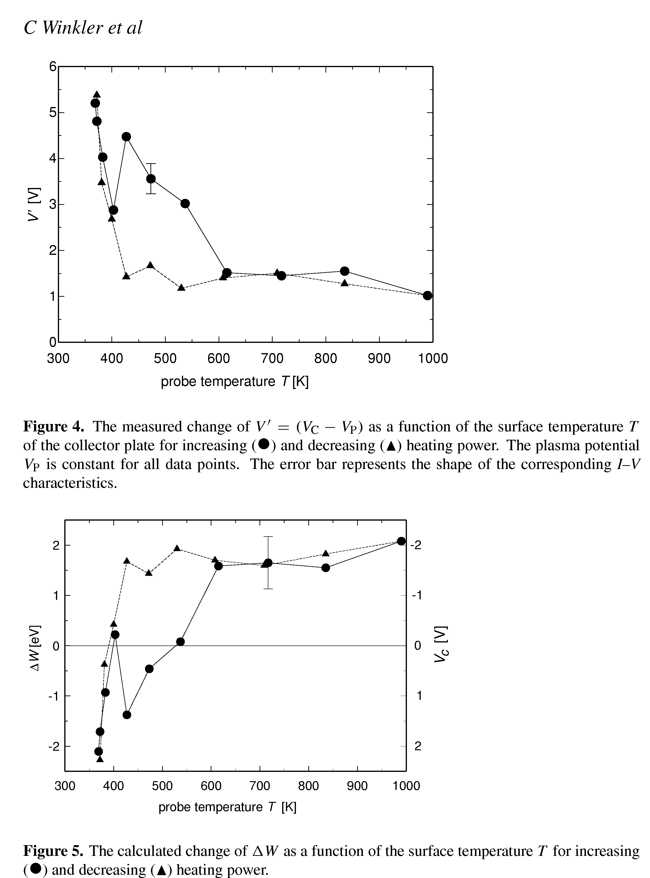
Calculated values of V' = (Φ_{c} – Φ_{pl}) as a function of the probe surface temperature T for increasing () and decreasing () heating power. The plasma potential Φ_{pl} is constant during the measurement and has been determined independently by an emissive probe as
–2,8 V.

Slide 45
In a magnetized K-plasma the probe is not only exposed to a flux of potassium ions but also of residual gas atoms (in particular O₂ and N₂).
Thus on the probe surface chemical compounds especially of the oxygen and potassium can form, with the tungsten surface acting as a kind of catalyser.
Under our assumptions flux of potassium ions is Γ_{K} ≅ 6⋅10¹⁴ cm^{–2}s^{–1},
Flux of residual gases is Γ_{r} ≅ 3⋅10¹⁴ cm^{–2}s^{–1} (although the background pressure in the Q-machine is kept as low as possible).
For probe temperatures below 350 K, probe is covered by several monolayers of potassium (work function W_{K} = 2,15 eV, pure tungsten W_{W} = 4,55 eV).
Therefore apparent Φ´_{pl} is shifted by W_{W} − W_{K} ≅ 2,4 V. Corresponding contact potential ≅ 5,2 V. Contact potential decreases to about 1 V for higher probe temperatures (> T ≅ 400 K). This means the residual gas monolayer is left alone on the surface. (The desorption energy of K is about 1 eV).
To remove also the residual gas layer, we would have to heat the probe to temperatures of T ≅ 1900 K, which is not possible in our setup since the probe would become emissive (not wanted in our case).
Simultaneously the work function increases strongly.
In the range 400 < T < 600 K surface contamination is dominated by a combination of residual gas and potassium. The mobility of the adsorbed K-atoms is high enough to allow them to move around on the surface and to promote chemical reactions with the neighbouring residual gas atoms. Typical reactions are K + 2O → KO₂ and K + OH → KOH, which both are exothermal, thereby enhancing the further desorption of the remaining potassium ions.

Slide 46
Change ΔW of the work function as a function of the probe surface temperature T for increasing () and decreasing () heating power. On the right hand side the corresponding values of the contact potential are indicated.

