Slide 1
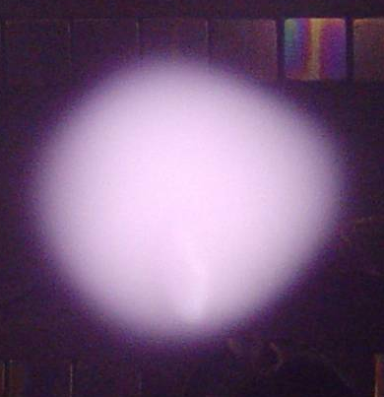


IEPPG
Diagnostics with Cold, Emissive and Heated Probes
Probes for Fusion Plasma
Roman Schrittwieser
with contributions by
Codrina Ionita, Franz Mehlmann, Christian Maszl,
and members of the Risø Laboratory for Sustainable Energy, Denmark,
and the Max-Planck-Institute for Plasma Physics, Greifswald,
and pf the Consorzio RFX, Padua, Italy
Innsbruck Experimental Plasma Physics Group (IEPPG)
Institute for Ion Physics and Applied Physics
University of Innsbruck

Slide 2
Outline
Some historical facts.
Poisson's equation and plasma potential Φ_{pl}.
Short reminder of the ideal theory of cold probes.
Floating potential V_{fl} and plasma potential Φ_{pl}.
Emissive probes.
Emissive probes in small tokamaks (CASTOR & ISTTOK).
Ball-pen probe in CASTOR & ASDEX Upgrade.
Cold probes in ASDEX Upgrade.
Magnetic probes in ASDEX Upgrade.
Most recent developments

Slide 3
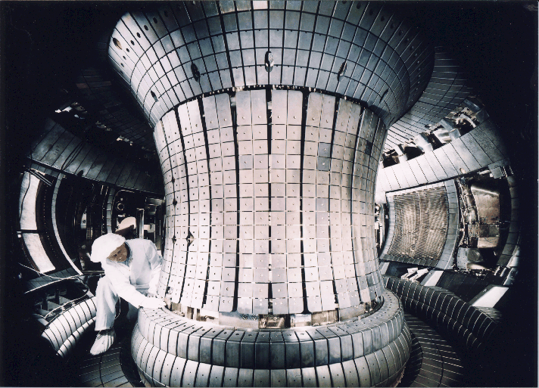
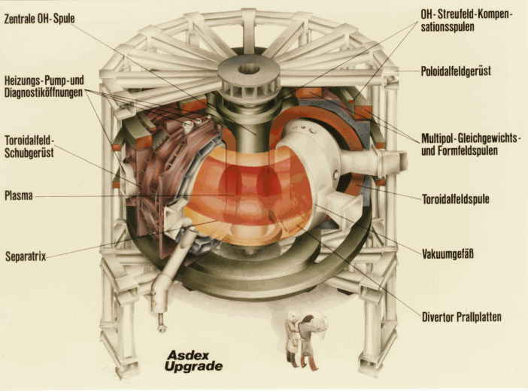
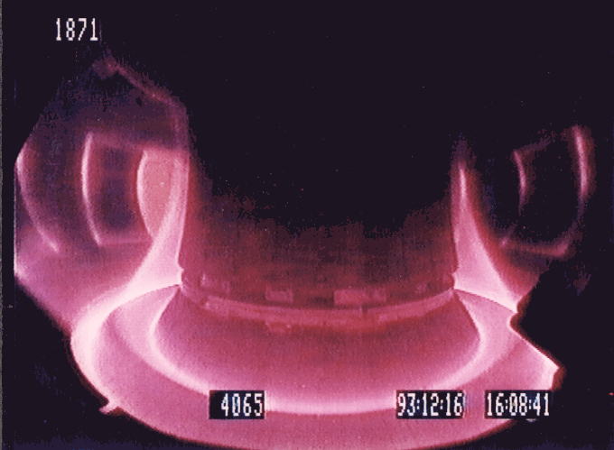
ASDEX Upgrade (AUG)
06/09/2018

Slide 4
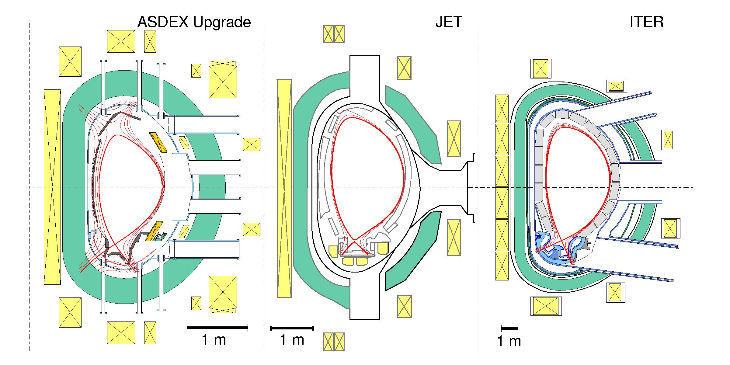
AUG, JET and ITER: a stepladder
R₀
2a
2b
Same current density: 1 MA 4 MA 15 MA
• similar in shape and divertor configuration (linear dimensions scale 1:2:4)
• different in size and therefore in dimensionless parameter r*=r_{gyro}/a

Slide 5
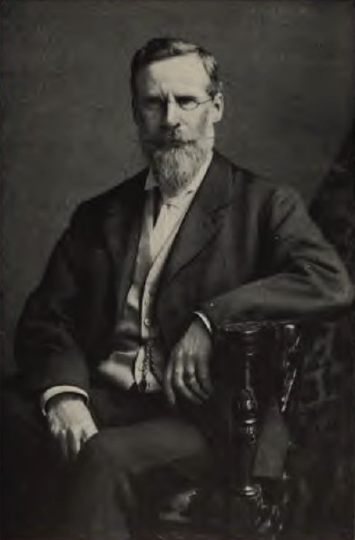
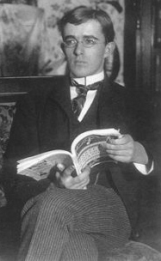
About probes, I
IPPG
A small electrode inserted into the plasma, biased with respect to the reference electrode (usually the electronic ground) and thus also with respect to the unknown plasma potential Φ_{pl}!
It seems plasma probes were already used by Sir William Crookes (1832-1919) in some of the first experiments in ionized gases. He called them the "fourth state of matter". Later the most important pioneer of plasma physics, Irving Langmuir, called ionized gases "plasmas". He also made probe diagnostic of plasmas one of the most powerful means of plasma diagnostic.
See I. Langmuir, "The Collected Works of Irving Langmuir", Pergamon Press, Inc., New York, 1961.
5

Slide 6
About probes, II
Advantages:
Probes are usually simple and easy to be constructed.
Therefore they are also relatively inexpensive.
They can be inserted into exactly the place where we want to measure having good spatial and temporal resolution.
Drawbacks:
Probes are material objects and therefore a certain disturbance of the plasma is inevitable.
In hot plasmas (fusion experiments) probes might be damaged and the sputtered or evaporated material might contaminate the plasma.
Probes produce sheaths around their collectors, and sheaths are among the most complicated phenomena in plasma physics
Therefore an exact probe theory is extremely complicated.

Slide 7
Charge carriers fluxes in a plasma
In case of a conventional Maxwellian plasma (consisting of elec-trons and single-charged positive ions) the flux of electrons is usually much stronger than that of due to the fact that m_{e} << m_{i}:
Even in the case of a quasineutral hydrogen plasma with the lightest possible positive ions (for T_{e} ≅ T_{i}) we obtain:
For heavier ions, and the usual case in a discharge plasma that T_{e} >> T_{i}, the ratio be-comes even larger.

Slide 8
The floating potential of a cold probe, I
The fact that almost always | j_{e} | >> | j_{i} | leads to the effect that any electrode which is inserted into a plasma and which electrically “floats” (i.e. it is not biased by an external power supply with respect to a reference electrode also in contact with the plasma) becomes negatively charged up to a value V_{fl} with respect to the plasma potential Φ_{pl}!

Slide 9
The floating potential of a cold probe, II
From ideal probe theory we obtain the following relation between the plasma and the floating potential:
Keep in mind this equation!
α depends on the ratio between actual electron and ion current to the probe:
A_{pe,pi} are the effective areas for electron and ion collection, respectively.
We have assumed a magnetized plasma and taken into account Bohm's criterion.
In a magnetized plasma A_{pe,pi} can deviate from each other and often A_{pe} < A_{pi}!
In a magnetized hydrogen plasma α ≅ 2 ÷ 4, depending on the magnetic field and the assumptions on A_{pe,pi} .

Slide 10
Plasma potential and
electron temperature
The other way around we can also calculate the plasma potential from this relation, provided we know T_{e}:
Here we point out that if we have a chance to measure Φ_{pl} and V_{fl} at the same position and independently from each other, this formula makes it possible to determine T_{e}:

Slide 11
Idealized cold probe current-voltage characteristic
I_{is}
Φ_{pl}
I_{p}
Plasma
Φ(x)
A
D: V_{p} > Φ_{pl}
B
V_{p}
Approximate sheath edges for
A, B and D
Probe
Schematic probe characteristic
x
C: V_{p} = Φ_{pl}
I_{es}
Potential profiles in front of the probe
(schematically)
B: V_{p} = V_{fl}
C
A: V_{p} << Φ_{pl}
D
Even in an idealized case – in a conventional Maxwellian plasma - the transition between the plasma and the probe is a highly com-plex situation.

Slide 12
Closer look on the cold probe
I-V characteristic
Ion saturation current region
Electron retarding field region
Electron saturation current region
V_{fl}
Φ_{pl}
A
I_{p}
V_{p}
B
From the characteristic Φ_{pl} can be determined by the inflection point
Here we also see well the difference between floating and plasma potential. For V_{p} = V_{fl} we have I_{p} = 0:
C
D

Slide 13
Why are plasma potential Φ_{pl}(x,t) and electric field E(x,t) = -∇ Φ_{pl}(x,t) so important?
The plasma potential controls the general particle transport in a plasma.
Electric field fluctuations control the radial loss of plasma particles across the magnetic field and are therefore essential for the confinement of the plasma.
Theories and numerical simulations of the edge region deliver electric field or plasma potential as most essential parameter.

Slide 14
How can the plasma potential in general be measured?
IEPG
In contrast to the measurement of other plasma parameters the determination of the plasma potential Φ_{pl} is more difficult.
Φ_{pl} can be measured by electron or ion beams, however, these methods are not only intricate but also expensive and do not have a good temporal or spatial resolution.
The simplest, least expensive and most straightforward method with good temporal and spatial resolution is the plasma probe.
However, although in principle we can derive Φ_{pl} from the cur-rent-voltage characteristic of a cold probe by the inflection point, this process either takes time and/or is also not free of errors in non-Maxwellian plasmas.
An additional problem is that the electron temperature can fluctuate during the measurement, and there can be temperature gradients in the region of investigation.

Slide 15
Direct measurements of the plasma potential
The best would be a probe whose floating potential is equal to the plasma potential.
Such a probe could be inserted into the plasma, and by simply measuring its potential with a high input impedance voltmeter we would get the plasma potential without having to use the formula mentioned above (Φ_{pl} = V_{fl,cold} + αT_{e}*) which, moreover, is only valid for a Maxwellian plasma, i.e. a plasma without electron drifts or beams!

Slide 16
What can we do to make the floating potential of a probe identical with the plasma potential?
In principle there are two possibilities:
Either we compensate the plasma electron saturation cur-rent by an equally strong current on the negative side of the characteristic;
this is the principle of the emissive probe.
Or we reduce the plasma electron saturation current, until its magnitude becomes equal to that one of the ion satura-tion current;
this is the principle of the ball-pen probe.

Slide 17
I-V characteristics of probes allowing a direct determination of Φ_{pl} in a magnetized plasma
Emissive probe characteristic
I_{p}
V_{fl}
|dI_{p}/dV_{p}|
Conventional cold probe characteristic
Φ_{pl}
V_{p}
Ball pen probe characteristic
For simplicity, Φ_{pl} is assumed to be zero.

Slide 18
Floating potential of an emissive probe, I
In this case the equation above becomes:
I_{em} is given by the Richardson-Dushman equation:
The other constants are:
A_{p} electron emitting probe surface
A* Richardson constant
T_{w} temperature of the emitting probe material,
W_{w} work function of the emitting probe material.

Slide 19
Floating potential of an emissive probe, II
α_{em} = ln[(I_{es}/(I_{is}+I_{em})] is also the difference Δ_{em} between plasma potential and floating potential with and without electron emission normalized to the kinetic electron temperature:
And if we achieve this, then indeed we can reach the condition that:
Thus, when the emission current (plus the usually negligible ion saturation current) just compensate the electron saturation current, the floating potential of an emissive probe equals the plasma potential.

Slide 20
Difference between plasma and floating potential of an emissive probe
Theoretical dependence of V_{fl,em} for increasing electron emission; Δ_{em} difference between V_{fl,em} and Φ_{pl}, normalised to T_{e}*: (a) Δ_{em} versus emissive current density j_{em} normalised to electron current density j_{es}. (b) Δ_{em} versus actual temperature of a heated tungsten wire T_{w}.

Slide 21
Construction of an emissive probe and fluxes around it
Inside the bores the tungsten wire is spliced with thin copper threads to in-crease the conductivity. This guarantees that only the probe loop is glowing when a current is passed through.
Particle fluxes
Two-bore ceramic tube of Al₂O₃ or BN.
Plasma ions
Plasma electrons
Emitted electrons
Plasma ions
Plasma electrons
Electrical connection to external power supply
Loop of tungsten or thoriated tungsten wire, 0.2 mm diameter
Emitted electrons
Electric currents

Slide 22
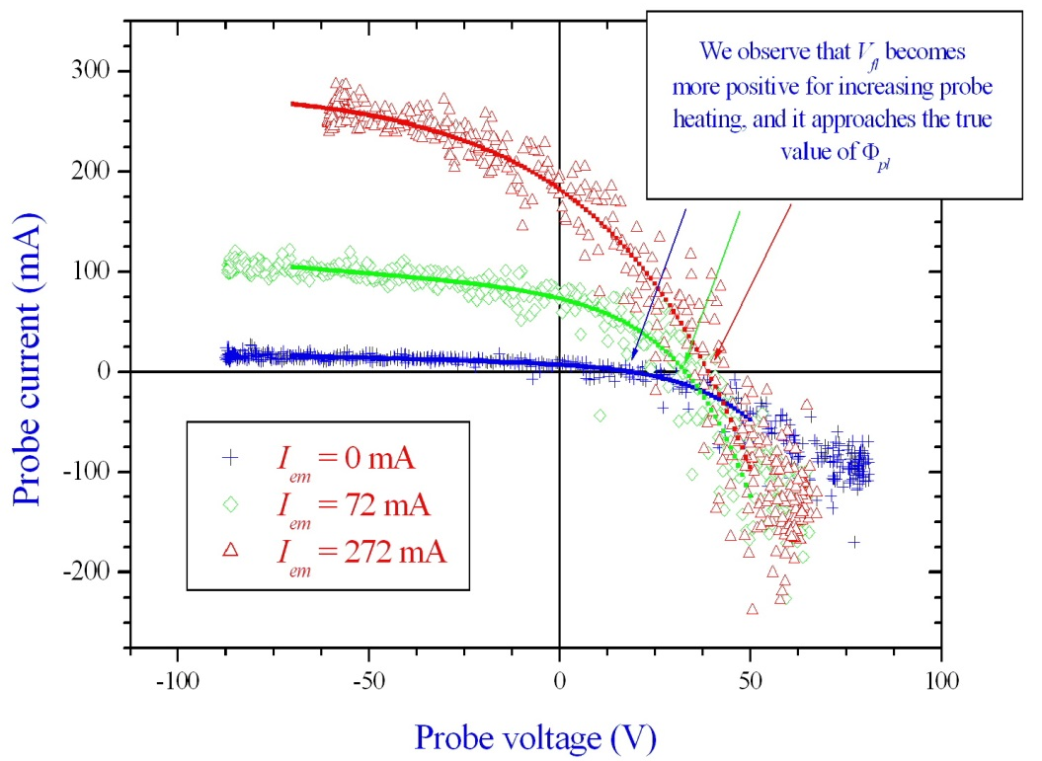
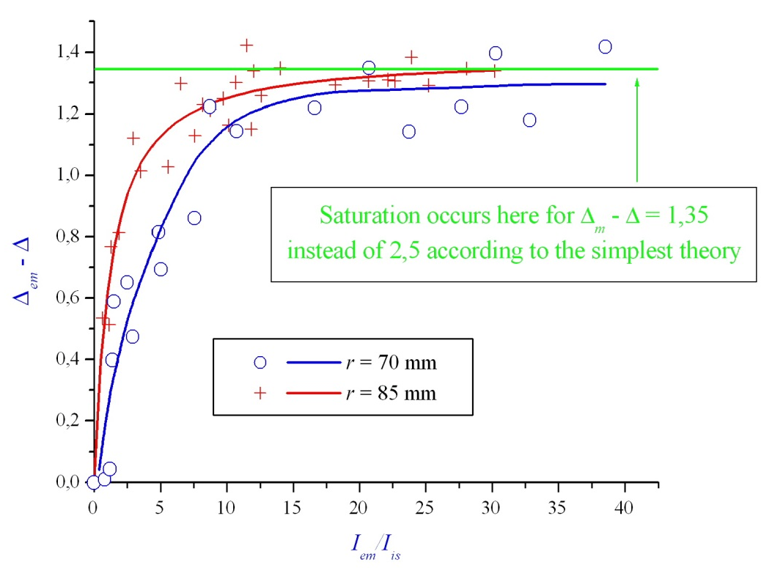
Typical probe characteristics from CASTOR tokamak, Prague
Current-voltage characteristic with increasing wire heating
Floating potential with increasing wire heating
Our experiments in CASTOR have at least qualitatively confirmed the theo-retically prescribed behaviour of an emissive probe!

Slide 23
Emissive probes in reality I
In reality, however, often there remains a more or less great dif-ference between Φ_{pl} and V_{fl,h}, i.e.
This seems to be due to space charge effects by the cold emitted electrons and depends mainly on T_{e}:
This will not be further discussed here, but this question is still open for discussion since there are contradicting results.
See e.g.: A. Marek, M. Jilek, I. Pickova, P. Kudrna, M. Tichy, R. Schrittwieser, C. Ionita, Contrib. Plasma Phys. 48 (5-7) (2008), at press.

Slide 24
Emissive probes in reality II
In our cases of small tokamak experiments T_{e} ≅ 15 eV, and α_{h} thus not zero but α_{h} ≅ 1,15.
However, what matters is that:
This means that the floating potential of an emissive probe de-livers always a better approach to the plasma potential than that of a cold probe and the dependency on T_{e} is reduced! This is espe-cially true when fluctuations of T_{e} have to be taken into account.

Slide 25
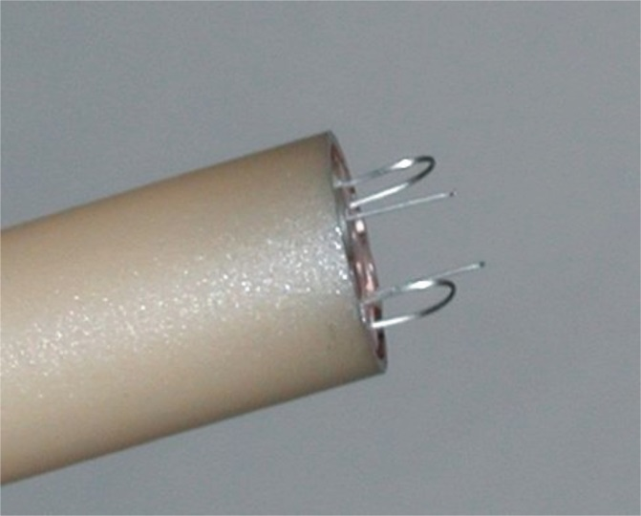
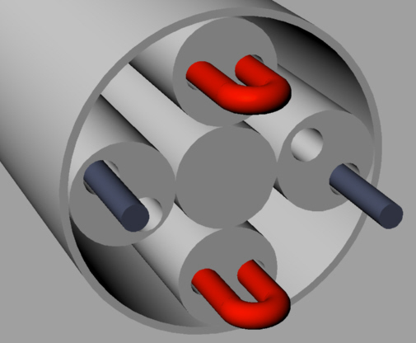
Arrangements with emissive and cold probes I
In CASTOR tokamak, Prague:
Poloidal spacing between the two emissive probes is 5,4 mm, toroidal spacing between the two cold probes is 5,6 mm. With this set-up E_{ϑ} and n_{pl} can be measured simultaneously.

Slide 26
Arrangements with emissive and cold probes II
In ISTTOK, Lisbon:
3
d₂₃ = 3,8
3,4
2
1
2,4
d₁₂ = 3,0
Poloidal
Poloidal
Toroidal
Radial
Three emissive probes and one cold probe of 0,2 mm W-wires for measuring E_{r}, E_{θ} and n_{pl} simultaneously:
Φ_{pl,1,2,3} is determined with the heated probes at three different positions.
From that we can calculate E_{r} and E_{ϑ}:

Slide 27
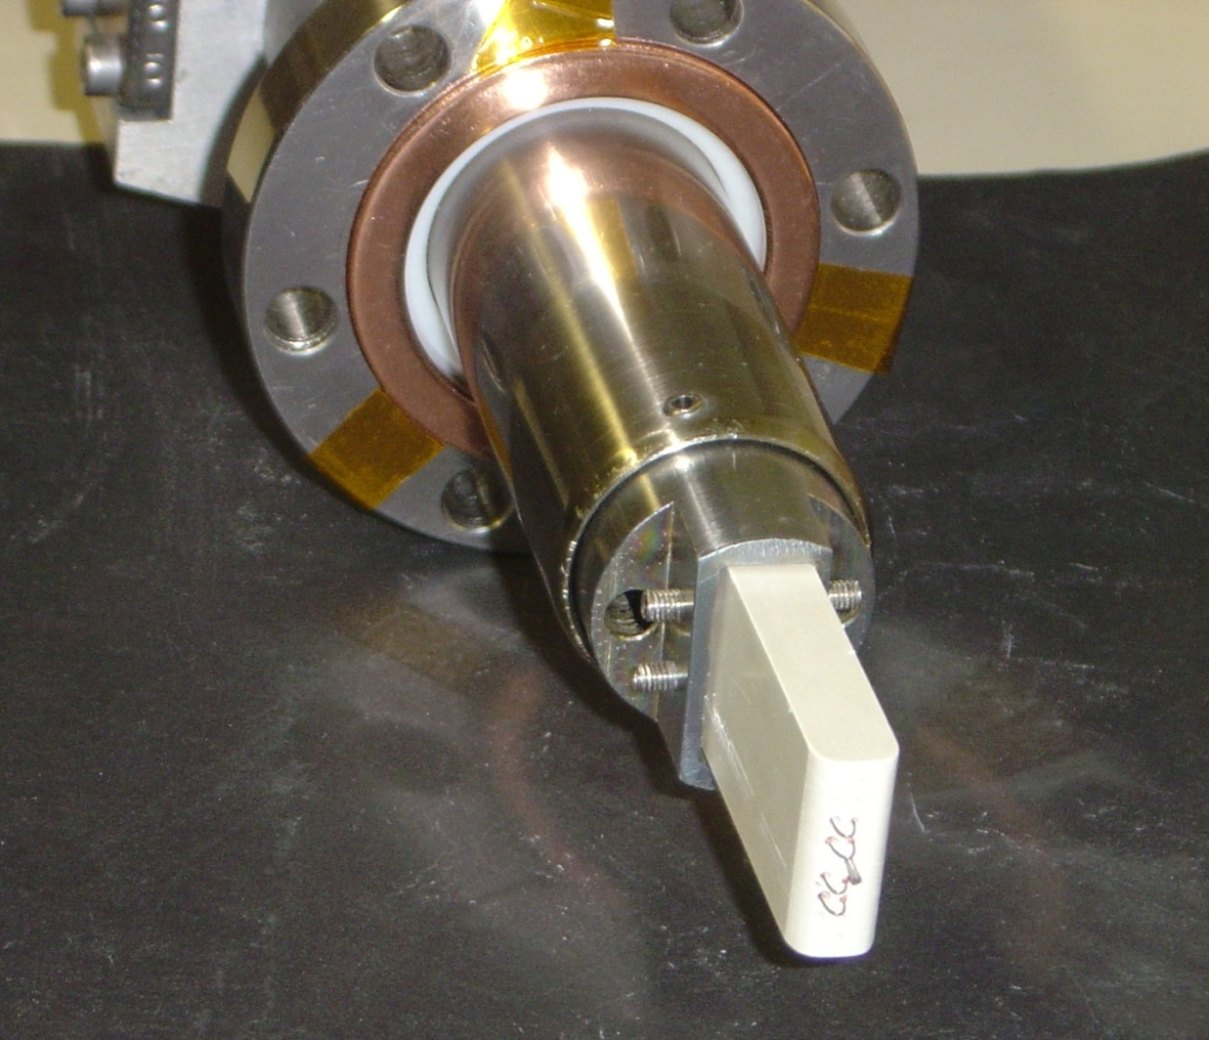
Arrangements with emissive and cold probes II
In ISTTOK, Lisbon:
A combination of four emissive probes and one cold probe. The probe head is inserted perpendicularly, thus in poloidal direction, to measure the poloidal electric field and its fluc-tuations. The additional cold probe allows it to measure also the ion den-sity.

Slide 28
Measurements in ISTTOK I
Determination of the electron temperature from the difference between plasma potential and floating potential:
Comparison between T_{e} deter-mined in the usual way from the I-V characteristic of a cold probe and once from the formula of before:

Slide 29
Measurements in ISTTOK II
(a) Comparison between plasma potential Φ_{pl} measured with an emissive probe and the floating potential V_{fl,c}; (b) standard deviation of both quantities:
While the deviation between Φ_{pl} and V_{fl,c} in (a) is obviously due to T_{e}, the deviation between the standard deviations, especially inside the LCFS, must be due to fluctua-tions of T_{e}.

Slide 30
Measurements in ISTTOK III
(a) Power spectrum of the poloidal electric field fluctuations measured with CPs (blue dashed line) and EPs (red solid line; (b) time averaged cross coherency spectrum of the poloidal electric field and the density fluctuations, measured at r – a = –8 mm inside the scrape-off layer (SOL)
A clearly enhanced coherence is observed in the low frequency range when the emissive probe data are considered, suggesting a good correlation between density and temperature gradient fluctuations.

Slide 31
Measurements in ISTTOK IV
Radial profile of the turbulent flux measured with the cold probes (dashed line – blue dots) and the emissive probes (solid line – red dots).
As a consequence of the higher power density of the E_{θ} fluctuations and the increase of the correlation between the fluctuations of n and E_{θ}, the particle flux measured with the emissive probes is significantly larger than that measured with cold probes.

Slide 32
Ball-pen probe I
Katsumata-type probes for direct measurements of the plasma potential
The principle of the Katsumata probe:
Strong difference be-tween the gyro-radii of ions and electrons ⇒ latter can be screened off from the collector, while the ions can reach it.
Shifting collector up and down (i.e. for varying h) ⇒ perpen-dicular ion energy distribution can be scanned.
Ions
B
Electrons
h
Metallic or ceramic
screening tube
Collector
*I. Katsumata and M. Okazaki, JJAP 6 (1967), 123; I. Katsumata, CPP. 36 (1996), 73.

Slide 33
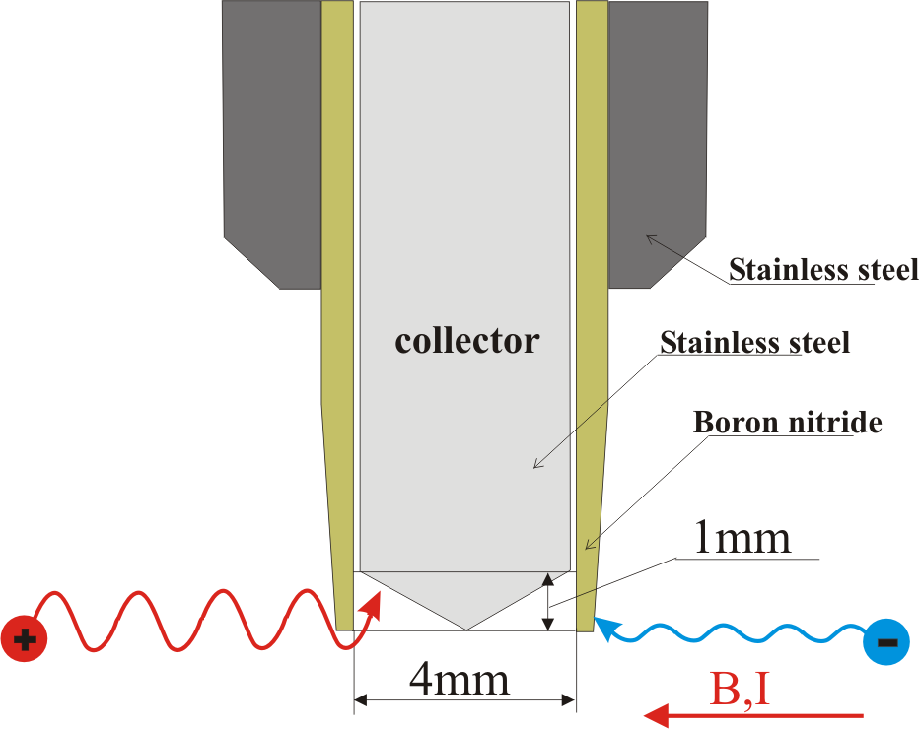
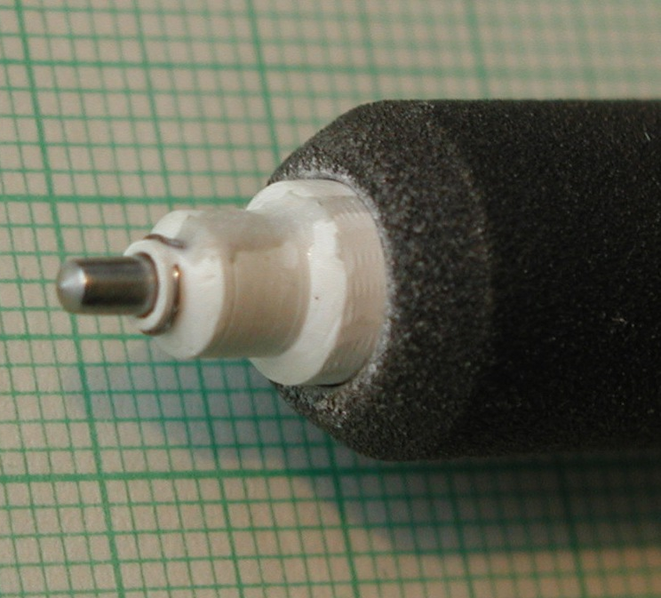
Ball-pen probe II
plasma sprayed corundum
boron nitride tube
Additional Langmuir probe
stainless steel collector
Additional Langmuir probe
h

Slide 34
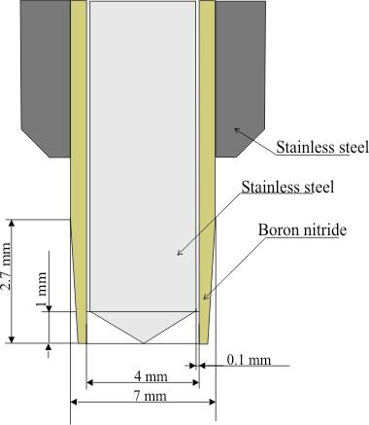
Ball-pen probe III
The collector can be moved 1 mm outward and 5 mm inward the tunnel.
The Larmor radius for ions and electrons is for T_{e} = T_{i} = 10 eV and B = 1 T approximately
r_{i} = 0.46 mm and r_{e} = 0.01 mm.
B,I
34

Slide 35
Basic equations for the ball-pen probe
Langmuir probe in a Maxwellian plasma :
where
The ratio of collecting areas A_{e}, A_{i} is given by

Slide 36
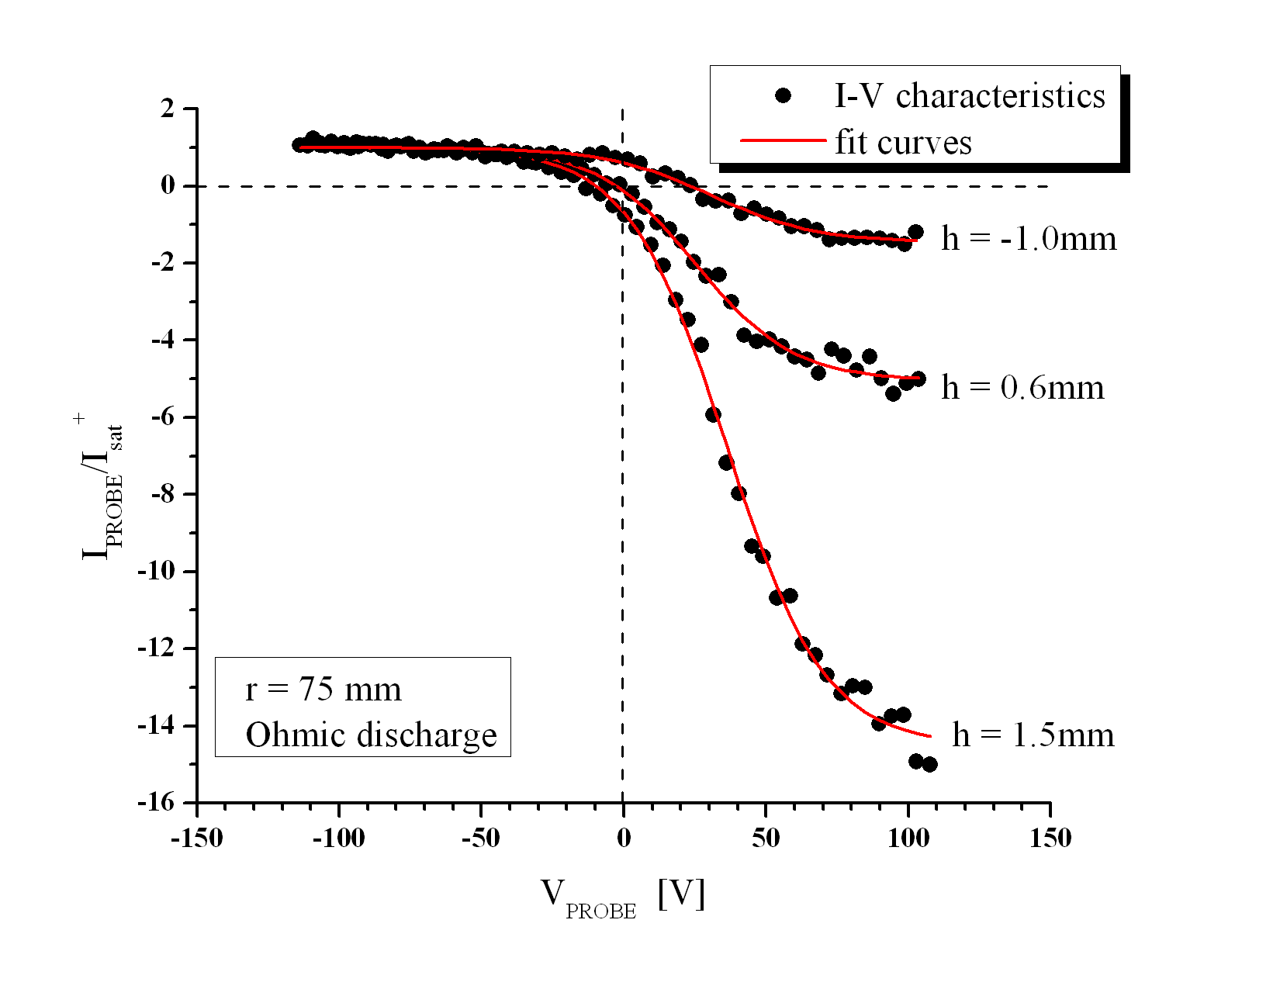
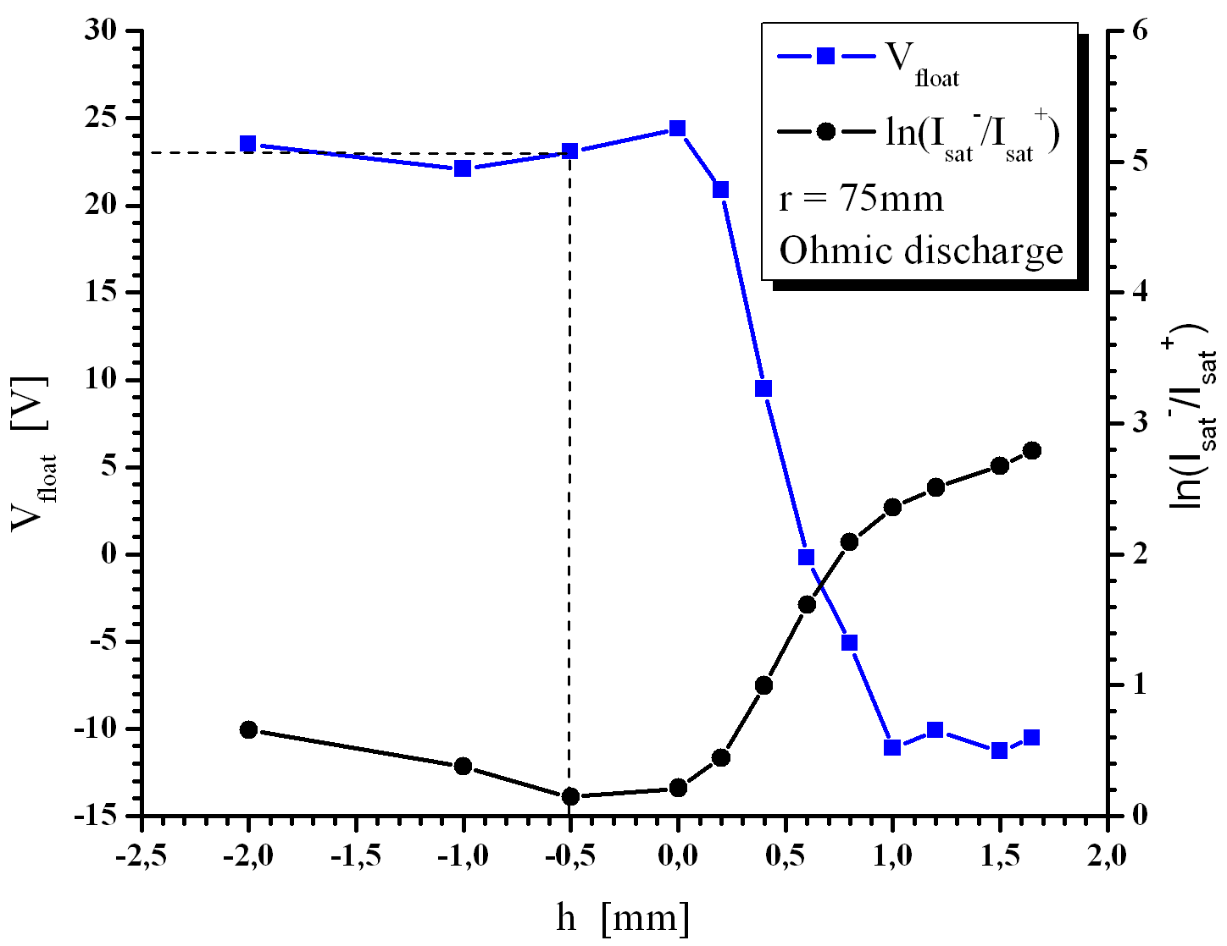
Some measurements with the ball-pen probe
(a) (b)
(a) I-V characteristics for various collector positions. is negative when the collector is inside the shielding tube; (b) floating potential Vfl (blue squares) and ln(Ies/Iis) (black dots) with respect to h. The radial position of the probe head is at r = 75 mm inside the edge region of CASTOR.

Slide 37
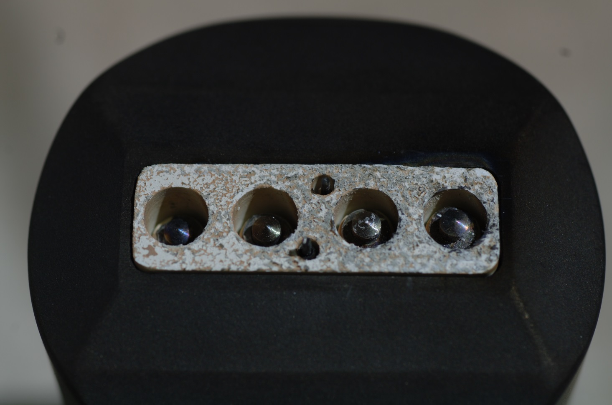
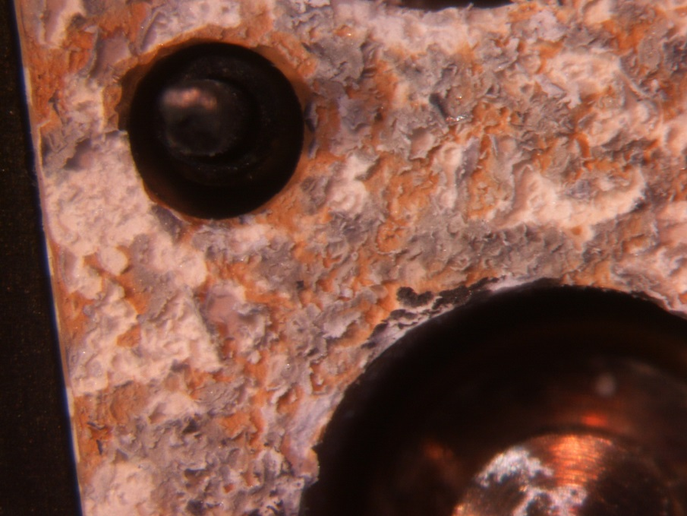
Ball-pen probes after measurements
Boron nitride surface has been exposed to high energy radiation.

Slide 38
Modification of the Ball-pen probe
boron nitride
boron nitride
carbon shield
BPP collector
carbon shield
BPP collector
previous
new

Slide 39
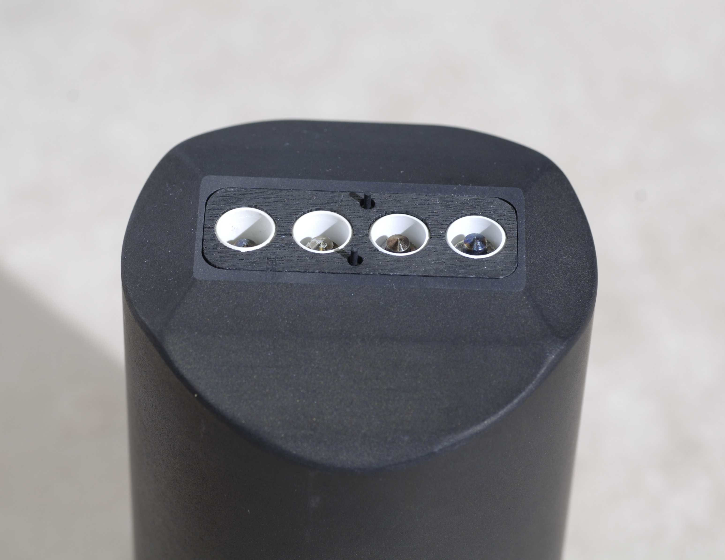
Ball-pen probes for ASDEX Upgrade
(upgraded version)
BPP2
h = -2 mm
BPP1
h = -1 mm
LP1
BPP3
h = -3 mm
BPP0
h = -0.5 mm
LP2
B
carbon shield

Slide 40
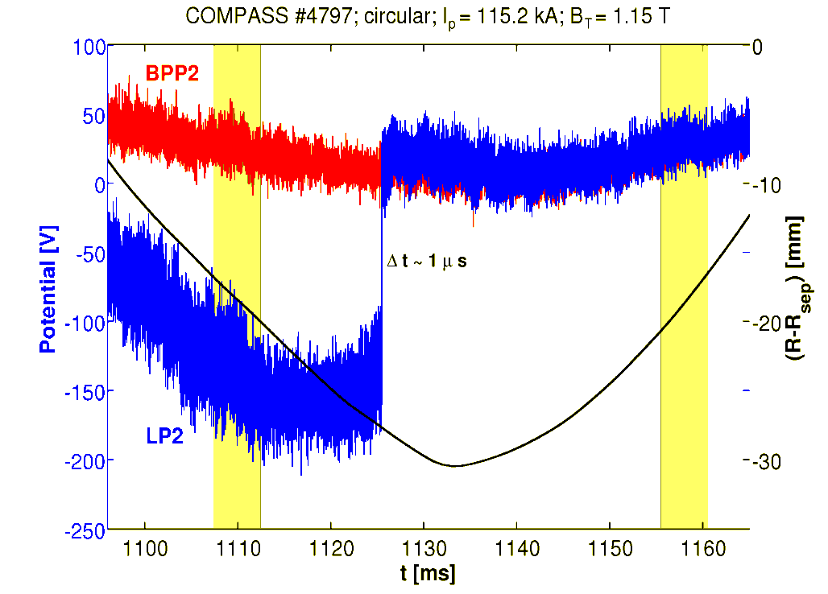
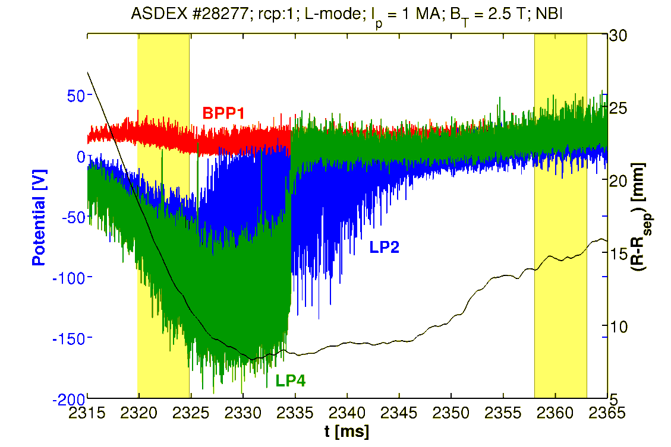
Ball-pen probes in COMPASS and AUG
Langmuir probes become emissive in COMPASS and ASDEX Upgrade
LP1
LP2
B
Temporal evolution of the BPP2 (red) and LP2 (blue) potential during the probe head reciprocation. The transition from the cold to the self-emitting LP2 starts at t = 1120ms. It is radially 25 mm inside the separatrix.
Temporal evolution of the BPP1 (red), LP2 (blue) and LP4 (green) potential during the probe head reciprocation.
carbon shield
The fact that a normally cold probe pin can be heated so strongly that it becomes emis-sive and that its floating potential becomes approximately equal to that of a ball-pen probe is very important and helpful!

Slide 41
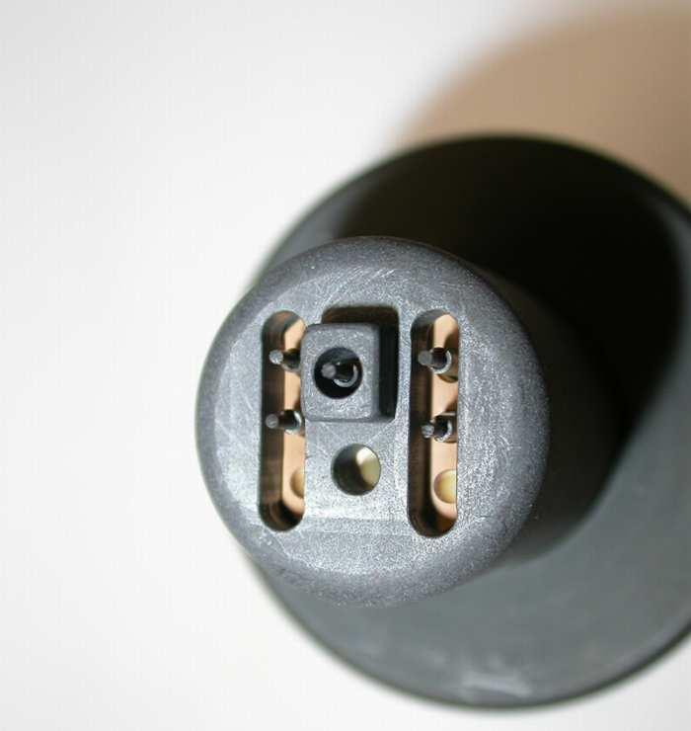
Probe head for ASDEX Upgrade, I
Probe head for ASDEX Upgrade:
B_{t}
I_{is_ur}: negatively biased
V_{fl_ul}: floating
V_{fl_ll}: floating
V_{fl_m}: floating
Swept: I-V characteristic
B_{r}
I_{p}
I_{is_ur}
V_{fl_ul}
≅ 40 mm
B_{ϑ}
V_{fl_ll}
V_{fl_m}
swept
From the swept probe: T_{e}
2 MHz Sampling Frequency
41

Slide 42
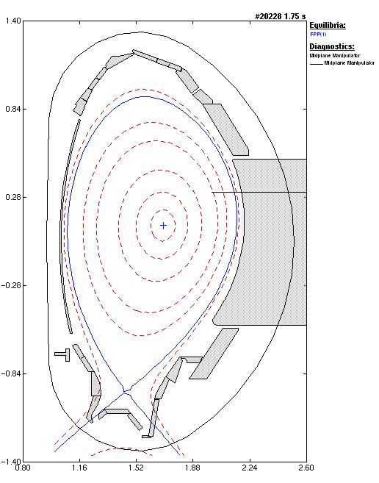
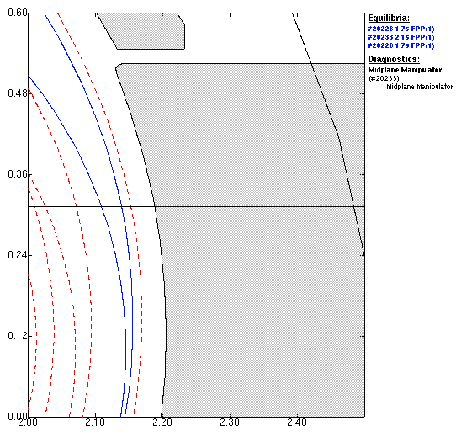
Probe head for ASDEX Upgrade, II
This probe head is mounted on the midplane manipulator and inserted up to three times during an average AUG shot of 7 s length:
Experimental arrangement
Distances between probe head and separatrix:
Penetration of the probe into the scrape-off layer (SOL)
Midplane manipulator
l_{lim}
(for shot #20233)
LCFS, with l_{min} being the distance of the probe head from it, in case of:
H-mode shot #20228, l_{min} = 44 mm
L-mode shots #20233, l_{min} = 79 mm
Radial position of the probe head with respect to the rest position:

Slide 43
Measurements in ASDEX Upgrade, I
We remember:
B_{t}
B_{r}
I_{p}
I_{is_ur}
V_{fl_ul}
From the swept probe: T_{e}
B_{ϑ}
V_{fl_ll}
With the help of these quantities, the radial fluctuation-induced particle flux and the Reynolds stress can be derived:
V_{fl_m}
swept

Slide 44
Measurements in ASDEX Upgrade, II
The radial fluctuation-induced particle flux Γ_{r} with the velocity v_{r} , induced by edge fluctuations, is mainly due to an E×B drift in the radial direction. A radial E×B drift can only be caused by an electric field in the poloidal direction, E_{θ}, respectively by its fluctuations.
The Reynolds stress Re is a measure of the anisotropy of the turbulent velocity fluctuations, which produce a stress on the mean flow. This may cause a poloidal flow. If Re has a radial gradient a sheared poloidal flow results. This tends to quench the radial flow since a sheared poloidal flow can tear apart larger eddies at the edge that would cause a strong radial particle transport.
The radial flux of poloidal momentum M_{r} is also due to the radial loss of plasma and energy. For various reasons the plasma torus shows rotation in toroidal and therewith also in poloidal direction. In H-mode the toroidal rotation is mainly due to neutral beam injection (NBI).

Slide 45
Measurements in ASDEX Upgrade, III
Comparison of the flux in L-mode and ELMy H-mode :
Temporal evolution of turbulent flux during the times indicated:
Large type-I ELM events during H-mode shot #20228 (a).
L-mode shots #20233 and #20234 do not show such large events (b,c).
The inter-ELM intervals (a) show very small transport compared to the ELMs and even less than during L-mode.

Slide 46
Measurements in ASDEX Upgrade, IV
Integrated flux in L-mode and ELMy H-mode during ELMs and in between ELMs:
Integrated fluctuation-induced flux (fluence) with linear fits of the slopes for the L-mode shots (red and blue) and during the H-mode shot (black).
The H-Mode shows large events (ELMs) during which the inte-grated flux increases in large steps, whereas the L-mode has no such steps, but shows more transport than during the inter-ELM intervals, which are very quiet.
Shot number, evaluated interval | ⟨Γ_{r}⟩ (m^{–2}s^{–1})
#20228, entire H-mode | 3,7×10¹⁹
#20228 H-mode, ELM intervals | 5,6×10²⁰
#20228 H-mode, inter-ELM intervals | 3,2×10¹⁸
#20233 L-mode | 1,6×10¹⁹
#20234 L-mode | 9,1×10¹⁸
Gradients of the linear fits are showing the average fluxes:

Slide 47
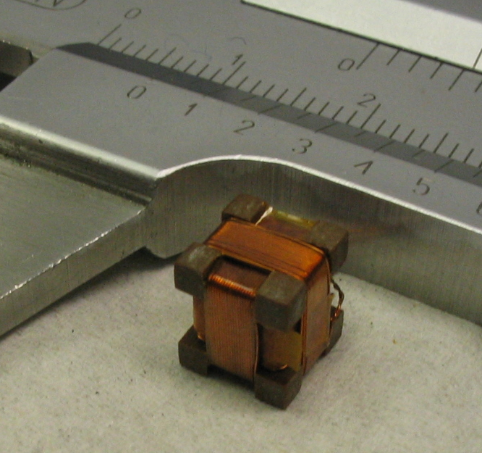
New probe head for electric and magnetic signals in AUG, I
Six Langmuir probes and one magnetic triple sensor.
The magnetic triple pick-up coil is sensitive to magnetic field fluctuations b_{r}, b_{φ}, b_{θ}, in radial, toroidal and poloidal direction.
Toroidal direction
Plasma current
Electron current
Triple magnetic pick-up coil
1
2
3
4
5
6

Slide 48
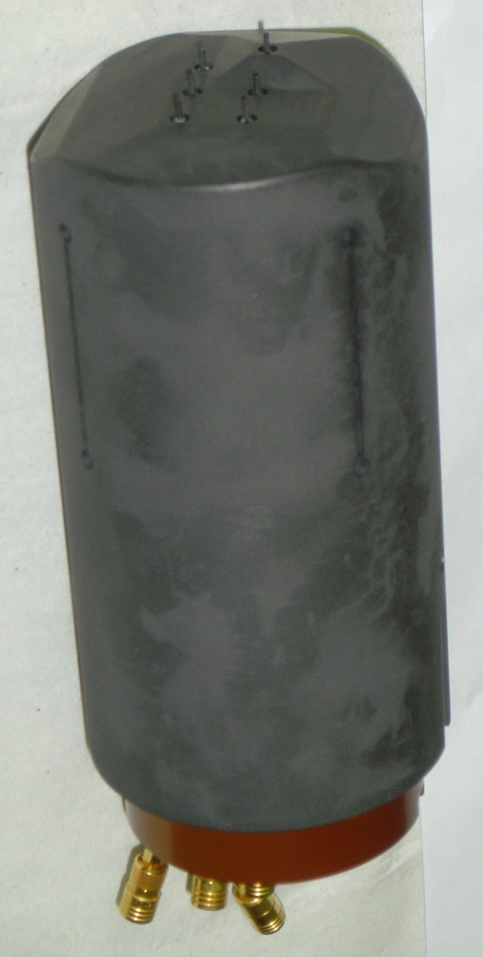
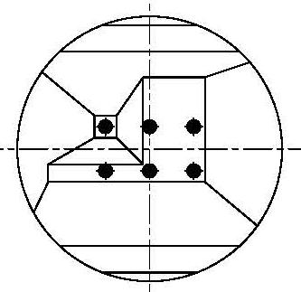
New probe head for electric and magnetic signals in AUG, II
Probe 1: floating, radially protruding by
3 mm, V_{fl,1}
Probe 2: floating, V_{fl,2}
Probe 3: floating, V_{fl,3}
Probe 4: negatively biased, I_{is,4}
Probe 5: swept, T_{e}
Probe 6: floating, V_{fl,6}
Probe head mounted on the midplane manipulator of AUG
Poloidal direction
Front view of the probe head
(as seen from the plasma):
1
2 3
10 mm
4 5
6
B_{total}
10 mm
10 mm

Slide 49
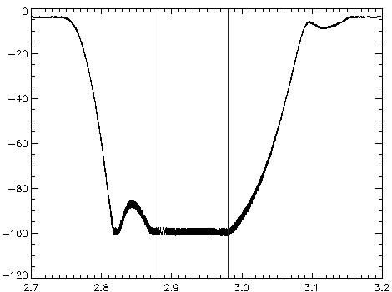
New probe head for ASDEX Upgrade, III
This probe head is mounted on the midplane manipulator and inserted up to three times during an average AUG shot of 7 s length:
Experimental arrangement
Distances between probe head and separatrix:
Penetration of the probe into the scrape-off layer (SOL)
Limiter shadow
SOL
Last closed flux surface during a typical H-mode shot; probe head is about 5 cm in front of the LCFS.
Same for a L-mode shot: 8 cm
Radial position of the probe head with respect to the rest position:

Slide 50
Measurements of electric signals in AUG
This probe arrangement allows the determination of poloidal and radial electric field and plasma density (d₃₆ = 10 mm, d₁₂ = 3 mm):
Of course, here we have to assume that the electron temperature is the same on all probe pin positions.
From these results, radial particle transport Γ_{r} , Reynolds stress Re and radial flux of poloidal momentum M_{r} can be derived:
With n and v_{r,θ} being defined as X = X₀ + X_{fl}, the momentum flux splits up into four contributions:
The first term of M_{r} contains the Reynolds stress and the second one is the convective momentum flux containing the radial particle flux. The third term is composed of only fluctuating quantities. The fourth term of M_{r} does not contribute on average, because if the average is taken over the entire time, we see that ⟨n₀v_{r,fl}v_{θ,0}⟩ = n₀v_{θ,0}⟨v_{r,fl}⟩ = 0.

Slide 51
Flux measurements during type-I ELMs, I
Sequence of type-I ELMs:
Temporal evolution during the entire probe insertion:
(a) of the instantaneous radial turbulent flux (red) and its integral (blue) showing typical type-I ELMs,
(b) ion saturation current to probe 4 during the same interval.
The slope of the blue line shows the strong difference between the trans-port during ELM intervals (strong particle loss) and inter-ELM intervals (good confinement).
The two green arrows indicate the detail shown in the next transparency.

Slide 52
Flux measurements during
type-I ELMs, II
Fine structure of one ELM:
Detail of temporal evaluation during the interval indicated by two green arrows above, i.e., transport during one ELM.
We see the fine structure of one type-I ELM: Each of the small step corre-sponds to a current filament [ii,iii].
We observe also negative (= inward) transport, in particular after strong positive transport events.
[ii] M. Endler, I. Garcìa-Cortès, C. Hidalgo, G.F. Matthews, ASDEX Team, JET Team, Plasma Phys. Control. Fusion 47, 219 (2005).
[iii] A. Kirk, N. Ben Ayed, G. Counsell, B. Dudson, T. Eich, A, Herrmann, B. Koch, R. Martin, A. Meakins, S. Saarelma, R. Scannell, S. Tallents, M. Walsh, H.R Wilson, MAST Team, Plasma Phys. Contr. Fusion 48, B433 (2006).

Slide 53
Measurements of radial flux of poloidal momentum in AUG, I
From these results, radial particle transport Γ_{r} , Reynolds stress Re and radial flux of poloidal momentum M_{r} can be derived:
With n and v_{r,θ} being defined as X = X₀ + X_{fl}, the momentum flux splits up into three relevant contributions:
The first term of M_{r} contains the Reynolds stress and the second one is the con-vective momentum flux containing the radial particle flux. The third term is composed of only fluctuating quantities. Thus it is called triple fluctuating product.

Slide 54
Measurements of radial flux of poloidal momentum in L- and H-mode in AUG, I
(a) (b)
Total momentum is shown as black line, the other lines show the parameters listed; (a) during L-mode discharge #23157, (b) during H-mode #23163; the red and blue vertical lines delimit the time interval of the single blob and ELM, respectively, shown in the figures below.
The integrated flux (fluence) of momentum shows a stepwise increase during the H-mode and a continuous decrease during the L-Mode. The steps in the H-mode correspond to ELMs. The fluxes in H-mode and L-mode have different signs on average. Here positive sign means outward transport of positive poloidal momentum, whereas negative sign means outward transport of negative poloidal momentum.

Slide 55
Measurements of radial flux of poloidal momentum in L- and H-mode in AUG, II
Close-up, I
(a) (b)
Instantaneous (a) and integrated (b) momentum flux (fluence) during the ELM time interval delimited by the red and blue vertical line in the previous figure; total momentum (black line), the other lines show the parameters listed. The red and blue vertical lines delimit the time interval of the single ELM filament shown in the figure (a) below.
In the close-up of one ELM the filamentary structure is visible. In the very big event at t ≈ 3,0103 s the nonlinear component (v_{θ,fl} v_{r,fl} n_{fl} - red line) is nearly twice as big as the convective component (v_{θ,0}Γ_{r} – green line).

Slide 56
Measurements of radial flux of poloidal momentum in L- and H-mode in AUG, III
Close-up, II
(a) (b)
Close up of the transport events shown in the previous figures by the red and blue lines. Total momentum (black line), the other lines show the parameters listed; (a) one filament during an ELM, (b) during blob events in the L-mode.
In the close-up on one ELM filament in H-mode and one blob event during L-mode the dominating components of the flux (v_{θ,0}Γ_{r} and v_{θ,fl}v_{r,fl}n_{fl} for H-mode, v_{θ,0}Γ_{r} and Re for L-Mode) are shown. The flux components do not always have the same sign. This is also seen in simulations.

Slide 57
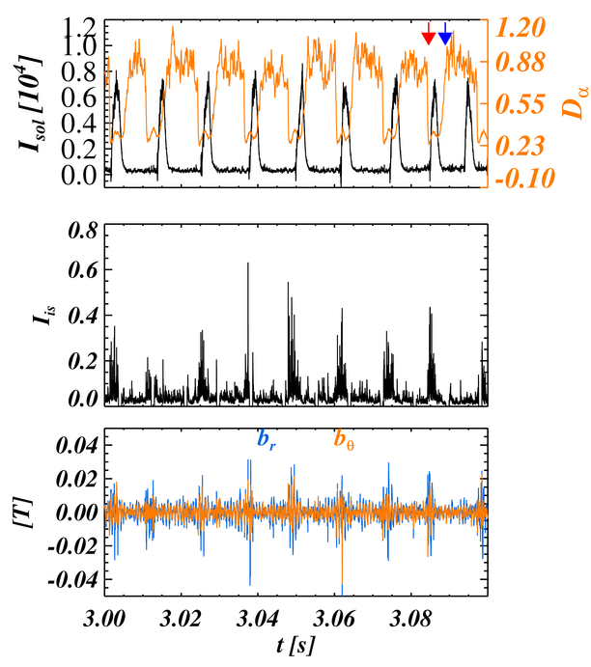
Magnetic measurements during
type-I ELMs, I
Raw magnetic signals of shot #23161:
Temporal evolution of:
Current in the SOL (black) and D_{α}-line intensity at the inner di-vertor (orange).
The red and blue arrow in show the time intervals for the hodograms in the respective colors in the next transparency.
Ion saturation current.
Magnetic signals b_{r} and b_{θ} from the radial and poloidal sensor coils, respectively.

Slide 58
Magnetic measurements during type-I ELMs, II
Hodograms of shot #23161:
Hodograms of the poloidal and radial magnetic sig-nals, b_{θ} and b_{r} for the time intervals shown by the arrows in the respective colors in the figure above:
Red line during an ELM interval (in the timeframe of I_{is}).
Blue line during an
inter-ELM interval.

Slide 59
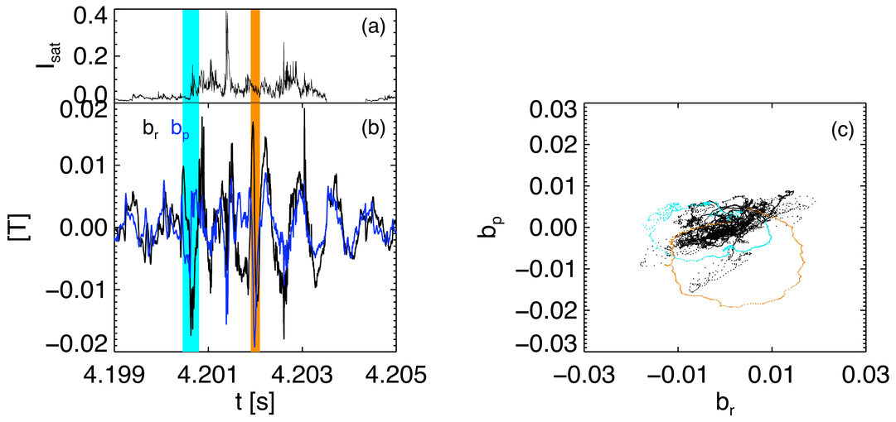
Magnetic measurements during type-I ELMs, III
(a)Temporal evolution of I_{sat} (black line).
(b) Temporal evolution of b_{r} (black line) and b_{θ}=b_{p} (blue line) Blue and orange bars show time inter-vals for the hodograms in (c).
A phase jump of π/2 occurs in the blue and orange intervals
(c) Due to phase jumps in the blue and orange intervals in (b), we obtain closed loop hodograms (in corresponding colours), which are indications of current filaments aligned mainly in toroidal direction. The black curve shows the hodogram of the inter-ELM time intervals of (b), yielding a complex pattern in between ELMs without closed loop.

Slide 60
Characterisation of the spectral properties of magnetic field fluctuations
We assume that the ELMs' magnetic fluctuations are mainly generated by parallel currents carried by ELM filaments, and are clearly distinguished from general MHD activity due to propagating waves taking place in the inter-ELM intervals.
To check this ansatz we apply the Degree of Polarization (DOP) analysis. We suppose the presence of a single plane wave at frequency ω. Then the wave vector k has to satisfy:
The DOP is based on the evaluation and diagonalization of the spectral matrix S = ⟨B_{j}B_{k}⟩, calculated in Fourier space using Fast Fourier Transform with Hanning windowing.
Defining λ_{1,2,3} as the eigenvalues of this set of equations the DOP is defined as:
For a pure undulatory state the polarisation P = 1. We have a plane wave for P ≥ 0.8, whereas for P ≤ 0.8 the fluctuations are better represented by coherent structures passing by the measuring point; these structures are our ELMs.

Slide 61
Degree of Polarisation of magnetic field fluctuations
Spectrogram of DOP
Within the I_{sat} reference frame, during inter-ELM intervals DOP > 0,8 ⇒ plasma waves (MHD activity) (dark blue and black ranges).
During ELM intervals DOP < 0,8 ⇒ strongly localized coherent structures interpreted as current carrying filaments (green and red ranges).

Slide 62
Minimum variance analysis
The minimum variance analysis [D. R. Weimer, J. Geophys. Res., 108, 12 (2003)] has been introduced in order to determine the direction normal to an approximately one-dimen-sional current layer from single point measurements of the three components of the ma-gnetic field vector. The method is based on the solution of the eigenvalue problem
, where
is the magnetic variance matrix.
The brackets indicate the mean values averaged over the time the structure spends travelling in front of the probe.
μ, ν = 1,2,3 denote the Cartesian components of x, y and z of the chosen system,
λ and n are the eigenvalues and eigenvectors of the system, respectively.
The eigenvectors corresponding to the eigenvalues λ₁, λ₂ and λ₃, represent the direction of maximum, intermediate and minimum variance of the magnetic field respectively.
The eigenvector corresponding to the minimum eigenvalues corresponds to the direction of minimum variance and is normal to the plane spanned by the magnetic field perturbations.

Slide 63
3-D hodogram and current filament
3-D trajectory of all 3 component of B-field fluctuations spans a well defined surface with a much smaller fluctuation in the parallel direction. The closed elliptical loop lies in a plane slightly tilted with respect to the local frame of reference.
The direction normal to the plane of the ellipse can be determined by using the minimum variance analysis (black line). This direction coincides well with the direction of B_{total} (blue line).

Slide 64
Reconstructed current filaments
A 2-D reconstruction in the reconstructed maximum variance plane shows that the magnetic fluctuations are generated by a monopolar current distribution (red line = elliptical fit). This is also supported by the fact that the loop lies practically only in two quadrants of the plane. A bipolar loop would span over three quadrants.
Simulation of a monopolar current filament (red ellipse) and bipolar one (blue cardioid-like shape with a cusp at the origin).

Slide 65
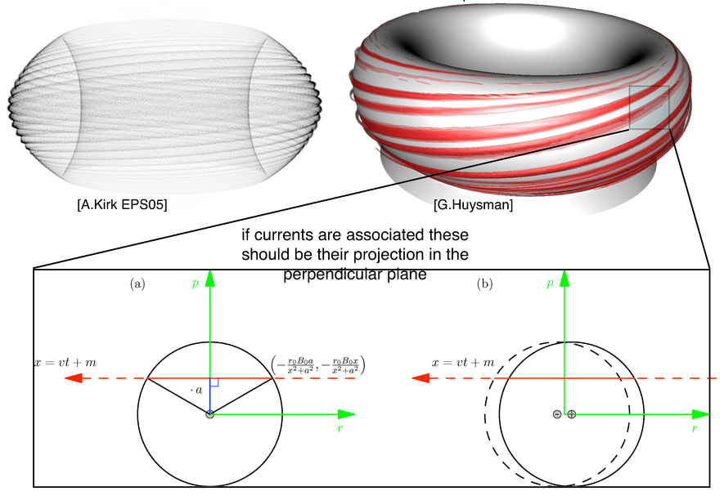
Density filaments – current filaments
An ELM is a densi-ty filament pro-duced by a peel-ing-ballooning perturbation in the SOL.
If currents are associated to these density filaments, there projection in the perpendicular plane should look like that:
(a) in case of a monopolar current filament,
(b) in case of a bipolar current filament

Slide 66
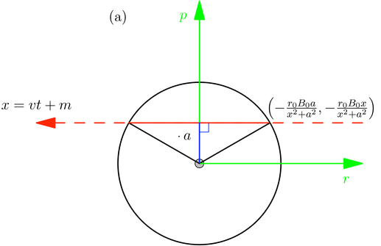
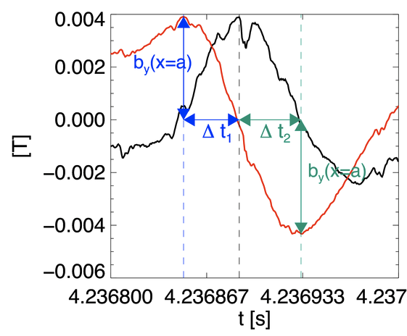

Calculating the current in a filament, I
Schematic of a monopolar filament moving towards the probe with an assumed velocity v_{x} = 1 km/s mainly in radial direction x but in reality with also a poloidal component
Real signals during an ELM filament corrected for the maximum-inter-mediate variance plane
a is the distance of closest approach of the filament to the probe, which can be estimated for constant v_{x}: a = Δt v_{x}
Δt is the time delay between the maximum of b_{x} and the maximum/minimum of b_{y} ,
These are indeed the expected signals for the two components of b during such an event.

Slide 67
Calculating the current in a filament, II
Assuming a monopolar filament flowing with velocity v_{x}, the current can be estimated noting that:
and
with
Consequently
Based on these assumptions we obtain a current I₀ = 1,7 kA. With 1 cm radius of the filament this corresponds to a current density up to 6 MA/m².

Slide 68
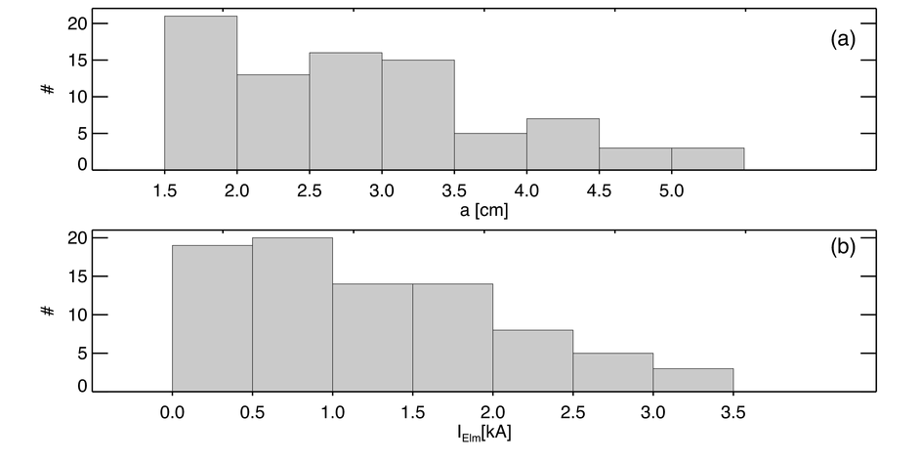
Statistics of the current filaments
Statistics on 4 shots with similar characteristics reveal that all the observed current filaments are in the SOL and that the bulk of the current is below 1 kA.
The distance of the filament from the probe is a few cm.
N. Vianello et al., "Direct observation of current in ELM filaments on Asdex Upgrade", arXiv:0910.2362 (available at http://lanl.arxiv.org/abs/0910.2362), Phys. Rev. Lett., submitted.

Slide 69
Robust emissive probe for the SOL
and beyond, I
 | LaB₆ | CeB₆ | W | C | TiC | ZrC
Work function (eV) | 2,7 | 2,6 | 4,55 | 4,61 | 3,35 | 3,5
Richardson constant (A cm⁻²K⁻²) | 29 | 3,6 | 60 | 45 | 25 | 3
Melting temperature (K) | 2482 | 2823 | 3695 | 4023 | 3430 | 3813
Density (kg m⁻³) | 4720 | 4797 | 19300 | 2250 | 4930 | 6730
Specific heat capacity (J kg⁻¹K⁻¹) | 628 | 628 | 138 | 709
Emissivity | 0,765 | 0,770 | 0,28 | 0,95
Work function, Richardson constant, melting temperature, density, specific heat capa-city and emissivity (if available) for lanthanum hexaboride, cerium hexaboride, tungsten, carbon, titanium carbide and zirconium carbide

Slide 70
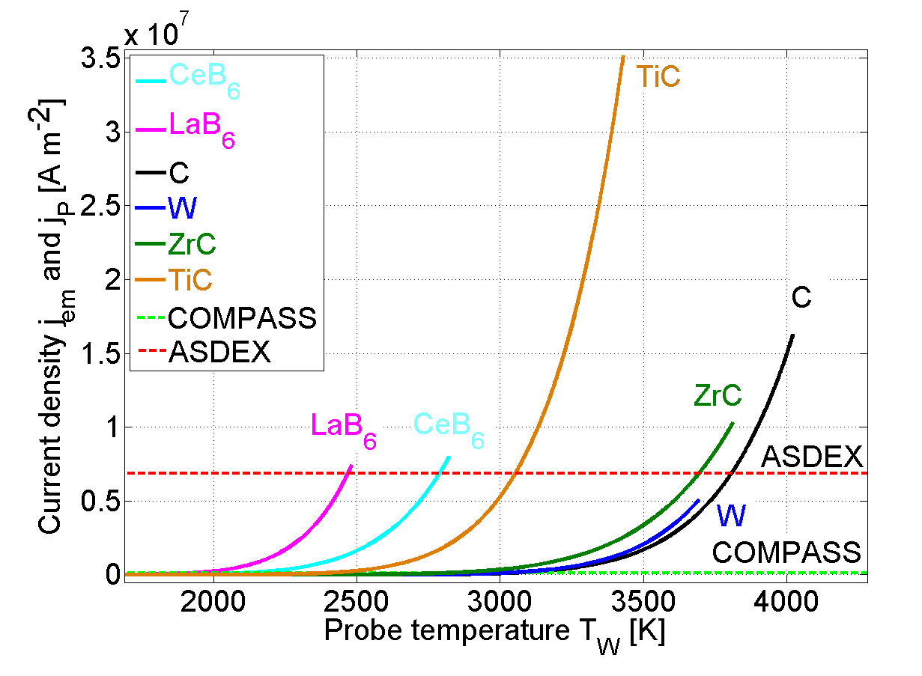
Robust emissive probe for the SOL
and beyond, II
Emitted current den-sity from various ma-terials versus temp-erature, compared to the average current densities in the SOL of ASDEX Upgrade and COMPASS

Slide 71
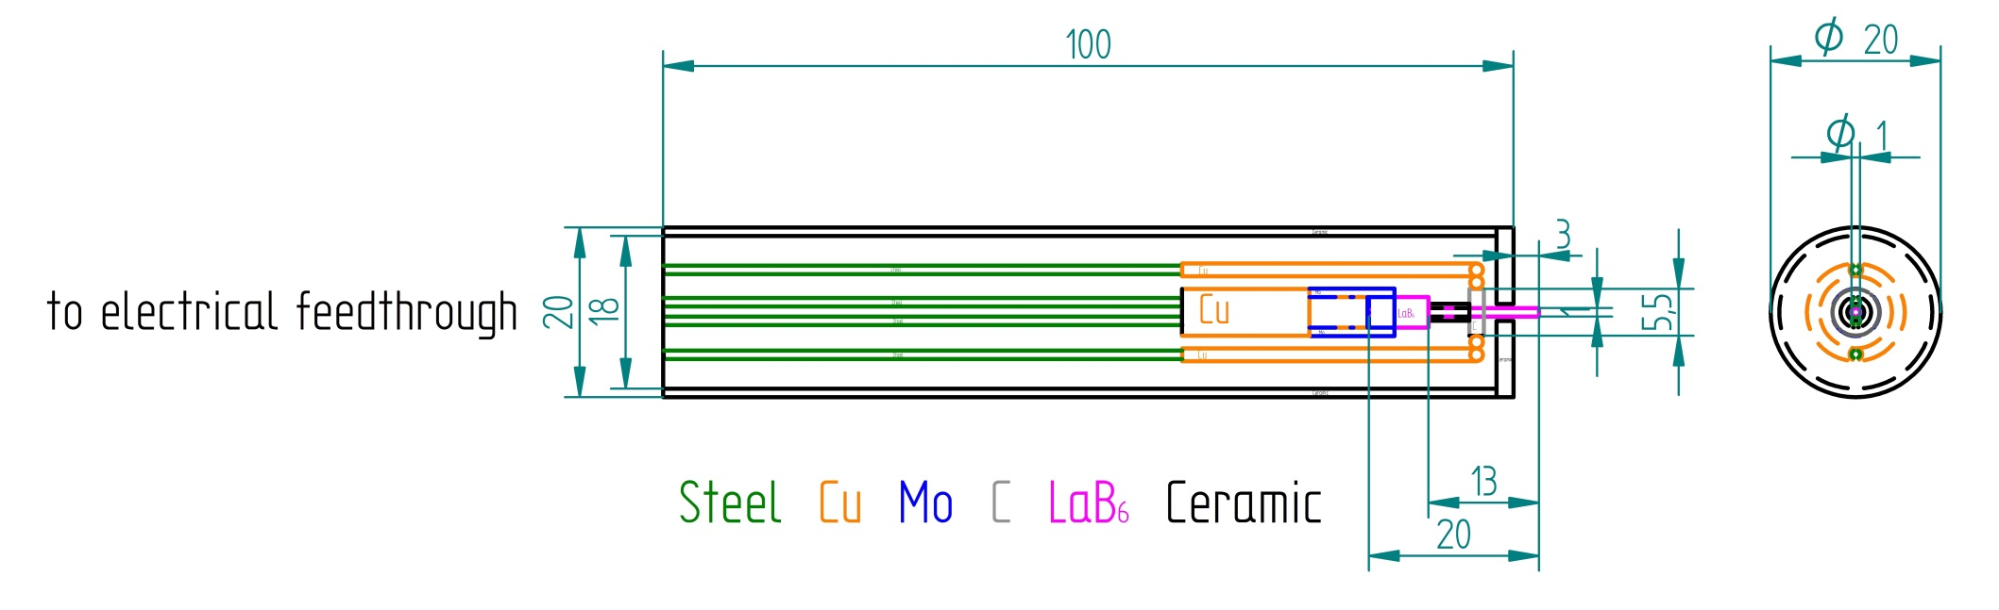
Robust emissive probe for the SOL
and beyond, III
Schematic of the emissive probe prototype: the LaB₆ pin (20 mm length, 1 mm diameter) is heated electrically indirectly on the lower part inside the case.

Slide 72
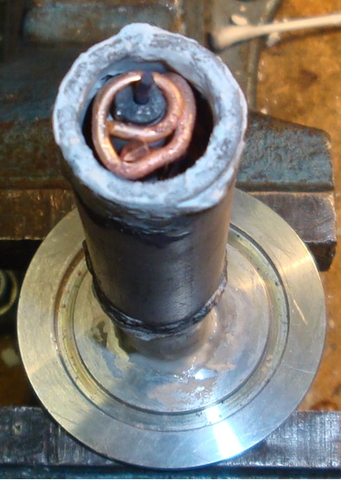
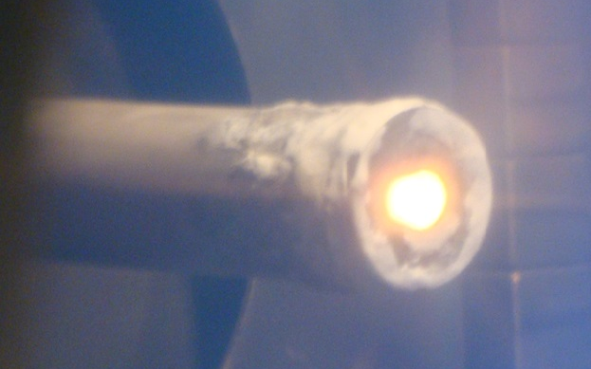
Robust emissive probe for the SOL
and beyond, IV
Prototype of the emissive probe in operation:
Note! Only the pin is glowing, but the bright spot is blurred due to overexposure.
Prototype of the emissive probe open.

Slide 73
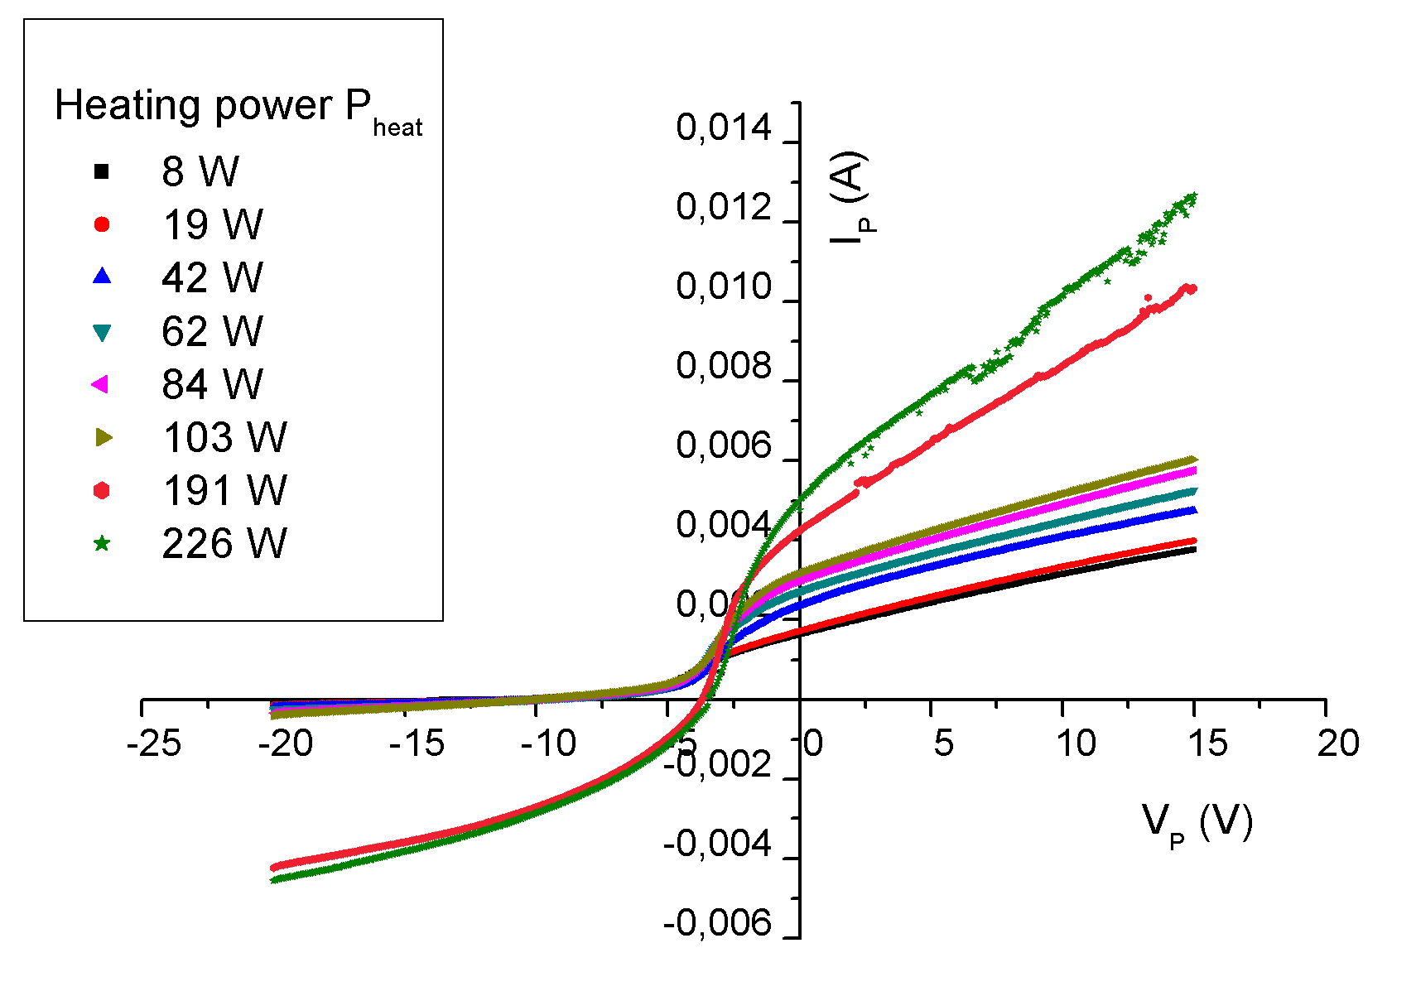
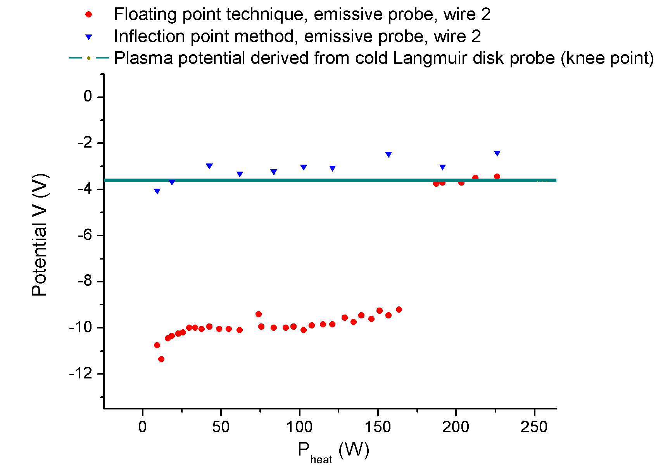
Robust emissive probe for the SOL
and beyond, V
IV-characteristic for increasing heating power.
Floating potential of probe versus heating power.
The strong variation of the plasma electron current on the right side with the probe temperature is probably due to the geometry of the probe. It has been observed in other probe geometries also but not in always.

Slide 74
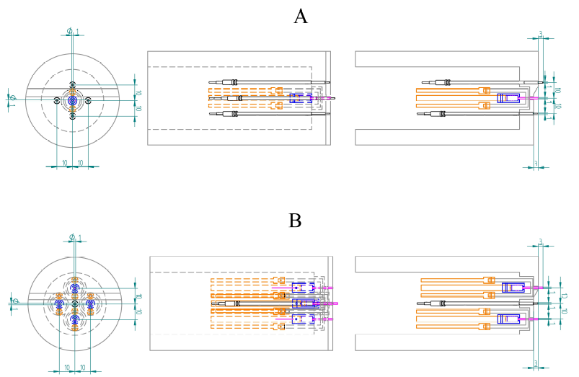
Graphite probe head with such emissive probes for measurements in the SOL and beyond
Two possible de-signs of a probe head with (A) one such emissive probe and four conventional AUG cold probe pins, and (B) four such emissive probes and one cold probe in the center for plasma poten-tial, electron tem-perature and transport meas-urements in ASDEX Upgrade.

Slide 75
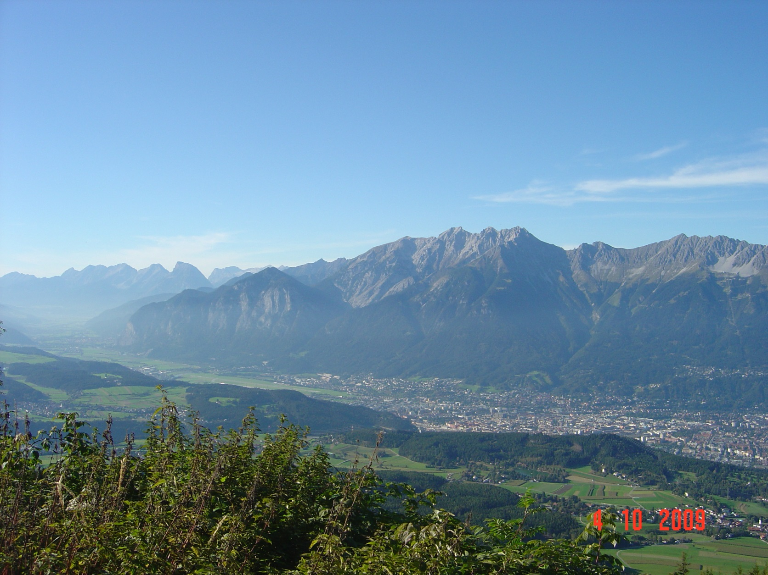

Thank you very much for your attention!
Institute for Ion Physics and Applied Physics

