Slide 1
Free Movement of Persons in the Nordic States
Associate Professor Jaan Paju

Slide 2
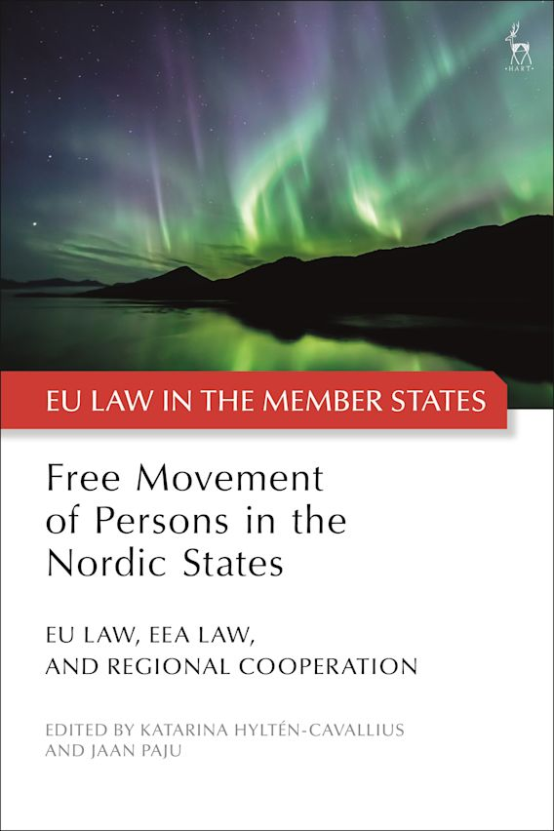

Slide 3
The Anthology’s overarching question
Can it be argued that there exists a concept of Nordic citizenship, founded on inter-Nordic cooperation and its relationship with EU law and EEA law?

Slide 4


Slide 5
Complex legal landscapes
National law
Nordic Conventions (for the good of Nordic State citizens)
EU law (Article 35 1 on parallel international conventions; EU Law supremacy…)
EEA law (EEA-agreement: certain secondary law, no primary law)

Slide 6

Interaction…

Slide 7

… or no interaction?

Slide 8
The anthology takes a dual approach:
Firstly, it tracks the legal development of nationality law in Nordic states.
Secondly, it sets out the social rights that follow from the three different regimes.

Slide 9
Table of Contents
Introduction
Personal free movement rights in the Nordic region
Katarina Hyltén-Cavallius & Jaan Paju
The Interplay of EU Law, EEA Law and Nordic Cooperation: Various Perspectives
2. The Vision of Regional Integration in the Nordic States
Henrik Wenander
3. Understanding the Legal Relationship of EU Law, EEA Law and Multi-Lateral Conventions
Graham Butler
4. Fundamental Rights Protection of the Individual in EEA Law: the Tension between the ECHR standards and the EU Charter
Davíð Þór Björgvinsson
5. Broken Wings: Closure of borders in the three Nordic EU Member States during the Covid-19 Pandemic
Ulla Neergaard, Jaan Paju and Juha Raitio
The Individual's Access to Free Movement Rights in the Nordic Region
6. Free Movement Rights in Denmark
Catherine Jacqueson
7. Free Movement Rights in Sweden
Thomas Erhag
8. Free Movement Rights in Finland
Päivi Johanna Neuvonen
9. Free Movement Rights in Norway
Christian Franklin
10. Free Movement Rights in Iceland
Ólafur Ísberg Hannesson
11. Free Movement Rights in the Associated Territories: Greenland and the Faroe Islands
Ulla Neergaard
Conclusion
12. Integrationist, complementary, or irrelevant? Contours of a Nordic Citizenship coinciding with EU Citizenship and EEA law
Katarina Hyltén-Cavallius & Jaan Paju

Slide 10
Preliminary findings
- Most of the Nordic cooperation on a regional level is of a legally non-binding character and therefore of no real legal substantial value.
- However, The effects of Nordic cooperation facilitate as well as complements the realisation of free movement rights stemming from EU law (and even goes beyond the requirements of EU legal integration with regard to equal treatment).
- Long-established culture of administrative cooperation gives rise to the blurry contours of some kind of a non-formalized Nordic citizenship

