Slide 1
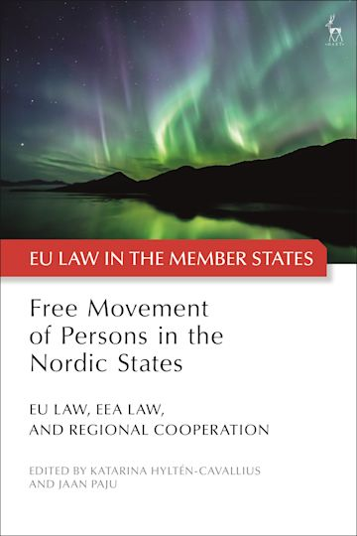

Slide 2

The Nordic region to become the most integrated region in the world by 2030
Is there a “Nordic citizenship”, parallel to Union citizenship?

Slide 3
The Nordic legal cooperation
The Helsinki Treaty (1962)
Agreement on a common labour market (1954)/(1982)
The Passport Convention (1957)
Nordic Convention on Social Assistance (1994)
Agreement on Public Registration (2004)
Nordic Convention on Social Security (2012)

Slide 4
Free movement of persons law and naturalisation processes governed by:
Nordic National migration law
TFEU > Art. 18, 20, 21 on EU Citizens + Art 45 on Workers
Directive 2004/38, Regulation 883/2004, Regulation 492/2011
Nordic Conventions
Article 351 TFEU

Slide 5

Multilayered picture

Slide 6
The Nordics
Faroe Islands
Greenland
Åland
EU
Denmark
Finland
Sweden
EES
Norway
Iceland

Slide 7
Question posed
Does Nordic cooperation add anything qualitatively as part of this multi-layered field of free movement of persons law?
or
Does the Nordic cooperation merely further compound any tensions between national law and EU/EEA law?

Slide 8
Part I
THE INTERPLAY OF EU LAW, EEA LAW AND NORDIC COOPERATION: VARIOUS PERSPECTIVES
The Vision and Legal Reality of Regional Integration in the Nordic States
Henrik Wenander (Lund University, Sweden)
Free Movement of Persons in the Nordic States through EU Law and EEA Law
Graham Butler (Southern University, Denmark)
Fundamental Rights of the Individual in EEA Law: The Tension between the ECHR Standards and the EU Charter
Davíð Þór Björgvinsson (University of Akureyri and University of Iceland)
Closure of Borders in the Three Nordic EU Member States During the Covid-19 Pandemic
Ulla Neergaard (University of Copenhagen), Jaan Paju (Stockholm University) and Juha Raitio (University of Helsinki)

Slide 9
Part II
2) THE INDIVIDUAL’S ACCESS TO FREE MOVEMENT RIGHTS IN THE NORDIC REGION
EU
Free Movement Rights in Denmark, Catherine Jacqueson (University of Copenhagen, Denmark)
Free Movement Rights in Sweden, Thomas Erhag (University of Gothenburg, Sweden)
Free Movement Rights in Finland, Päivi J Neuvonen (Durham University, UK)
EES
Free Movement Rights in Norway, Christian NK Franklin (University of Bergen, Norway)
Free Movement Rights in Iceland, Ciarán Burke (University of Jena, Germany) and Ólafur Ísberg Hannesson (EFTA Court, Luxembourg)
Greenland (OCT) and the Faroe Islands
Free Movement of Persons and the Autonomous Territories in the Danish Kingdom: Greenland and the Faroe Islands, Ulla Neergaard (University of Copenhagen, Denmark)

Slide 10
”The glitch…
Room for a possible Nordic Dimension???”
The glitch when Directive 2004/38 and Regulation 883/2004 are to be applied in parallel: a social risk for migrating economically inactive Union citizens
C-140/12 Brey (2013)
C-67/14, Alimanovic (2015)
C-308/14 Commission v. UK (2016)
C-181/19 Jobcenter Krefeld (2020)
C-411/20 Familienkasse Niedersachsen-Bremen (2022)
“Free Movement or Benefit Tourism: The Unreasonable Burden of Brey”,
Verschueren (2014)
“The ECJ sacrifices EU citizenship in vain: Commission v. United Kingdom”,
O’Brien (2017)
“On the Lack of Legal Reasoning in Case C-308/14, European Commission v United Kingdom”,
Paju (2019)
“Who cares? Caregivers’ derived residence rights from children in EU free movement law”, Hyltén-Cavallius (2020)

Slide 11
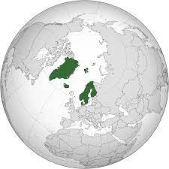
Q: Does the Nordic dimension alter this?
Q: Can it alter?

Slide 12
The Starting Point
The primacy of EU law
No room for going beyond EU-law
The EEA-principle of homogenity

Slide 13
Nordic ”add-on” No 1
A close administrative Nordic cooperation
(spirit of cooperation/mutual trust)
+
Individual EU free movement rights that can be claimed
= Add-on for ”Nordic union citizens”

Slide 14
Nordic ”add-on” 2:
Nordic Equal Treatment
  National law equals Nordic citizens with national citizens
  Hence, a regional citizenship is superfluos
  Greatest impact: the Faroe Islands and Greenland

Slide 15
Add-on 2: in compliance with EU law?
Article 18 TFEU?
  C-897/19 I.N. (2020)
  Hillion, C., Fredriksen, H. H., ’The ”special relationship” between the EU and the EEA EFTA States’ (2021)
  It could be argued…
  No discrimination visavi (Nordic) national citizens
  A Nordic free movement of persons that goes beyond EU law: for the good for economically inactive persons.
  Neuvonen: We see an integrative effect: is that a bad thing? Does it hamper the free movement in any aspect?

Slide 16
THE NORDICS
EU
EES
Equal treatment that follows from the Nordic national legislations

Slide 17

That notwithstanding, in general the Nordic co-operation lacks (legal) teeth

Slide 18
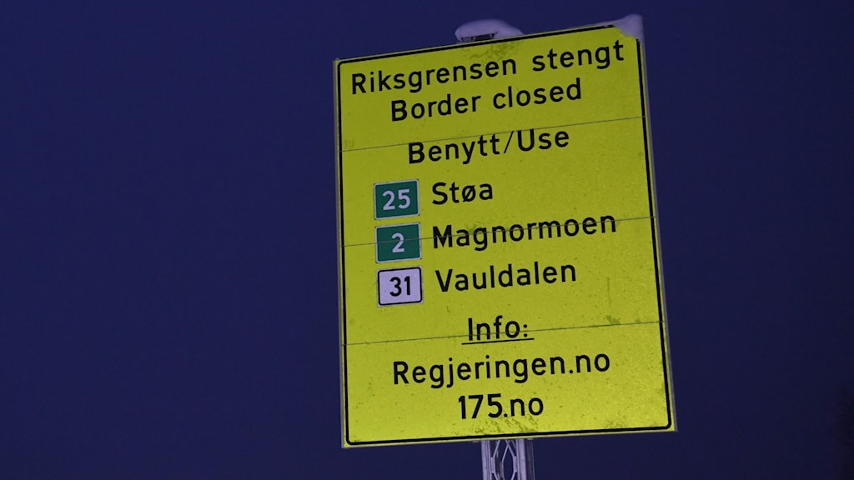

Slide 19
Findings
Nordic legal co-operation appears far less as an integrationist driving force than EU law
Nordic legal co-operation is based on EU law

Slide 20
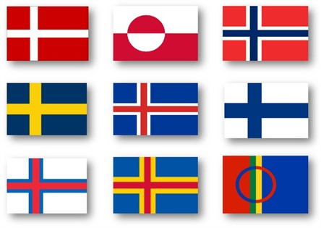
Still: a Nordic Dimension
Close administrative co-operation gives a clear added value and practical effectiveness (facilitator of EU law)
Nordic equal treatment goes beyond EU law

Slide 21

We argue for a Nordic Union Citizenship
We see blurry contours of a non-formalised ‘Nordic Union citizenship’ of sorts, built around a legal core of the Union citizenship that is conferred by EU law

Slide 22

The Nordic Citizenship: non-formalised and therefore as hard-to-grasp as the Northern lights

