Slide 1

[ Photo ]
Collaboration Profile
What I Bring
Seeking Expertise In
[Skill 1 title]
[Expertise 1 title]
[Brief description of skill 1]
[Brief description of expertise 1]
[Skill 2 title]
[Expertise 2 title]
[Brief description of skill 2]
[Brief description of expertise 2]
[Skill 3 title]
[Expertise 3 title]
[Your Name]
[Brief description of skill 3]
[Brief description of expertise 3]
[Your Role / Title]
[Skill 4 title]
[Expertise 4 title]
[Brief description of skill 4]
[Brief description of expertise 4]
[Institution]
Current Focus
[Describe your current projects or research focus here — e.g. Project A • Project B • Project C]
Email:
Fun fact:
[Write one fun or personal fact about yourself here]

Slide 2
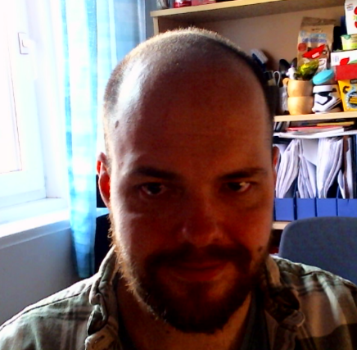






[ Photo ]
Collaboration Profile
What I Bring
Seeking Expertise In
RNA-seq & scRNA-seq
Functional validation
Bulk and single-cell pipelines
Wet lab follow-up of computational created candidate genes
Coding and Website development
Clinical data linkage
Reproducible modular pipelines, interactive Shiny apps, custom visualizations, Scientific figure design
Linking transcriptomic findings to patient cohorts or registries
Data visualization & statistics
Proteomics / metabolomics
Eike Struck
Combining transcriptomic, proteomic, or clinical data layers
Multi-omics integration beyond transcriptomics
PostDoc & Bioinformatician
Wet lab experience
Different techniques in vascular biology (Imaging, PCR, wound healing, cell proliferation)
Translational Vascular Research Group
UiT
Current Focus
• Bioinformatics & Lab based Science
• Tissue and cell-type-enriched gene discovery
• Endothelial cell transcriptomics in different stimuli
• Building interactive Apps for exploratory analysis of data
• Multi-dataset integration across public repositories
Email: eike.c.struck@uit.no
Fun fact:
I was TETRIS world champion, for less than two weeks about 20 years ago, and never received a prize for it ☺

